Slide 1
Interactive Motion Graphics
Week 05
TCNJ Dynamic Web Design
Jean Chu

Slide 2
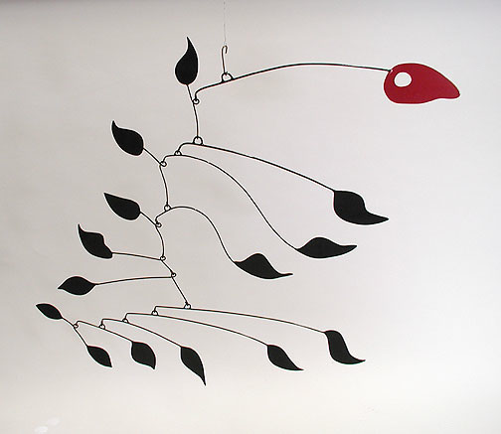
Kinetic Art

Slide 3
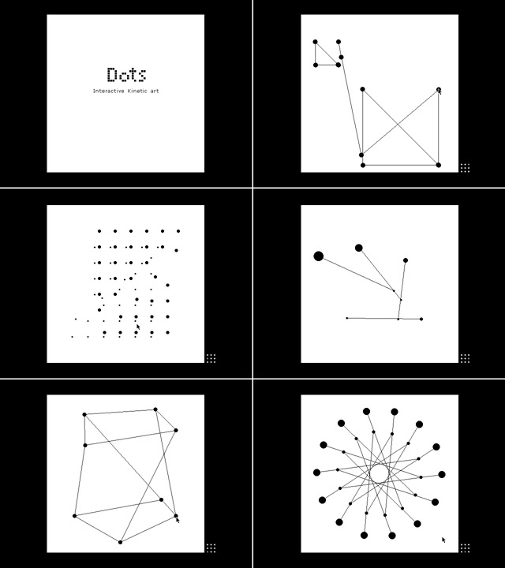
Interactive Kinetic Art
http://suzung.com/
Flash

Slide 4

Gallery of Computation- Jared Tarbel
Flash
Flash, Processing
http://levitated.net/daily/index.html
http://complexification.net/gallery/

Slide 5
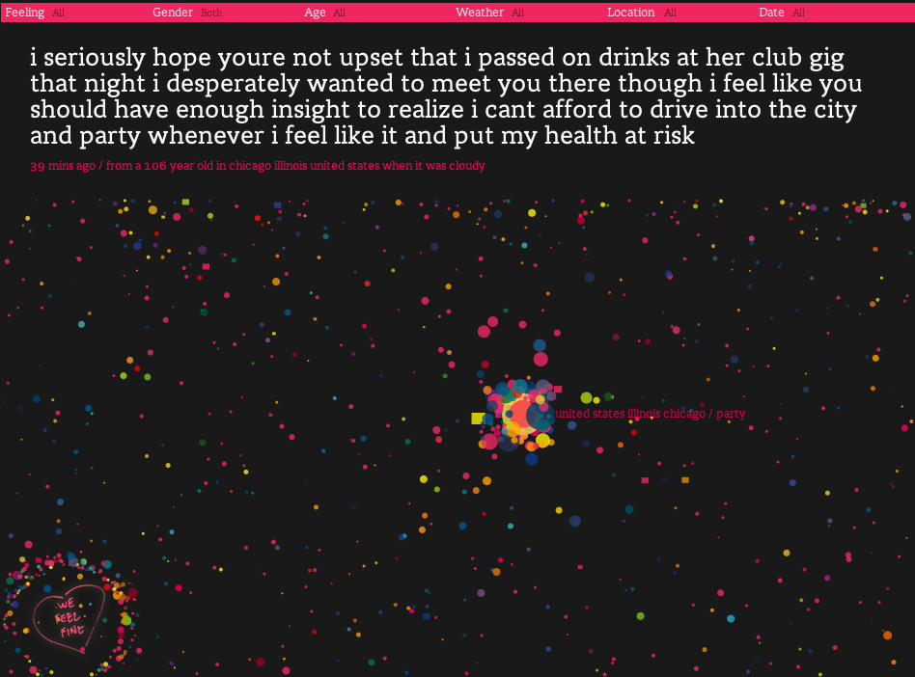
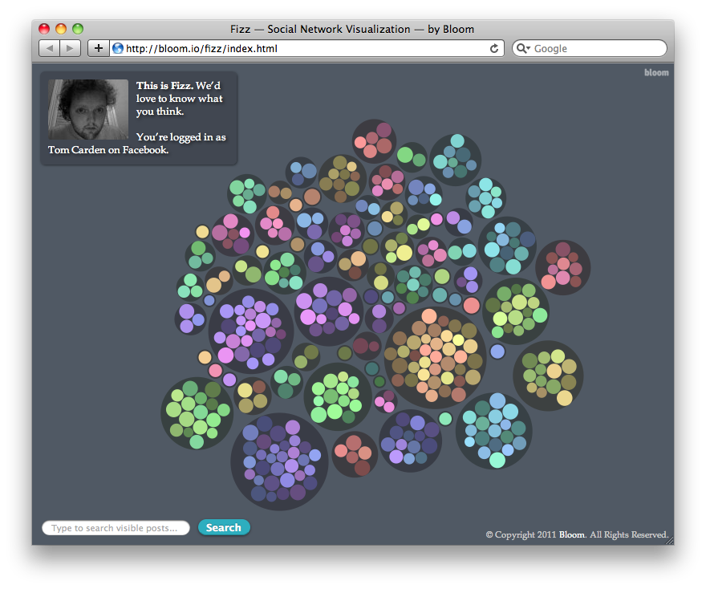
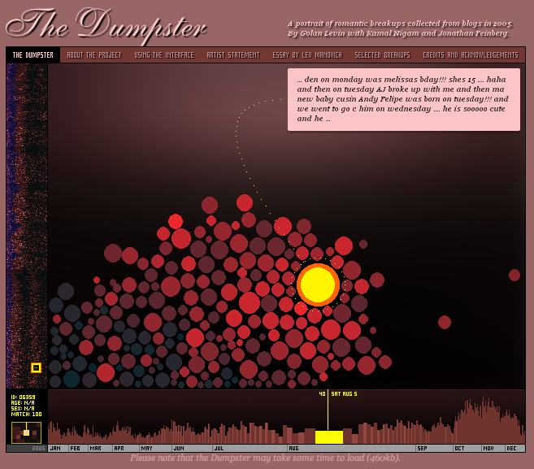
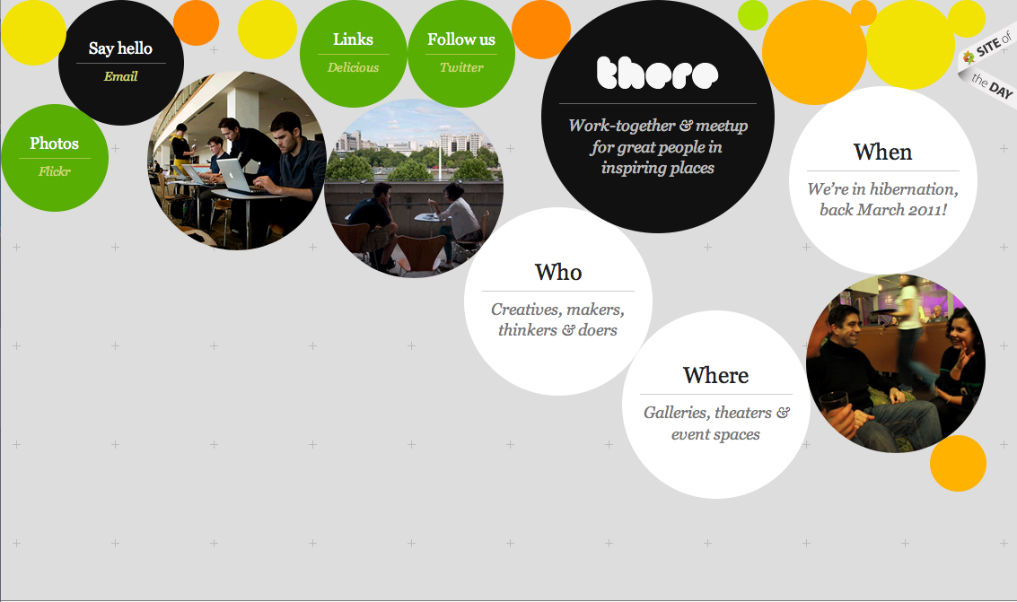
On the Web Interface
processing
processing
Wefeelfine.org
http://fizz.bloom.io/
processing
HTML5
http://artport.whitney.org/commissions/thedumpster/
http://therestudio.com/
Notes:
processing

Slide 6
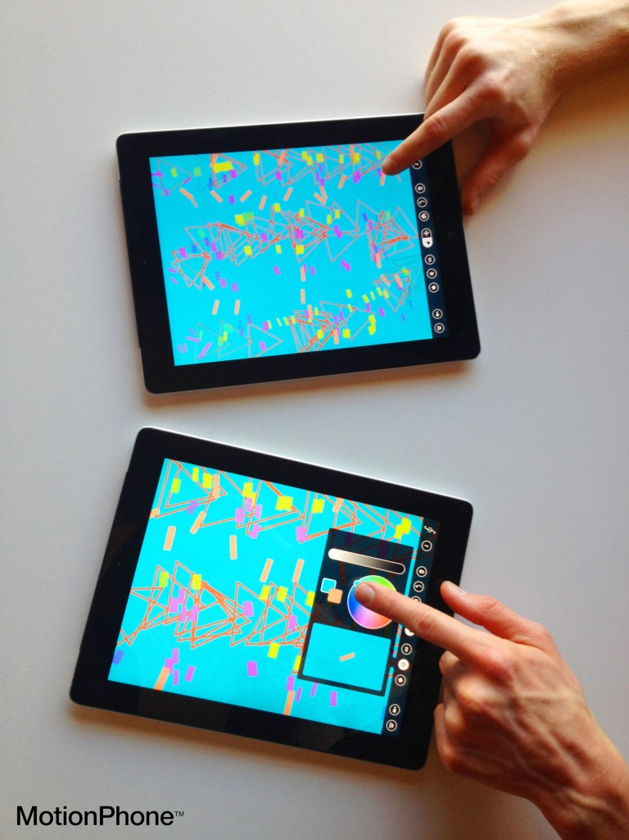
Visual Music on IPAD
http://www.snibbe.com/

Slide 7
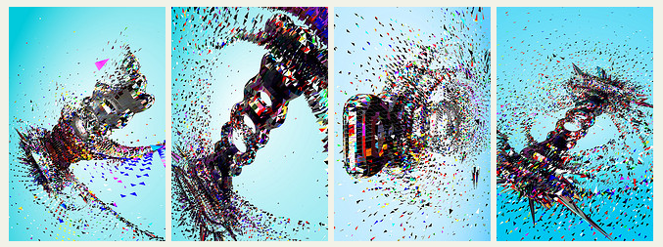
Interactive Identity
Postspectacular
http://postspectacular.com/

Slide 8
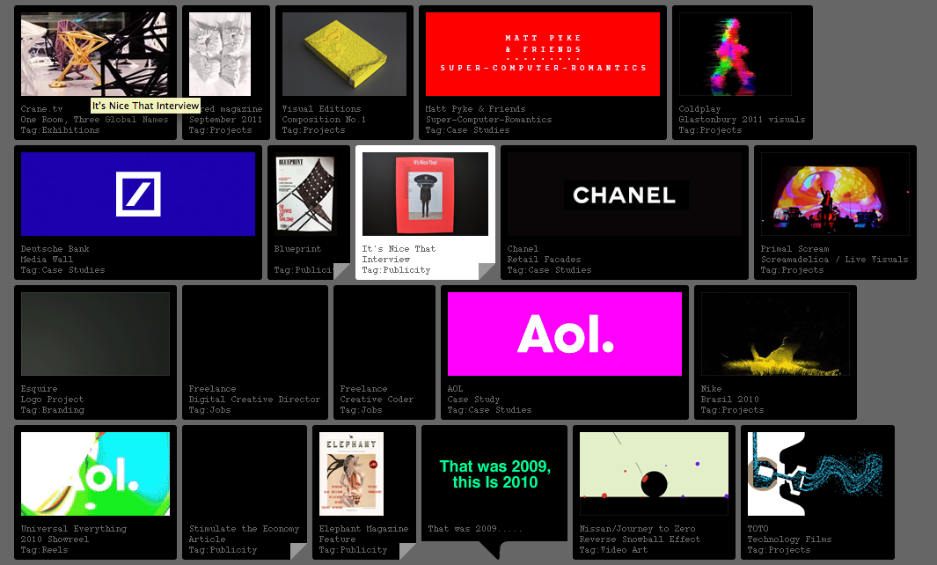
More
Universal Everything
http://universaleverything.com/

Slide 9
More HTML5 Demos
http://www.hongkiat.com/blog/48-excellent-html5-demos/

Slide 10
Generative Motion Graphics
Beautiful Motion Graphics Created With Programming: Showcase, Tools and Tutorials
http://www.smashingmagazine.com/2010/02/06/beautiful-motion-graphics-created-with-programming-showcase-tools-and-tutorials/

