Slide 1
TEXT As MOVING IMAGE
Week 05
TCNJ Dynamic Web Design
Jean Chu

Slide 2
MOVING IMAGE AS TEXT

Slide 3

Dada and Futurist on Experimental Typography
http://www.smashingmagazine.com/2010/02/21/art-manifestos-and-their-applications-in-contemporary-design/
Notes:
Futurist and Dada artists developed brilliantly innovative uses of typography that blurred the boundaries between visual art and literature
1910s and 1920s: Ilia Zdanevich, Filippo Marinetti, Guillaume Apollinaire, and Tristan Tzara
The Visible Word: Experimental Typography and Modern Art, 1909-1923
http://www.smashingmagazine.com/2010/02/21/art-manifestos-and-their-applications-in-contemporary-design/

Slide 4
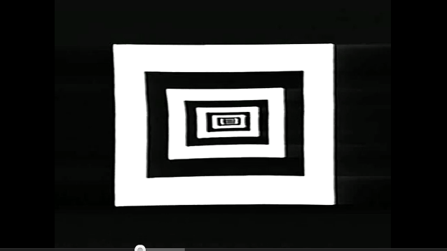
Garry Hill - Black White Text [1980]
http://www.youtube.com/watch?v=bg1O3NcPwBg

Slide 5
TEXT AS MOVING IMAGE

Slide 6
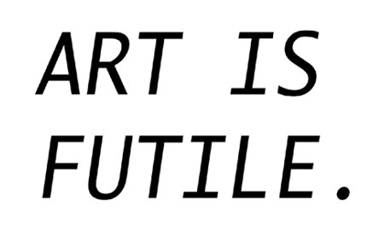
Young-Hae Chang - Heavy Industries
The Art of Sleep (2006)
http://www2.tate.org.uk/netart/artofsleep/theartofsleep.htm
http://www.yhchang.com/

Slide 7
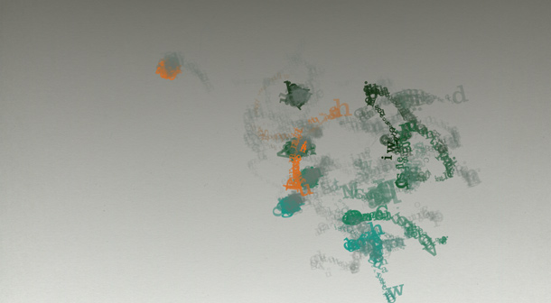
Sosolimited
Ascenders & Descenders
http://sosolimited.com/loops/
Notes:
http://sosolimited.com/loops/

Slide 8
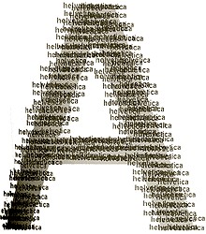
John Maeda
1995-2007
http://www.maedastudio.com/

Slide 9
SPEECH AS MOVING IMAGE

Slide 10
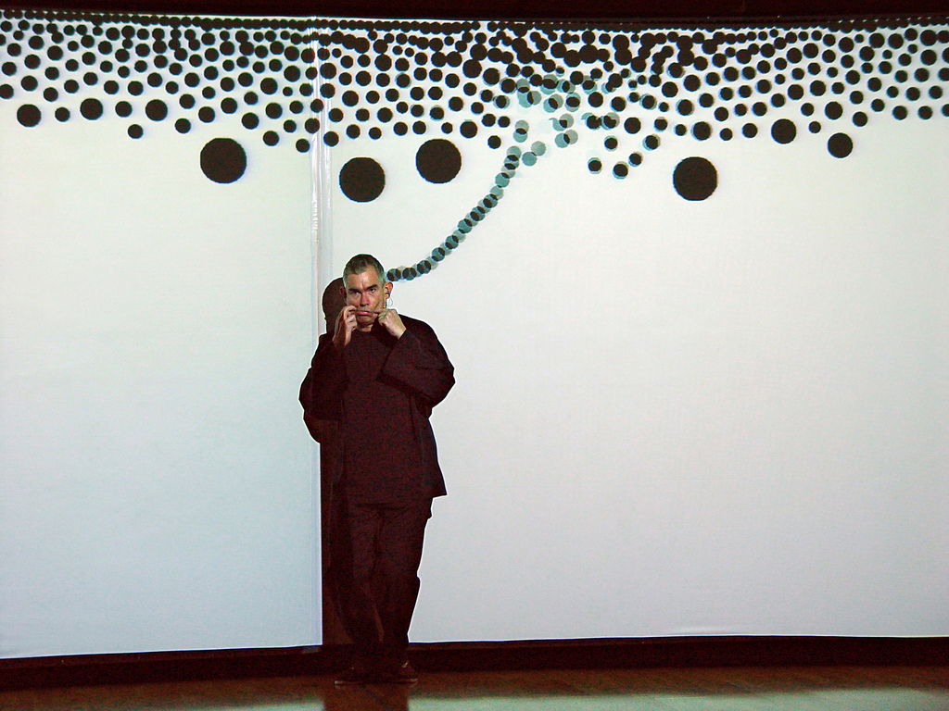
Golan Levin
Messa Di Voce
http://www.flong.com/projects/messa/
Notes:
http://www.flong.com/projects/remark/

Slide 11
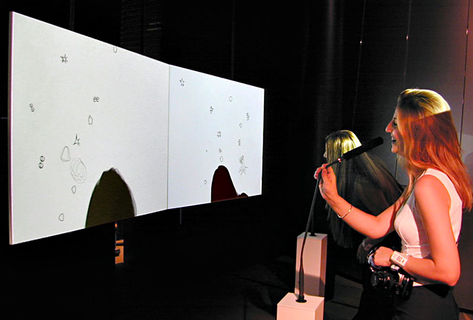
Golan Levin
Re: Mark
http://www.flong.com/projects/remark/
Notes:
http://www.flong.com/projects/remark/

Slide 12
Generative Identity

Slide 13
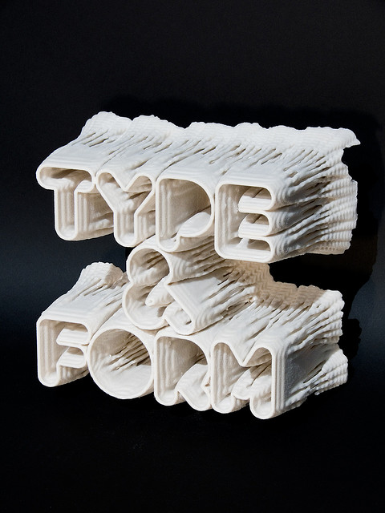
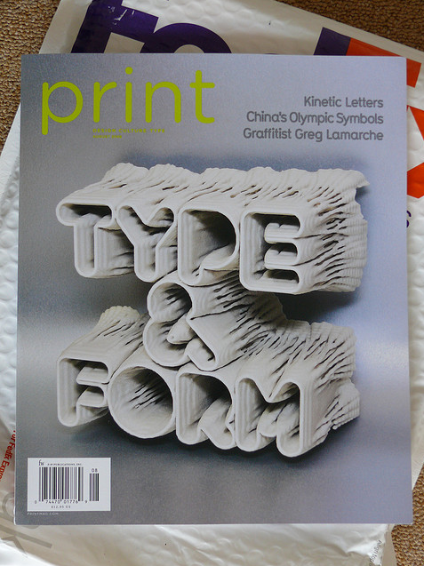
Postspectacular
http://postspectacular.com/process/20080702_printmagcover

Slide 14
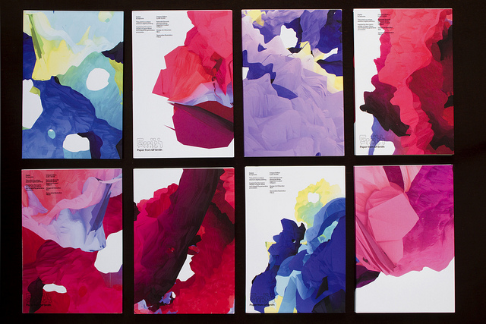
Generative Design
Field
http://www.field.io/

Slide 15
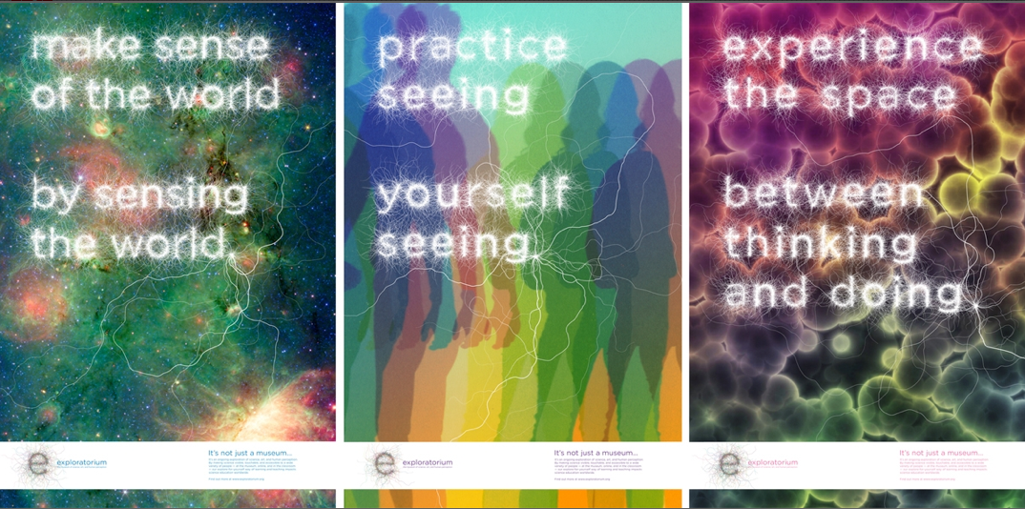
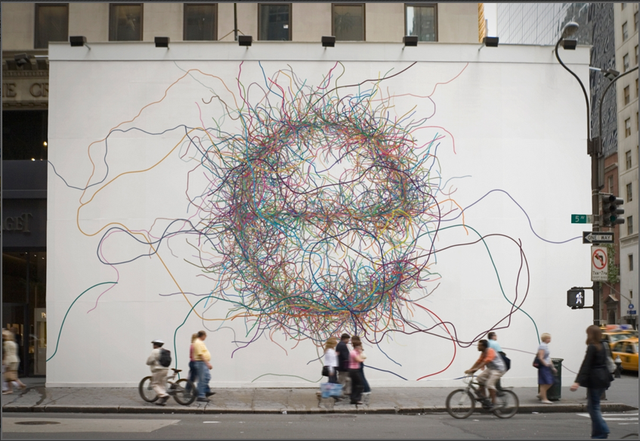
Paul Hoppe – ADOBE AWARDS WINNER 2011
Exploratorium (Generative Identity)
http://www.paulhoppe.adaagallery.com/

