Slide 1
Video on the Web

Slide 2

The Evolution of web video formats…
Animated Gif
HTML EMBED, OBJECT TAG
WebM
(Supported by Google)
Ogg
(Supported by Theora)
Mp4
(h264 video encoding)
Html5 video
MOV
(Apple's Quick Time Movie)
AVI
(by Microsoft)
WMV
(Window's Media Video)
SWF (Flash)
FLV (Flash Video)
RA (Real Media)
Mpeg-4 (mp4, m4v)
Notes:
1995
html5
Animated Gif (1995)
Real Player
QT, Flash
Web M
swf

Slide 3
Video Formats and Codecs
WebM Container
Ogg Container
MP4 Container
Supported by
Supported by
Supported by
Firefox, Chrome, Opera
Firefox, Chrome, Opera
Safari and
IE 9+
Vp8 Video Encoding
Theora Video Encoding
H.264 Video Encoding
Vorbis Audio Encoding
Vorbis Audio Encoding
AAC Audio Encoding
Notes:
WebM Container

Slide 4
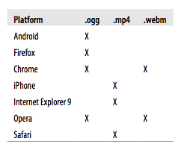
Browser Support
* HTML5, Oreilly Media p87
* Currently might be different from listed above
Notes:
Currently might be different from listed

Slide 5
Converting the Video (ogg, mp4, webm)
Miro Video Converter
http://www.mirovideoconverter.com/
HTML5 Video Format Converter
http://html5videoformatconverter.com/

Slide 6
Embedding video

Slide 7
HTML5 VIDEO
HTML5 Video
Properties
<video width="320" height="240" controls="controls">
<source src="movie.mp4" type="video/mp4" />
<source src="movie.ogg" type="video/ogg" />
<source src="movie.webm" type="video/webm" />
<object data="movie.mp4" width="320" height="240">
<embed src="movie.swf" width="320" height="240” >
</object>
</video>
Source url
Fall back
solutions
HTML5 Video
Notes:
Fall back solutions

Slide 8
Video Attributes
Loop
Controls: play/pause/etc buttons for your video
Autoplay
Autobuffer : The video is downloaded in the background, so when the user starts the video, it will be able to play at least some of the content. If both autoplay and autobuffer are used, then autobuffer is ignored.
Poster: to display a frame of the video (as a .jpg, .png, whatever)
http://www.w3schools.com/html5/tag_video.asp

Slide 9
Video Methods, Properties, Events
Methods
Properties
Events
currentSrc
currentTime
videoWidth
videoHeight
duration
ended
error
muted
paused
volume
width
height
play()
pause()
load()
canPlayType
Play
Pause
Progress
Error
Timeupdate
Ended
Abort
Waiting
Loadeddata
loadedmetadata
http://www.w3schools.com/html5/html5_video_dom.asp
Notes:
play()A method used to start playing a video.pause()A method used to pause a video that is playing.
methods

Slide 10
Before HTML5 : Object
Object (Not supports Opera)
<object width="420" height="360"
classid="clsid:02BF25D5-8C17-4B23-BC80-D3488ABDDC6B"
codebase="http://www.apple.com/qtactivex/qtplugin.cab">
<param name="src" value="movie.mp4" />
<param name="controller" value="true" />
</object>
Activex Control by the Browser
Codebase / Plugin Download
<embed src="http://www.computerhope.com/issues/ibm-linux.mov"
Pluginspage=http://www.apple.com/quicktime/ width="320" height="250” CONTROLLER="true” LOOP="false” AUTOPLAY="false” name="IBM Video”></embed>
EMBED Tag for Fall Back on Opera
Notes:
<object width="425" height="344">
<param name="movie"
value=”myvideolink.mov"></param>
<param name="allowFullScreen"
value="true"></param>
<param name="allowscriptaccess"
value="always"></param>
<embed src=myvideolink.mov"
type="application/x-shockwave-flash" allowscriptaccess="always"
allowfullscreen="true" width="425"
height="344"></embed>
</object>
Activex Control

Slide 11
Before HTML5 : Embed for Fallback
Embed (not support XHTML)
<embed src="http://www.computerhope.com/issues/ibm-linux.mov"
Pluginspage="http://www.apple.com/quicktime/"
width="320" height="250"
CONTROLLER="true"
LOOP="false"
AUTOPLAY="false"
name="IBM Video">
</embed>
EMBED
Tag Attributes
(Optional)

Slide 12
Object /Embed tag attribute
autostart Determines whether to start the video as soon as the page has loaded. (True, False)
hidden Determines whether to hide the video. For example, if you just want background noise with no video.(True, False)
loop Determines whether to continously replay the video after it has finished. (True, False)
playcount Determines how many times to repeat the video.
(A number value)
volume Determines how loud the audio should be.
(Number value between 1 and 100)

Slide 13
Video from the WEb

Slide 14
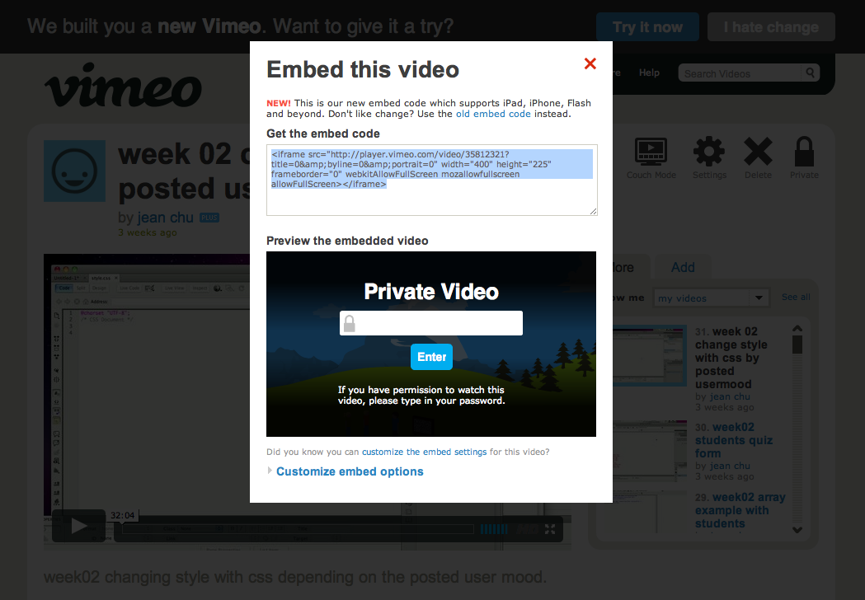
Iframe : supports iphone, ipad, etc
Notes:
<iframe src="http://player.vimeo.com/video/35812321?title=0&amp;byline=0&amp;portrait=0" width="400" height="225" frameborder="0" webkitAllowFullScreen mozallowfullscreen allowFullScreen></iframe>

Slide 15
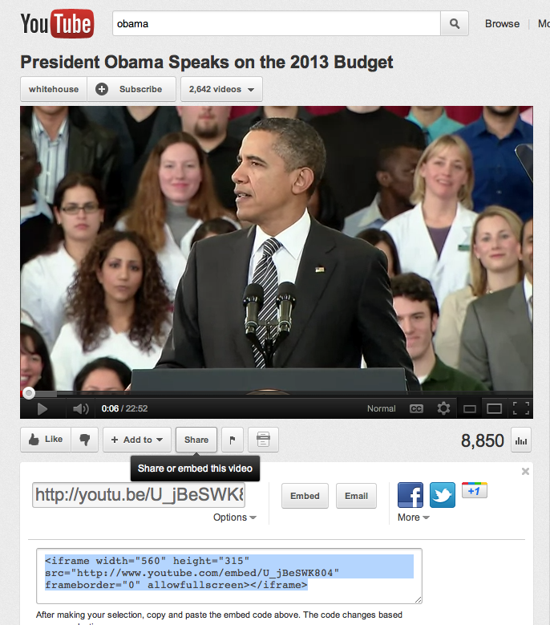
Iframe : For iphone, ipad, etc

Slide 16
Iframe: for iphone and ipad support
<iframe src="http://player.vimeo.com/video/35812321?title=0&amp;byline=0&amp;portrait=0" width="400" height="225" frameborder="0" webkitAllowFullScreen mozallowfullscreen allowFullScreen>
</iframe>
Notes:
<object width="425px" height="360px" >
<param name="allowFullScreen" value="true"/>
<param name="wmode" value="transparent"/>
<param name="movie" value="http://mediaservices.myspace.com/services/media/embed.aspx/m=5385825,t=1,mt=video,searchID=,primarycolor=,secondarycolor="/>
<embed src="http://mediaservices.myspace.com/services/media/embed.aspx/m=5385825,t=1,mt=video,searchID=,primarycolor=,secondarycolor=" width="425" height="360" allowFullScreen="true" type="application/x-shockwave-flash" wmode="transparent"/>
</object>

Slide 17
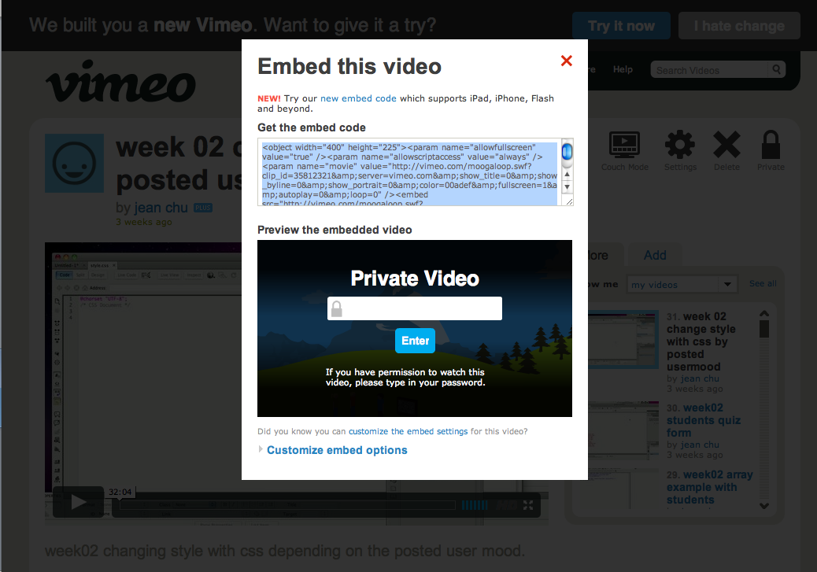
Embed (old way)
Notes:
<object width="400" height="225"><param name="allowfullscreen" value="true" /><param name="allowscriptaccess" value="always" /><param name="movie" value="http://vimeo.com/moogaloop.swf?clip_id=35812321&amp;server=vimeo.com&amp;show_title=0&amp;show_byline=0&amp;show_portrait=0&amp;color=00adef&amp;fullscreen=1&amp;autoplay=0&amp;loop=0" /><embed src="http://vimeo.com/moogaloop.swf?clip_id=35812321&amp;server=vimeo.com&amp;show_title=0&amp;show_byline=0&amp;show_portrait=0&amp;color=00adef&amp;fullscreen=1&amp;autoplay=0&amp;loop=0" type="application/x-shockwave-flash" allowfullscreen="true" allowscriptaccess="always" width="400" height="225"></embed></object>

Slide 18
Embed (old way)
<object width="400" height="225">
<param name="allowfullscreen" value="true" />
<param name="allowscriptaccess" value="always" />
<param name="movie" value="http://vimeo.com/moogaloop.swf?clip_id=35812321&amp;server=vimeo.com&amp;show_title=0&amp;show_byline=0&amp;show_portrait=0&amp;color=00adef&amp;fullscreen=1&amp;autoplay=0&amp;loop=0" />
<embed src="http://vimeo.com/moogaloop.swf?clip_id=35812321&amp;server=vimeo.com&amp;show_title=0&amp;show_byline=0&amp;show_portrait=0&amp;color=00adef&amp;fullscreen=1&amp;autoplay=0&amp;loop=0" type="application/x-shockwave-flash" allowfullscreen="true" allowscriptaccess="always" width="400" height="225">
</embed>
</object>

Slide 19
Embedding into Fancy Box
$(document).ready(function(){
$(”#myvideo").fancybox({
'width': 800, //or whatever
'height': 450, //or whatever
'type': 'iframe'
});
});
<a class=”myvideo"
href=“http://
player.vimeo.com/video/
33666404?
title=0&amp;byline=0&a
mp;portrait=0”
title=”mytitle”>
<img src=”my_thumb.jpg">
</a>

Slide 20
3. SWF Flash

Slide 21
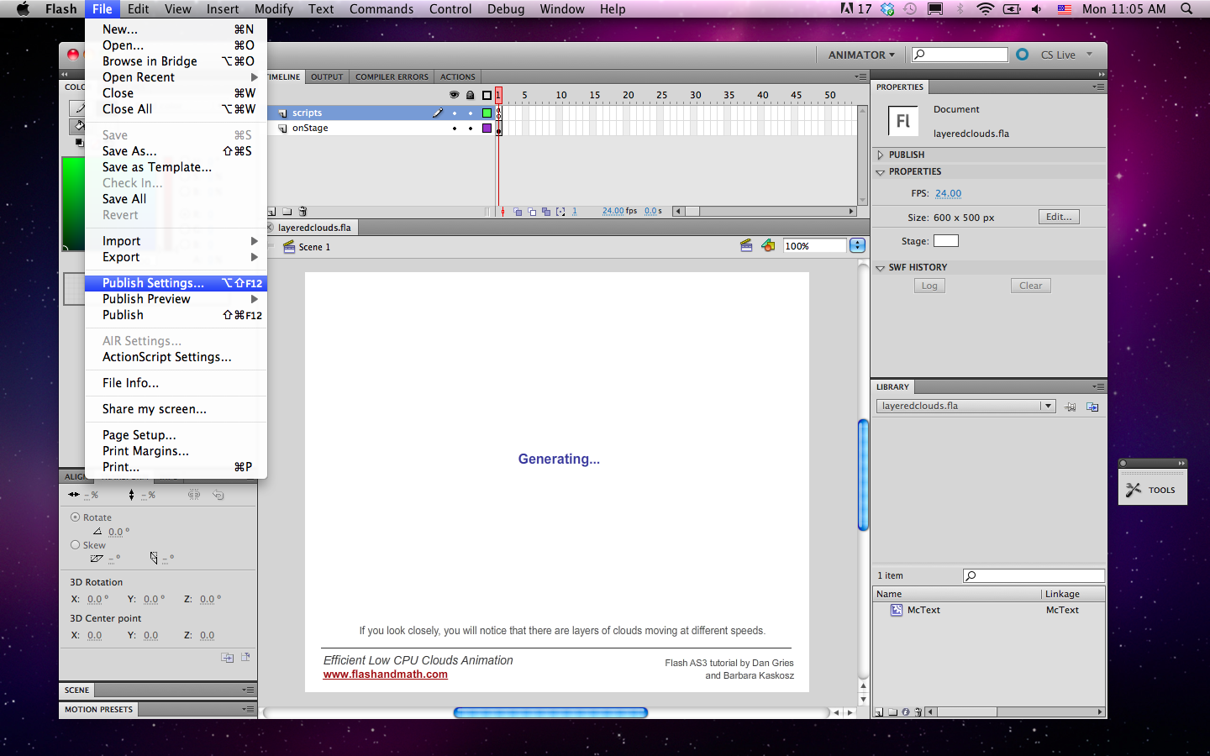
File > Publish Settings

Slide 22
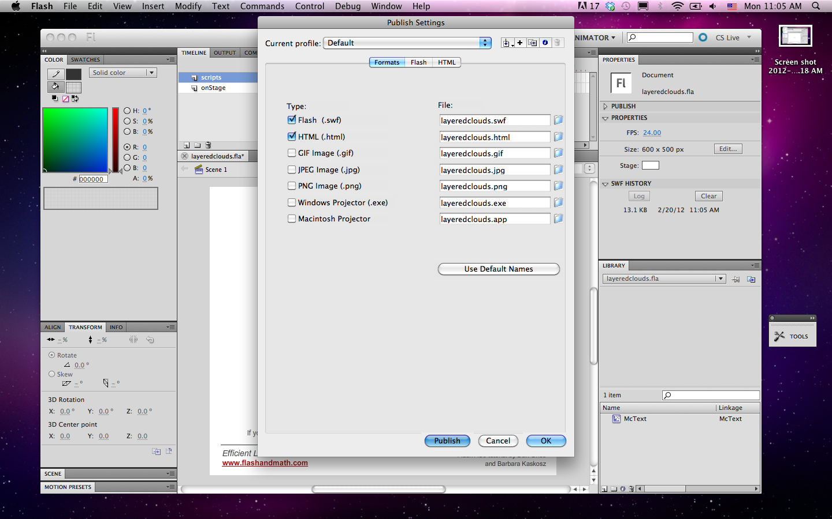
Check Formats and file locations (Formats : SWF, HTML)

Slide 23
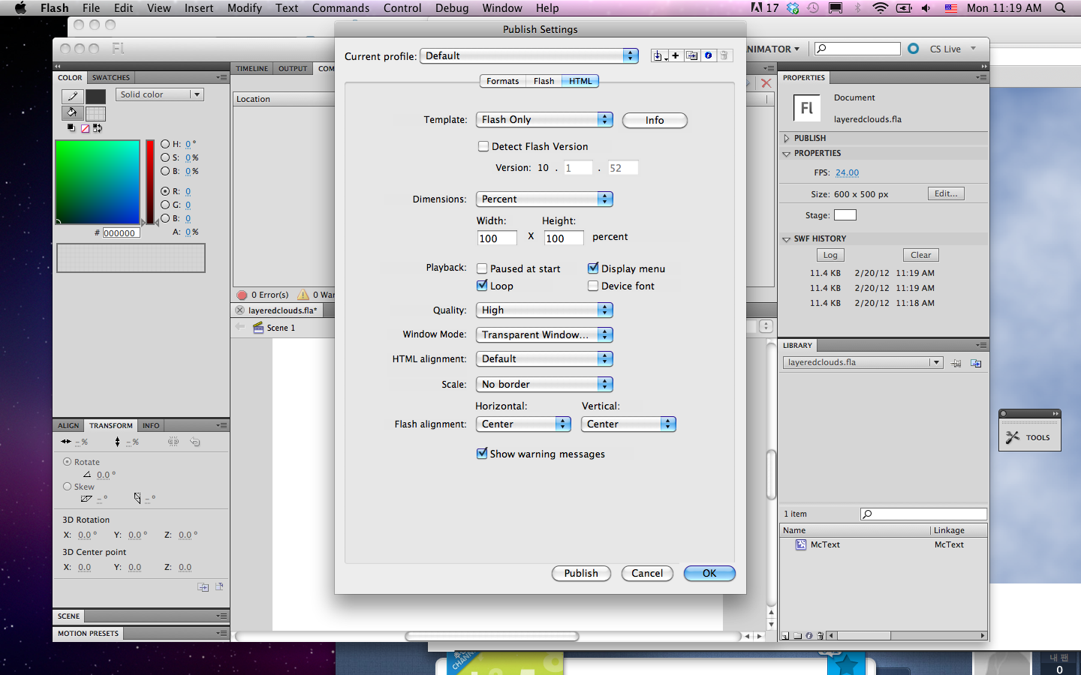
Check HTML settings and Publish

Slide 24

2 files: HTML, swf

Slide 25
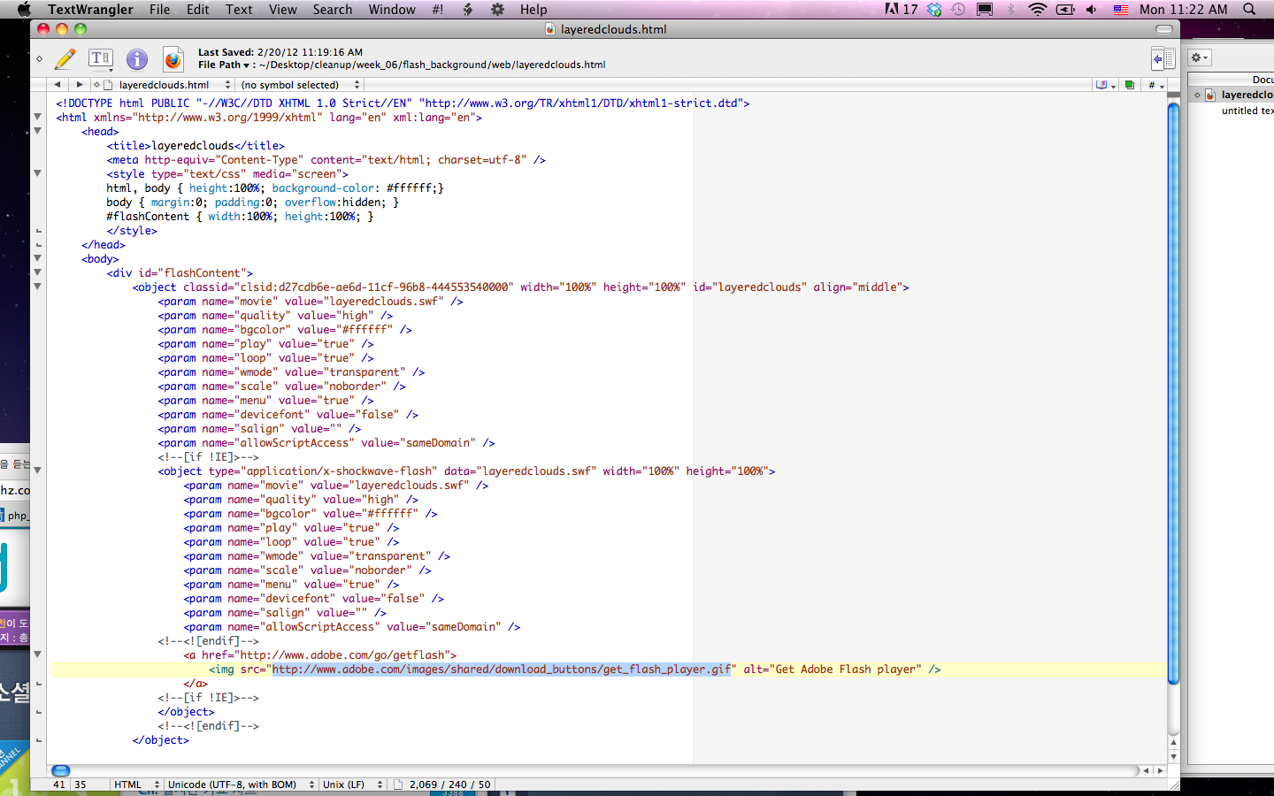
HTML file You can have your custom image to be shown when there is no flash player by changing the image src url below

Slide 26
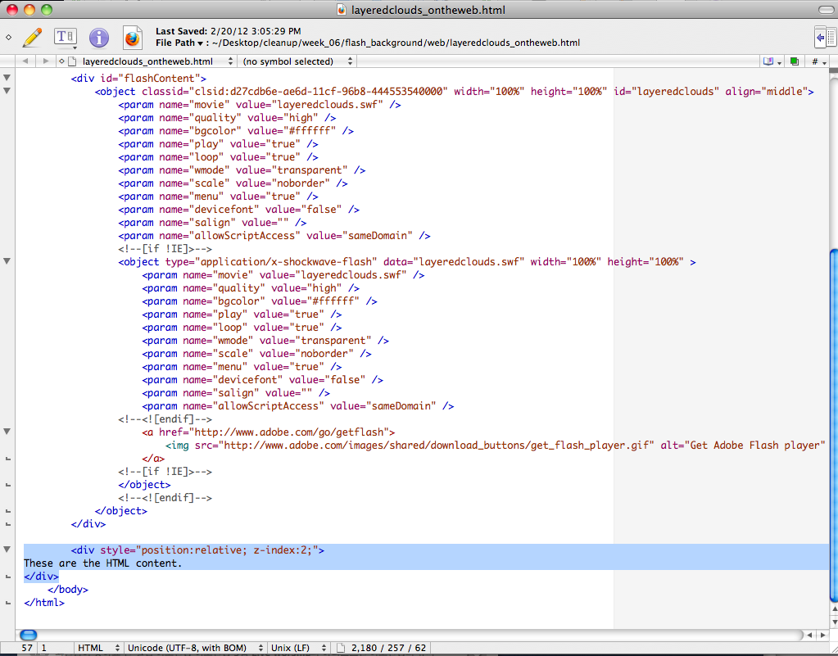

SWF as a background by z-index The z-index property specifies the stack order of an element. An element with greater stack order is always in front of an element with a lower stack order.

Slide 27
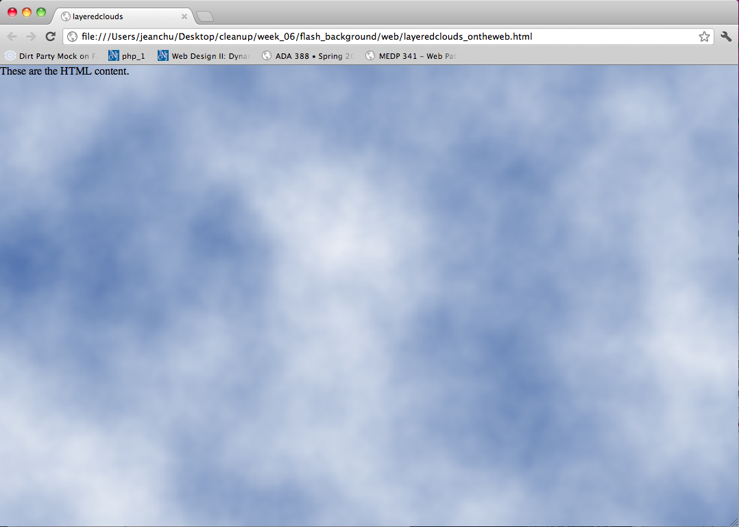
Finished!

