Slide 1
Adding maps, widgets, searchbox
Week 07
TCNJ Web 2
Jean Chu

Slide 2
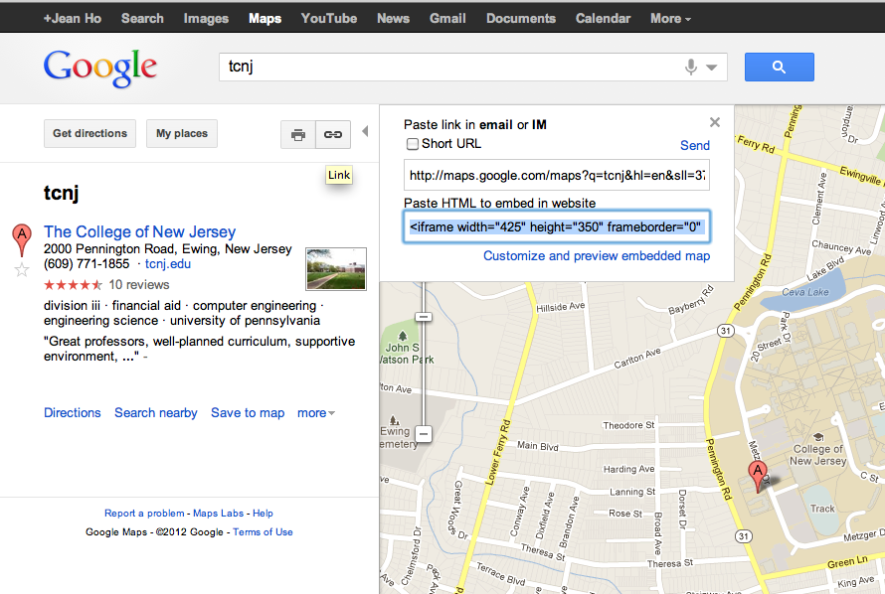
Add Google Map to your page via iframe
http://maps.google.com/help/maps/getmaps/plot-one.html

Slide 3
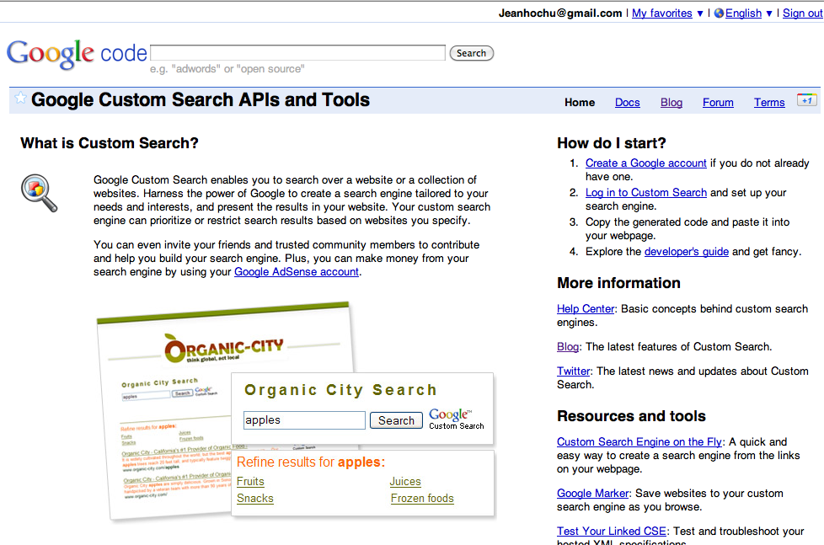
Google Custom Search API
http://www.google.com/cse/

Slide 4
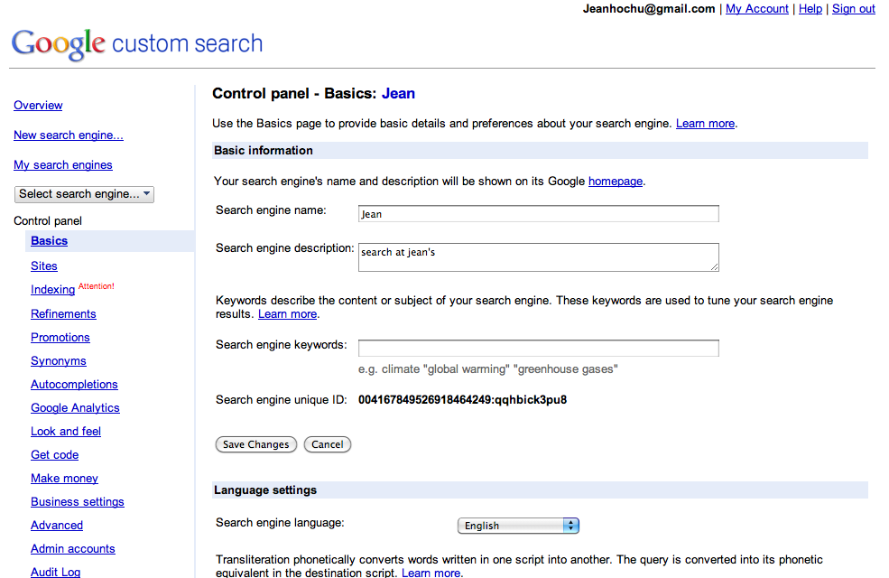
Google Custom Search Panel
http://code.google.com/apis/customsearch/docs/start.html

Slide 5
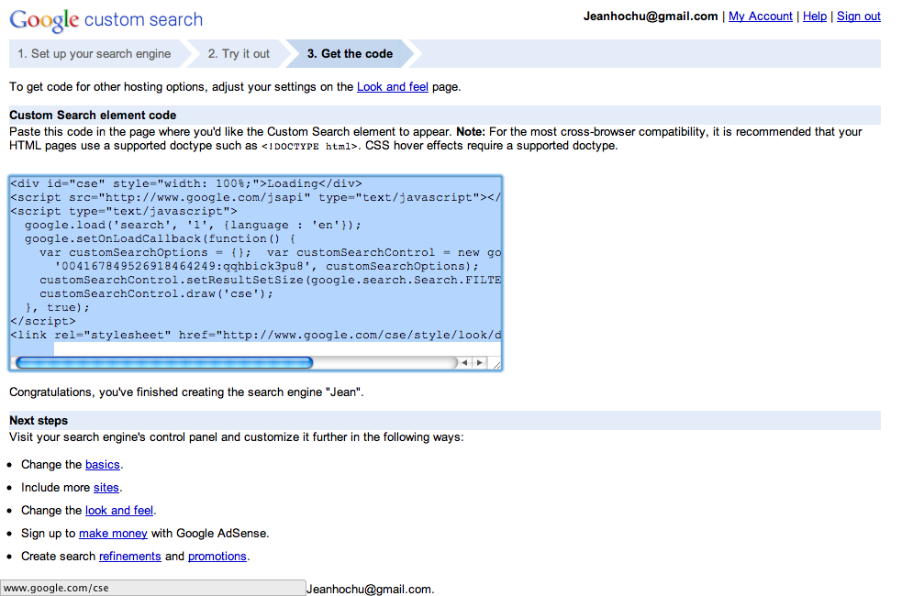
Google Custom Search Panel
<div id="cse" style="width: 100%;">Loading</div>
<script src="http://www.google.com/jsapi" type="text/javascript"></script>
<script type="text/javascript">
google.load('search', '1', {language : 'en'});
google.setOnLoadCallback(function() {
var customSearchOptions = {}; var customSearchControl = new google.search.CustomSearchControl(
'004167849526918464249:qqhbick3pu8', customSearchOptions);
customSearchControl.setResultSetSize(google.search.Search.FILTERED_CSE_RESULTSET);
customSearchControl.draw('cse');
}, true);
</script>
<link rel="stylesheet" href="http://www.google.com/cse/style/look/default.css" type="text/css" />

Slide 6

Twitter Resources

Slide 7
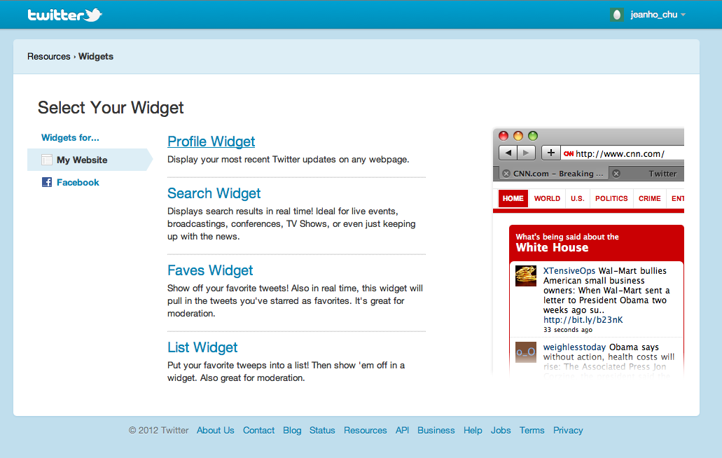
Adding Twitter Profile Widget to your site

Slide 8
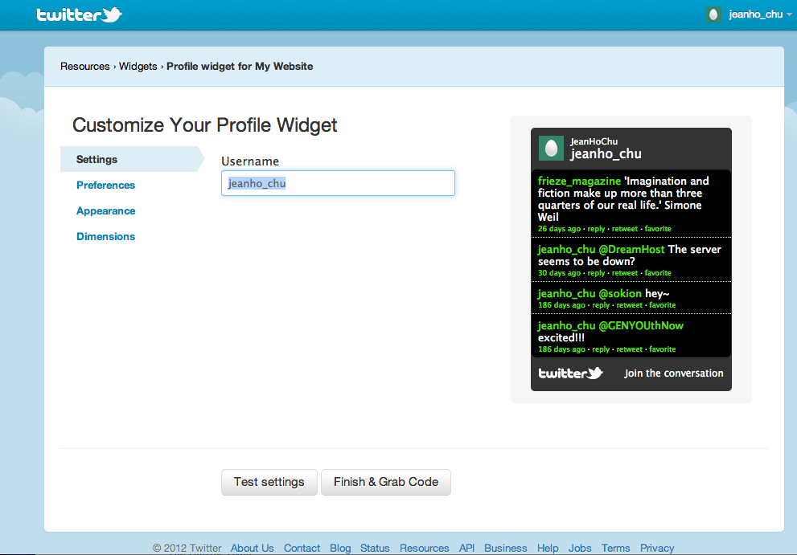
Adding Twitter Profile Widget to your site
https://twitter.com/about/resources/widgets/widget_profile

Slide 9
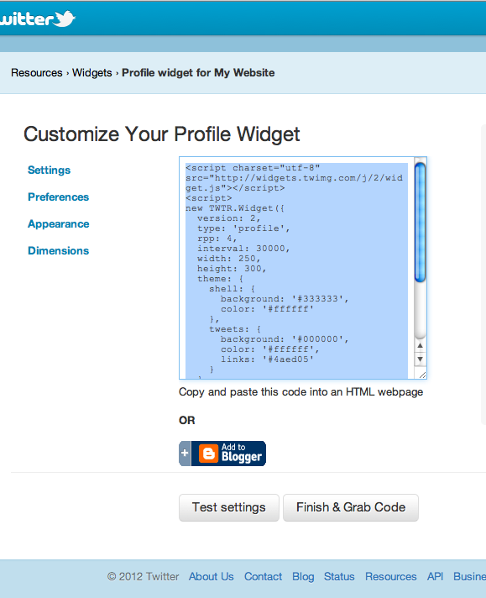
Adding Twitter Profile Widget to your site
<script charset="utf-8" src="http://widgets.twimg.com/j/2/widget.js"></script>
<script>
new TWTR.Widget({
version: 2,
type: 'profile',
rpp: 4,
interval: 30000,
width: 250,
height: 300,
theme: {
shell: {
background: '#333333',
color: '#ffffff'
},
tweets: {
background: '#000000',
color: '#ffffff',
links: '#4aed05'
}
},
features: {
scrollbar: false,
loop: false,
live: false,
behavior: 'all'
}
}).render().setUser('jeanho_chu').start();
</script>

Slide 10
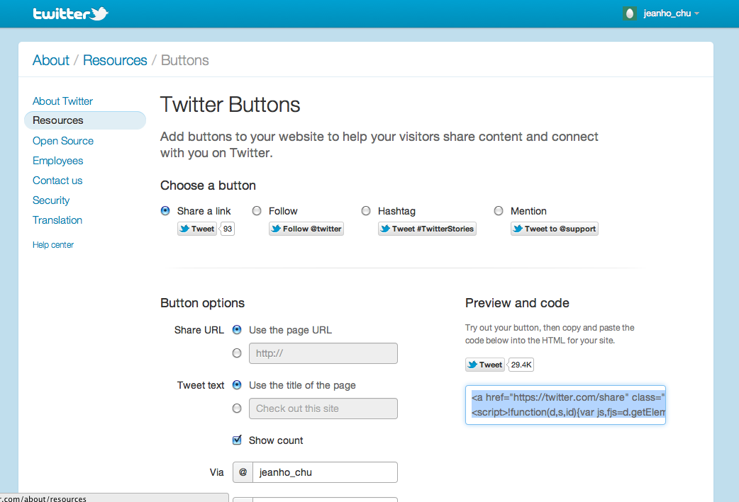
Twitter Share button
https://twitter.com/about/resources/buttons#tweet
<a href="https://twitter.com/share" class="twitter-share-button" data-via="jeanho_chu">Tweet</a>
<script>!function(d,s,id){var js,fjs=d.getElementsByTagName(s)[0];if(!d.getElementById(id)){js=d.createElement(s);js.id=id;js.src="//platform.twitter.com/widgets.js";fjs.parentNode.insertBefore(js,fjs);}}(document,"script","twitter-wjs");</script>

