Slide 1
Database and mySQL
Week 07
Dynamic Web TCNJ
Jean Chu

Slide 2
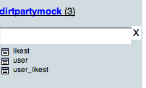
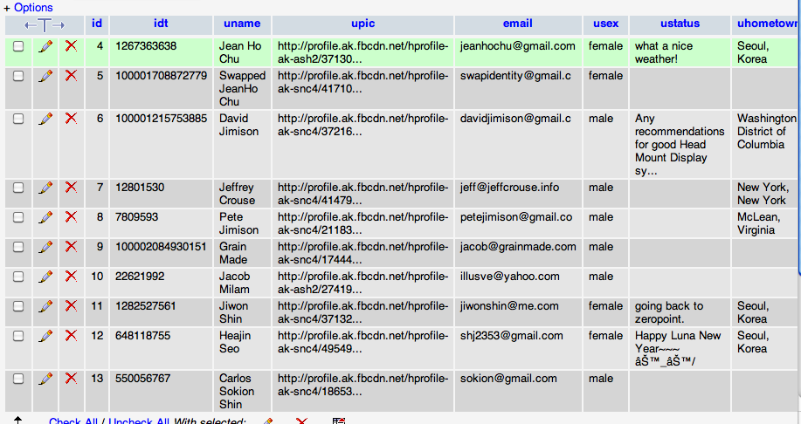
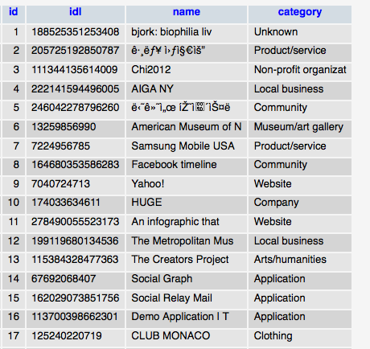

What is Database?
A database is a collection of tables (made up of columns and rows) that stores information.

Slide 3
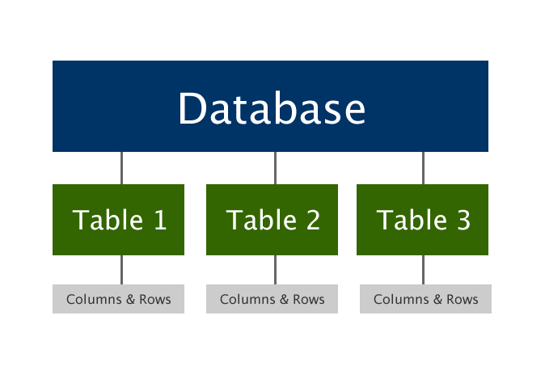

Slide 4

What is MySQL?
The most used relational database management system (RDBMS) that runs as a server providing multi-user access to a number of databases
Most databases are created, updated, and read using SQL (Structured Query Language)

Slide 5
Cf)Data Interchange Formats
JSON
XML
{"menu": {
"id": "file",
"value": "File",
"popup": {
"menuitem": [
{"value": "New", "onclick": "CreateNewDoc()"},
{"value": "Open", "onclick": "OpenDoc()"},
{"value": "Close", "onclick": "CloseDoc()"}
]
}
}}
<menu id="file" value="File">
<popup>
<menuitem value="New" onclick="CreateNewDoc()" />
<menuitem value="Open" onclick="OpenDoc()" />
<menuitem value="Close" onclick="CloseDoc()" />
</popup>
</menu>

Slide 6
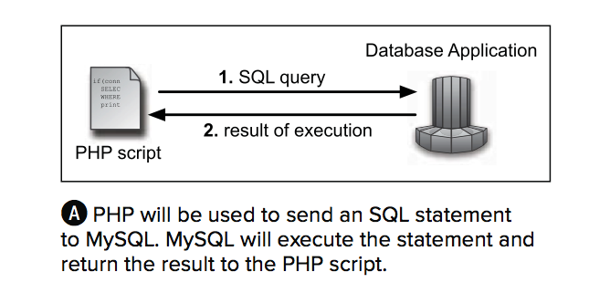
PHP & mySQL

Slide 7
Our Shared DB
Our Shared DB
Jean’s
Host:ipower.com
username: interactive
password: 11bestoftimes_2012
Host:data.jeanhochu.com
username: tcnj
password: dynamicweb
This will only allow you to log in to the control panel but will not give you remote access
This will not allow you to the control panel but will give you remote access
Notes:
This will only allow you to log in to the control panel

Slide 8

Host : ipower.com

Slide 9
Code
General
Remote Connnect
$dbc = @mysql_connect('localhost', 'username', 'password')
$dbc = @mysql_connect(’data.jeanhochu.com', 'tcnj', 'dynamicweb')
* note: Tcnjart.com ipower account setting do not support remote access to the database.
You could only use the control panel or use Jean’s personal database connection.
Notes:
Ipower do not support

Slide 10
Common SQL Commands
SELECT (Retrieves records from a table)
INSERT (Adds records to a table)
UPDATE (Updates records in a table)
DELETE (Deletes records from a table)

Slide 11
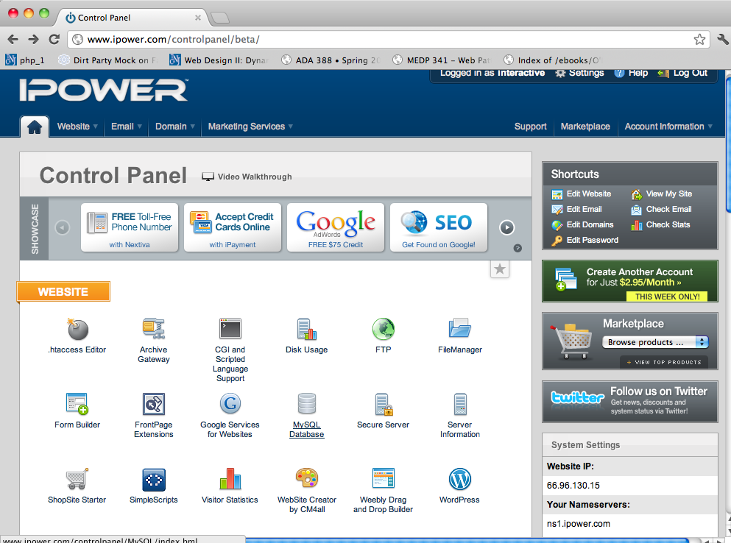
MySQL Database

Slide 12
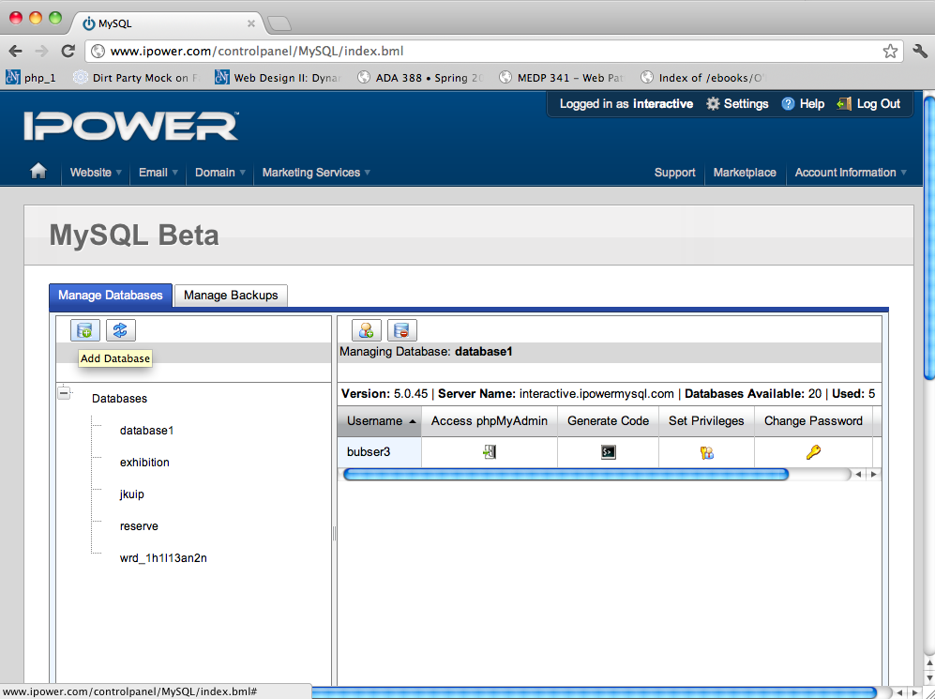
Add Database

Slide 13
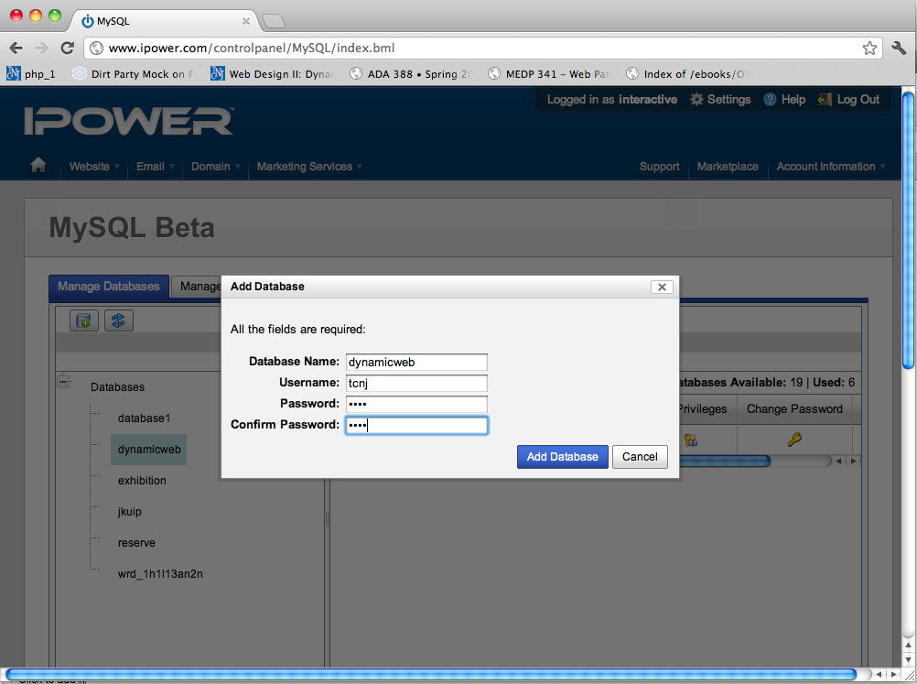
Add Database

Slide 14
Create Database
mysql_query('CREATE DATABASE somedb', $dbc);
Theoretically, it should work, but it won’t work in Jean’s server for permissions and security reasons.

Slide 15
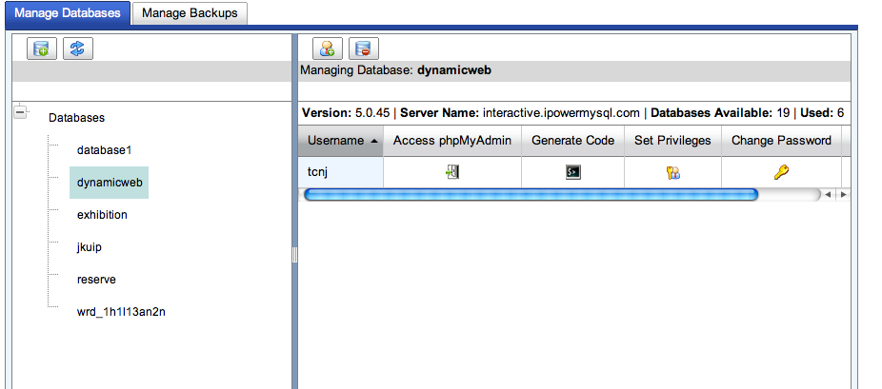
Manage Database

Slide 16
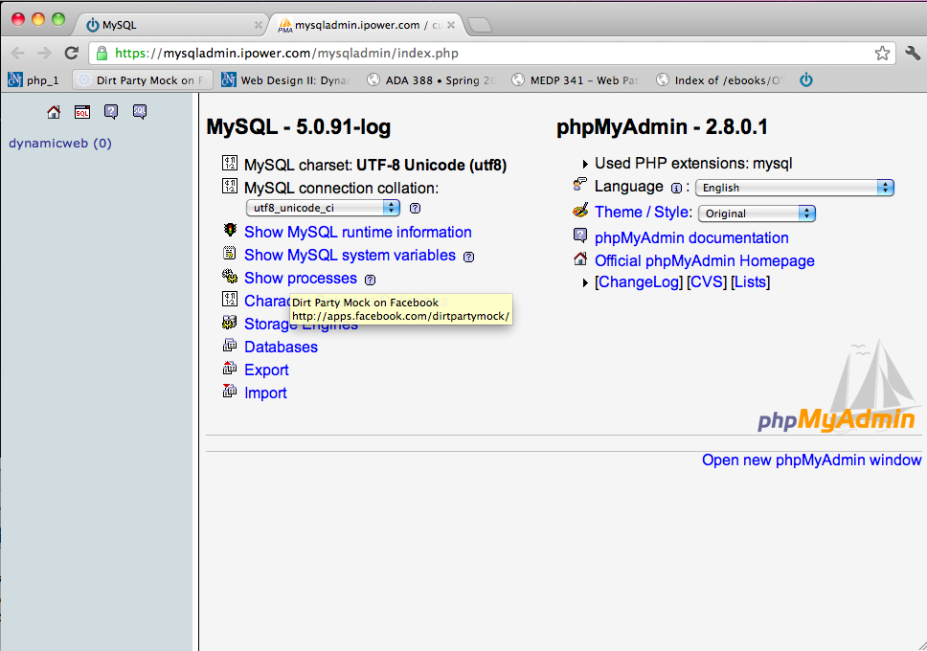
php MyAdmin

Slide 17
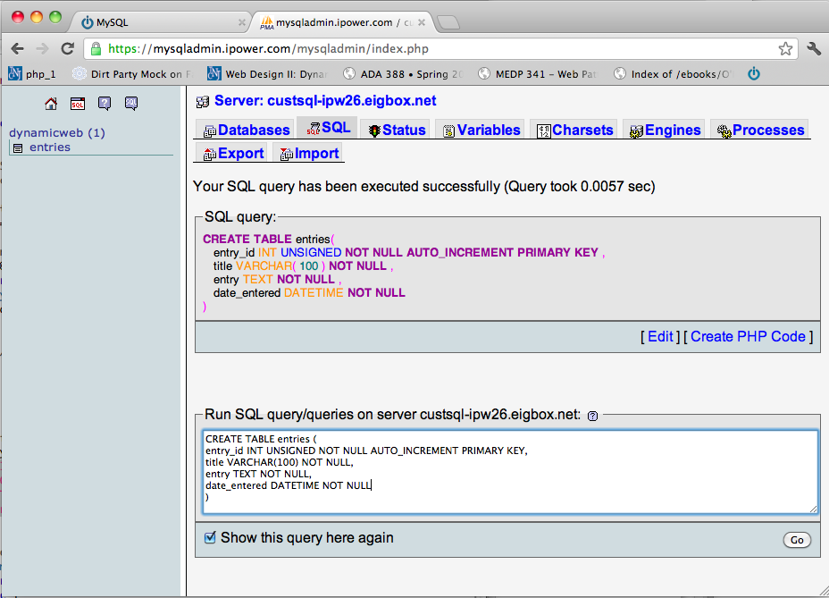
php MyAdmin

Slide 18
Create Table
CREATE TABLE tablename (column1 definition, column2 definition)

Slide 19
Create Table
Table name
CREATE TABLE entries (
entry_id INT UNSIGNED NOT NULL AUTO_INCREMENT PRIMARY KEY,
title VARCHAR(100) NOT NULL,
entry TEXT NOT NULL,
date_entered DATETIME NOT NULL);
Definition
Column
Datatype
Notes:
Table name

Slide 20
Common Datatypes
INT used for IDs
VARCHAR used for varying lengths (255 or less)
CHAR used for fixed lengths
TEXT used to store lots of text like blog entries
DATETIME used for storing dates
http://www.tizag.com/mysqlTutorial/mysqltables.php

Slide 21
Primary Key
Every table should have one.
It should contain a value.
That value must never change.
It must be unique for each record in the table.

Slide 22
auto_increment
If you add 'AUTO_INCREMENT' into the column description, it will assign the next-highest number available for the columns value.

Slide 23
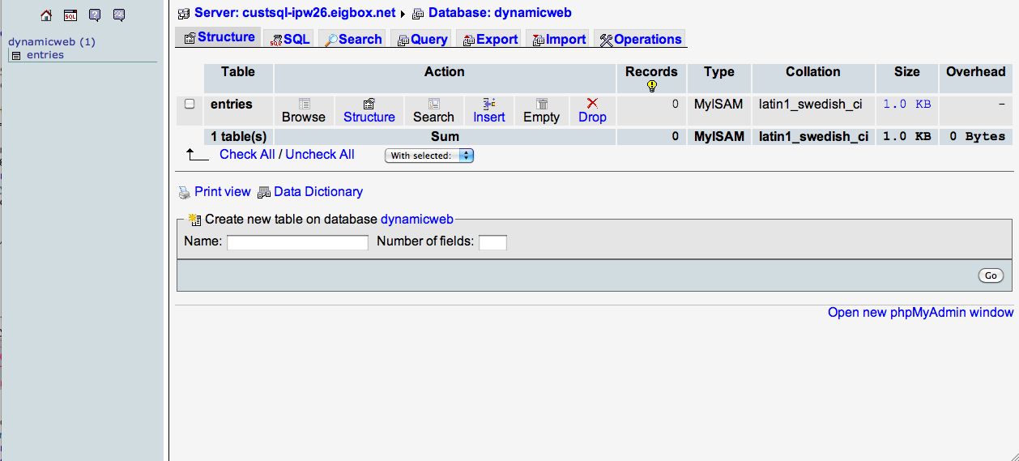
Table Created!
click
Notes:
click

Slide 24
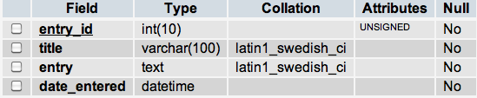
Table Created!

Slide 25
SELECT *
FROM `entries`
SELECT *
FROM `entries`
WHERE `entry_id` = '2'
LIMIT 0 , 30
SELECT *
FROM ‘entries’
ORDER BY ‘entry_id’
* asterisk is the equivalent of saying every column
http://www.tizag.com/mysqlTutorial/mysqlselect.php

Slide 26
Inserting Rows
INSERT INTO tablename VALUES (value1, value2, value3)
INSERT INTO tablename (column1_name, column2_name) VALUES (value1, value2)

Slide 27

Inserting Rows
INSERT INTO entries (entry_id, title, entry, date_entered) VALUES (0, '$title', '$entry', NOW())

Slide 28
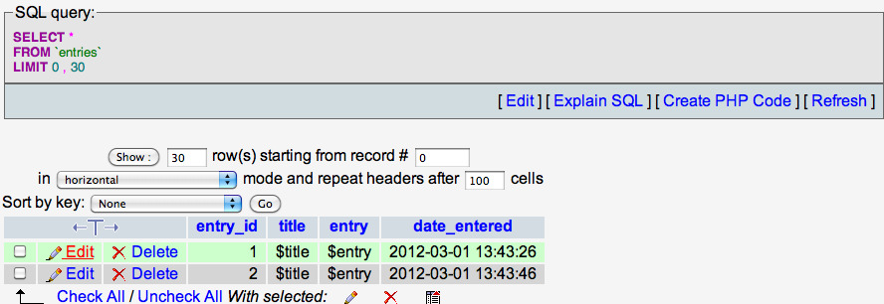
Row Inserted!

Slide 29
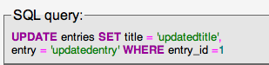
Updating Rows
UPDATE tablename SET column1_name= value, column2_name=value2 WHERE some_column=value

Slide 30
Row Updated!

Slide 31

Deleting Rows
DELETE FROM tablename WHERE column=value

Slide 32

Deleting Rows

Slide 33
References
PHP for the Web (Larry Ullman) : Chapter 12
http://www.tizag.com/mysqlTutorial/

