Slide 1
Search Engine Optimization (SEO)
Week 07
Dynamic Web TCNJ
Jean Chu

Slide 2
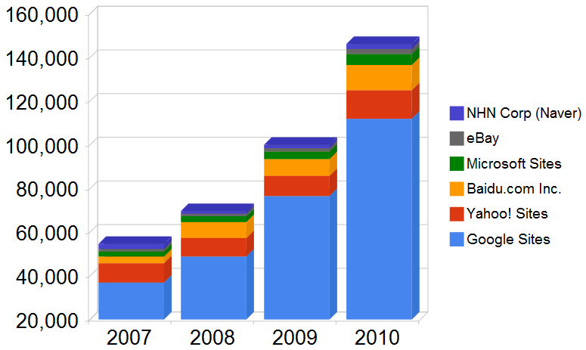

Search Volume Growth Over Time

Slide 3
What is SEO?
Search Engine Optimization is the process of improving a websites’ visibility and ranking in the search engines.

Slide 4
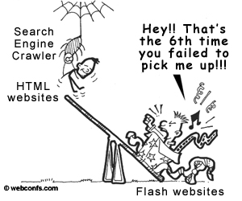
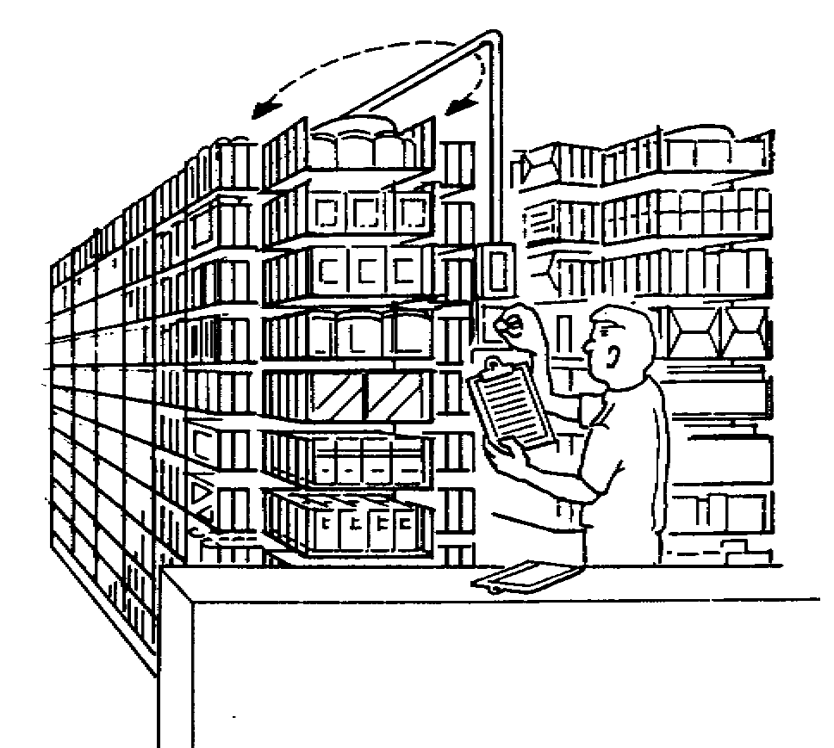
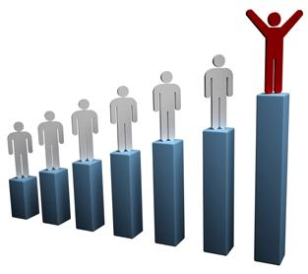
How Search Engine Works
Crawl
Index
Rank
Notes:
Crawl

Slide 5
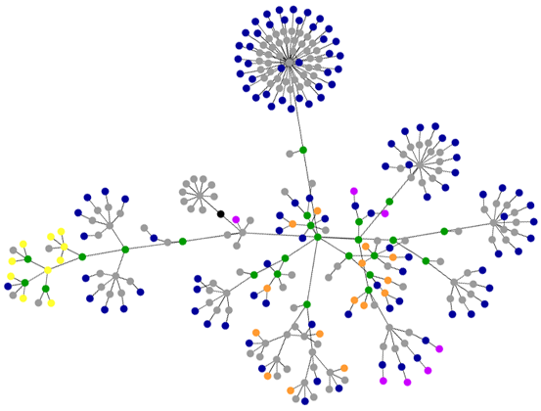
Crawling & Indexing
Without links, the engines might never find this page
Notes:
5
5

Slide 6
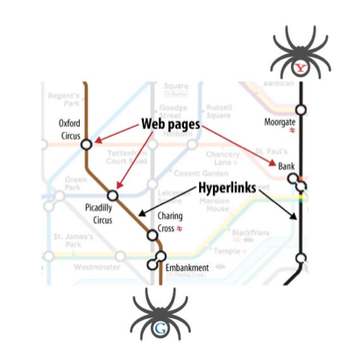
Crawl
Search engines crawl the Web to see what is there. This task is performed by a piece of software, called a crawler or a spider (or Googlebot, as is the case with Google)

Slide 7
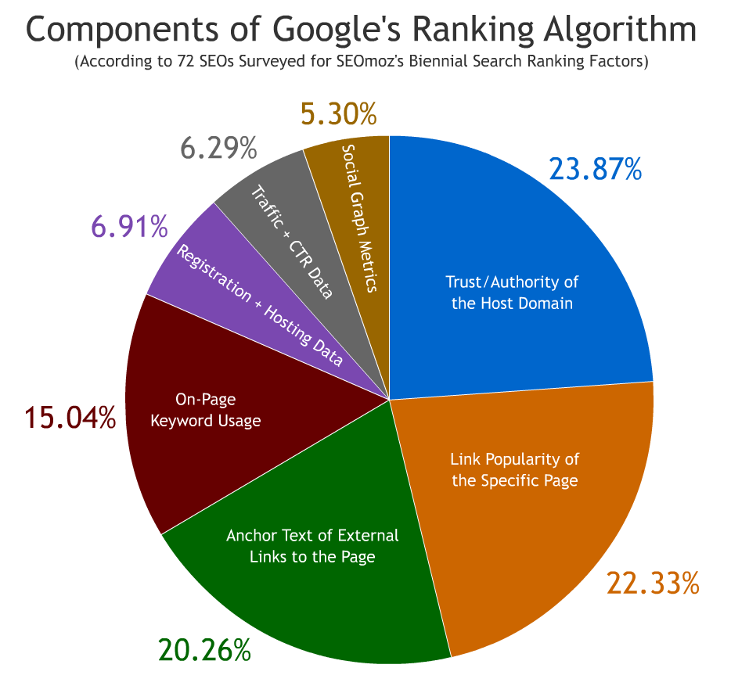
Algorithmic Ranking Factors
Notes:
7
7

Slide 8
What affects page rank ?
Number of other websites that link to your website
*** Following Results in giving higher ranks
Domain Authority
Diversity of External link Sources

Slide 9
Page Rank
The best way to increase your page rank is for other “popular” websites to link to your website.
If many other “Rank 0” websites link to your website, that won’t amount to very much.
If a few “Rank 5” websites link to your website, your own websites page rank might increase.
John Kuiphoff’s Class Design Fundamentals for the Web
http://www.socialsyllabus.com/calendar.php?state=viewentry&course=1&entry=29

Slide 10
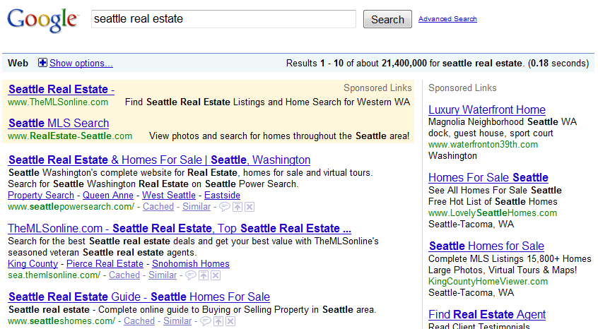
Organic vs Paid search
Paid
Organic
http:/googleblog.blogspot.com/2010/06/our-new-search-index-caffeine.html

Slide 11
Organic vs Paid search
10% of Clicks
90% of Clicks
http:/googleblog.blogspot.com/2010/06/our-new-search-index-caffeine.html

Slide 12
What do the robots see?

Slide 13
What do the robots see?
Texts
Title
Meta Description Tag
Links
H1, H2, H3, H(x)
Body texts
Image alt

Slide 14
Clean, Crawlable URLs as Keywords
Better
www.adioso.com/seattle/british-airways-flights
www.adioso.com/cat61/british
www.adioso.com/cat61/174
www.adioso.com/f?ID=174
www.adioso.com/f?cat=61&?ID=174
Worse
cdn6.fly.adioso.com/f?cat=61&?ID=174&CustID=5afsdf21
http:/googleblog.blogspot.com/2010/06/our-new-search-index-caffeine.html

Slide 15
Title Tags
Better
Usability Testing Software | UserTesting.com
UserTesting.com | Usability Testing Software
Usability Testing Software
Usability Testing, Usability Test, User Testing, User Software
UserTesting.com
Worse
NA
http:/googleblog.blogspot.com/2010/06/our-new-search-index-caffeine.html

Slide 16
Meta Description Tag
<head>
<title>My title</title>
<meta name="description" content="This is my description" />
</head>

Slide 17
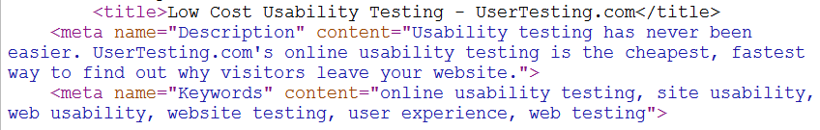
Meta Keywords?
The google search engines don’t use since the early 2000s. However bing still uses meta keywords tag
http:/googleblog.blogspot.com/2010/06/our-new-search-index-caffeine.html

Slide 18
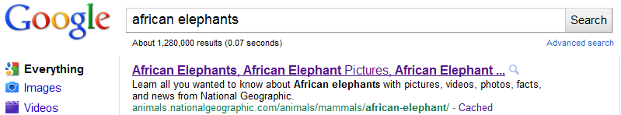
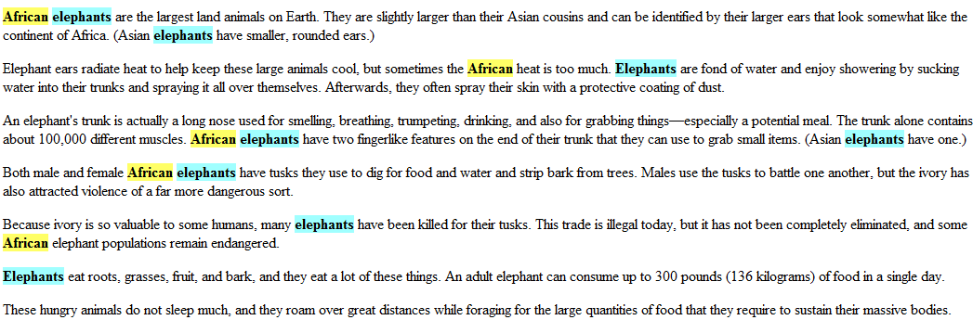
Body Text Keyword Usage
http:/googleblog.blogspot.com/2010/06/our-new-search-index-caffeine.html

Slide 19
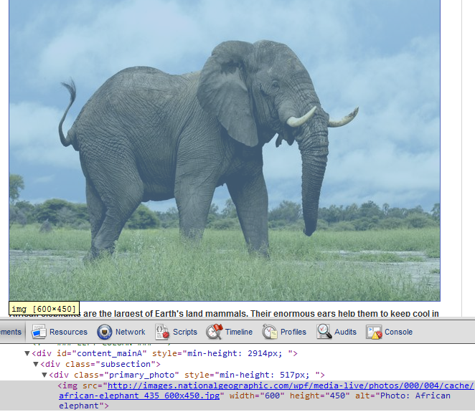
Images & Alt Attributes
Keywords in alt attributes are surprisingly well correlated with higher rankings
http:/googleblog.blogspot.com/2010/06/our-new-search-index-caffeine.html

Slide 20
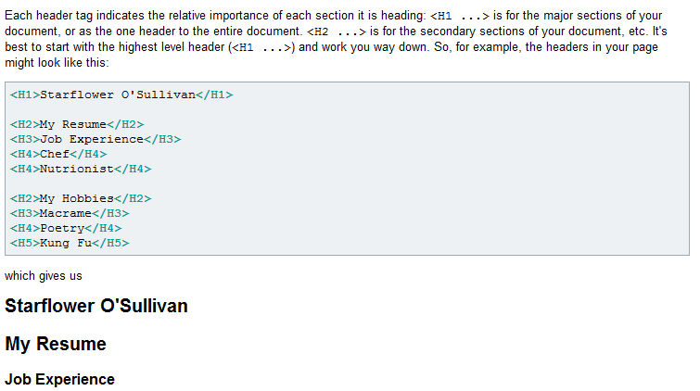
H1, H2, H3 Headlines
Keywords in H(x) tags are not particularly well correlated with high rankings, but may provide some, minor value.
http:/googleblog.blogspot.com/2010/06/our-new-search-index-caffeine.html

Slide 21
Page Depth
The number of required clicks to get to a page from the homepage. Pages that are available in one click are deemed more important than those that are nearly hidden and require more than 3 clicks to reach.
John Kuiphoff’s Class Design Fundamentals for the Web
http://www.socialsyllabus.com/calendar.php?state=viewentry&course=1&entry=29

Slide 22
Internal Links
The more internal links you have that point to a certain page, the more important search engines believe that page to be.
A common page that ranks well on almost every site is the homepage, because every other page on your website usually has a link back to the homepage.
John Kuiphoff’s Class Design Fundamentals for the Web
http://www.socialsyllabus.com/calendar.php?state=viewentry&course=1&entry=29

Slide 23
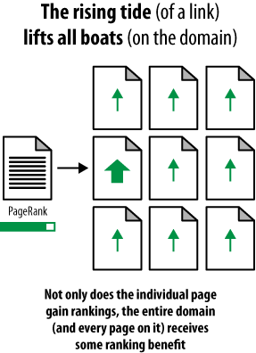
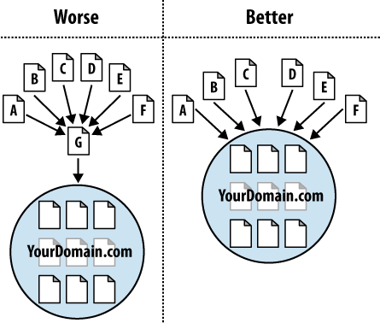
Preferably All on a Single Sub/Root Domain
http:/googleblog.blogspot.com/2010/06/our-new-search-index-caffeine.html
http://www.seomoz.org/blog/understanding-root-domains-subdomains-vs-subfolders-microsites

Slide 24
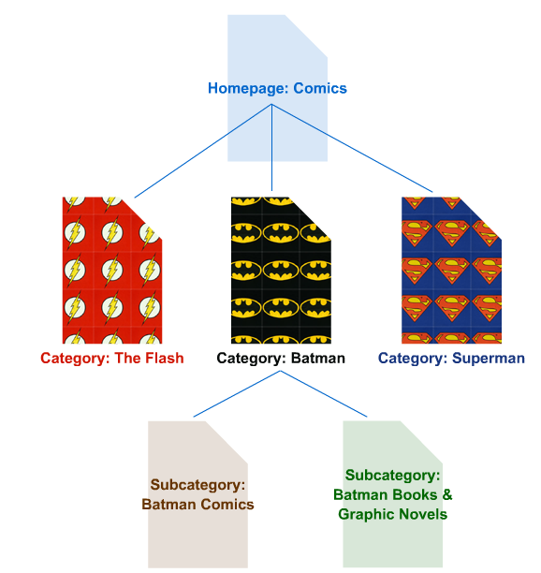
Logical, Shallow Information Architecture
http:/googleblog.blogspot.com/2010/06/our-new-search-index-caffeine.html
http://www.seomoz.org/blog/diagrams-for-solving-crawl-priority-indexation-issues

Slide 25
Make your site Searchable

Slide 26
Keywords
Think like an regular person, not an industry expert
Analyze your competition
Think local
Use the free tools (Google Analytics, Google Adwords)

Slide 27
Keywords
Broad keywords: Short, not specific. Example: music, electronics
Specific keywords: many adjectives or words that make the search very targeted. Example: using a jQuery photogallery
Branded keywords: words that are specific to your company or brand Example: radiohead
John Kuiphoff’s Class Design Fundamentals for the Web
http://www.socialsyllabus.com/calendar.php?state=viewentry&course=1&entry=29

Slide 28
Keyword usage
Keywords Density: the number of times your keywords are mentioned in your site. If it's too much, you'll look like a spammer; if it's too little, you won't look like a relevant match and the search engines won't consider your site.
Keyword Variation: Altering versions of your keywords will help you capture hidden search engine traffic.
Similar Keywords: closely related topics to your keywords that will aide the search engines in correctly categorizing your traffic.
John Kuiphoff’s Class Design Fundamentals for the Web
http://www.socialsyllabus.com/calendar.php?state=viewentry&course=1&entry=29

Slide 29
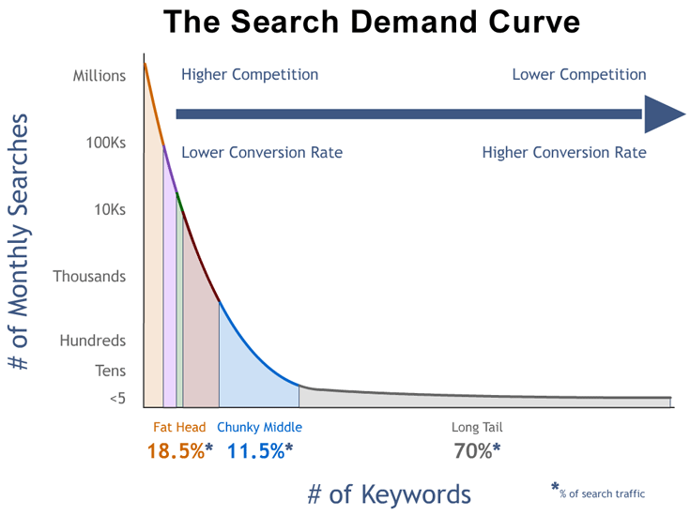
http://www.seomoz.org/blog
Notes:
29
29

Slide 30
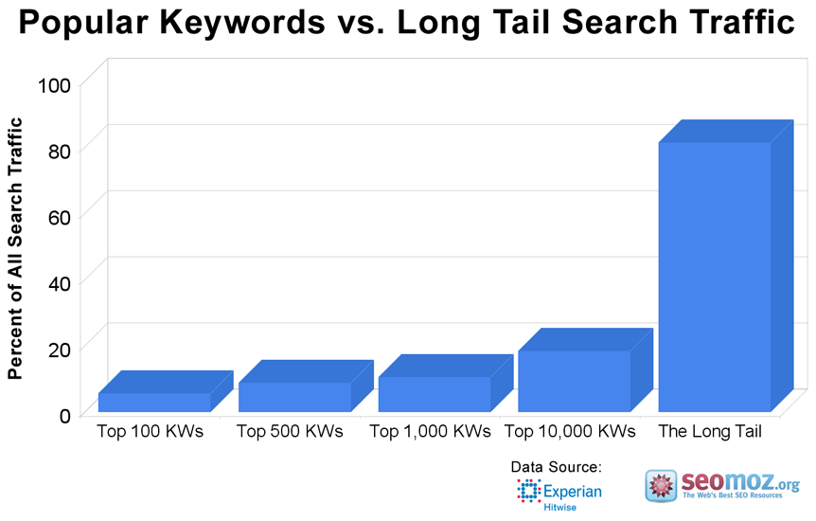
http://www.seomoz.org/blog
Notes:
30
30

Slide 31
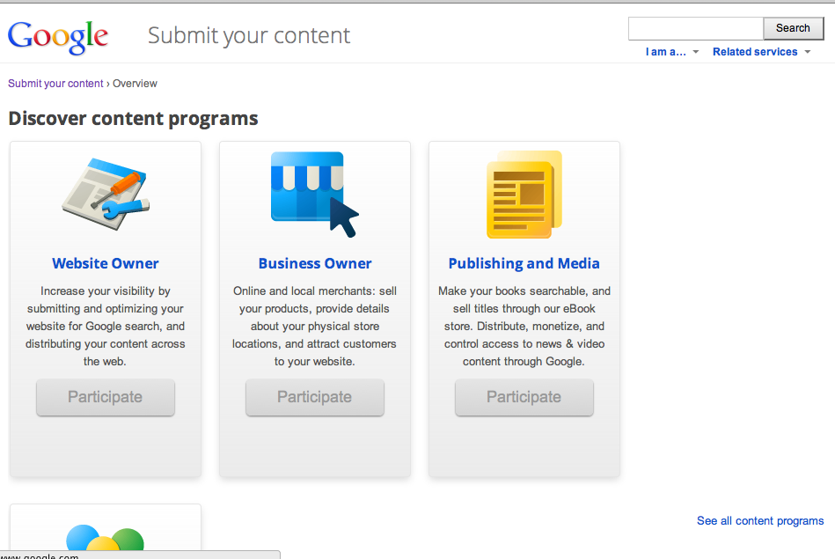
Submit to google
http://www.google.com/submityourcontent/

Slide 32
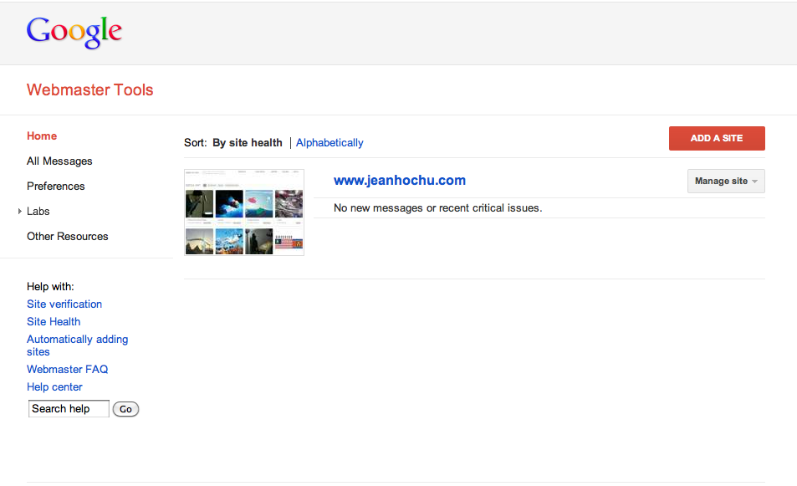
Google Webmaster Tools
https://www.google.com/webmasters/tools/

Slide 33
Tools
Google Webmaster Tools
https://www.google.com/webmasters/tools

Slide 34
References
http://www.tizag.com/SEOTutorial/
http://www.webconfs.com/seo-tutorial/

