Slide 1
Data Visualization
Week 08
TCNJ Web Design 2
Jean Chu

Slide 2
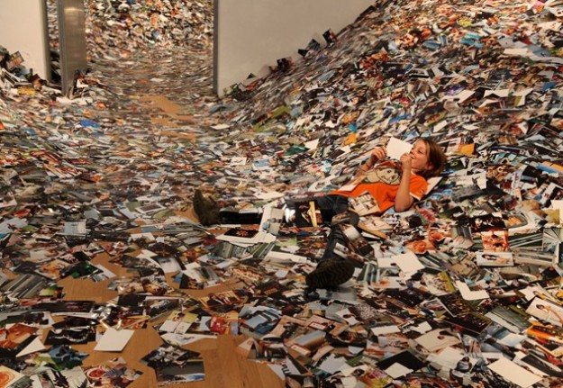
Information Overload!
Erik Kessels, 24 hours in photos:
http://www.creativereview.co.uk/cr-blog/2011/november/24-hours-in-photos

Slide 3
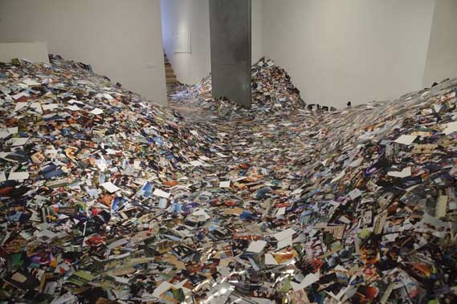

Slide 4
What is Data Visualization?
Visualization is the graphical presentation of information, with the goal of providing the viewer with a qualitative understanding of the information contents.
Information may be data, processes, relations, or concepts and they are abstracted in some schematic form

Slide 5
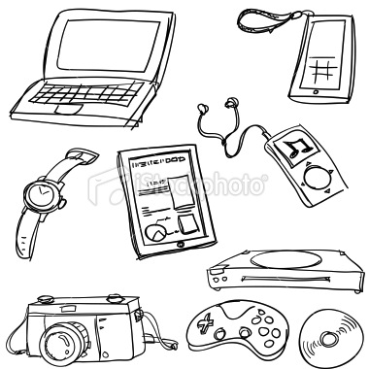
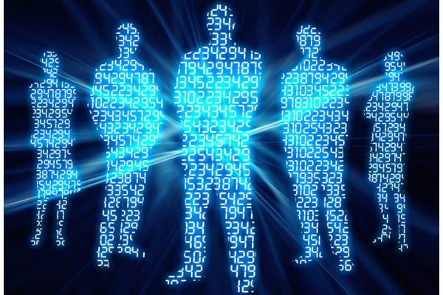
Data of our lives are being stored

Slide 6
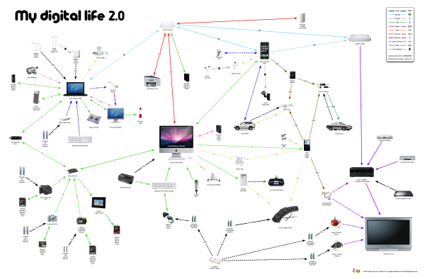
My Digital Life 2.0: A Consumer Gadget Map
http://www.coolinfographics.com/blog/2010/2/15/my-digital-life-20-a-consumer-gadget-map.html

Slide 7
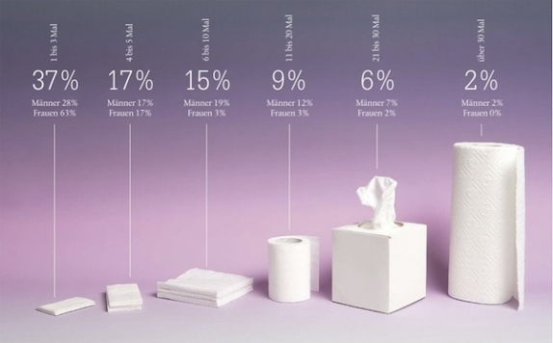
Infographic VS Data Visualization?
Infographics :
Any visual representation of data that is:
manually drawn (and therefore a custom treatment of the information)
specific to the data at hand (and therefore nontrivial to recreate with different data)
aesthetically rich (strong visual content meant to draw the eye and hold interest)
relatively data-poor (because each piece of information must be manually encoded).
Example of infographics
Data Flow 2, Gestalten
Designing Data Visualizations, Oreilly Media
Notes:
Designing Data Visualizations, Oreilly Media

Slide 9
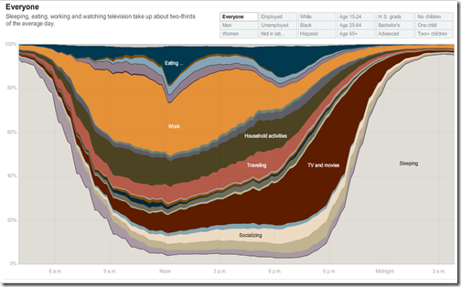
Infographic VS Data Visualization?
Data visualization and information visualization
Any visual representation of data that is:
algorithmically drawn (may have custom touches but is largely rendered with the help of computerized methods);
easy to regenerate with different data (the same form may be repurposed to rep- resent different datasets with similar dimensions or characteristics);
often aesthetically barren (data is not decorated); and
relatively data-rich (large volumes of data are welcome and viable, in contrast to infographics).
NYTimes
http://www.nytimes.com/interactive/2009/07/31/business/20080801-metrics-graphic.html
Designing Data Visualizations, Oreilly Media
Notes:
NYTimes Interactive

Slide 10
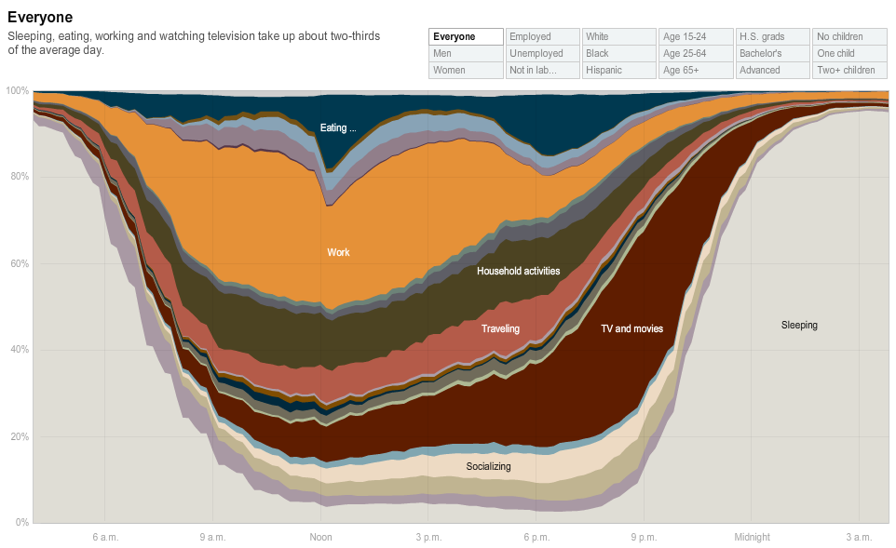

Slide 11
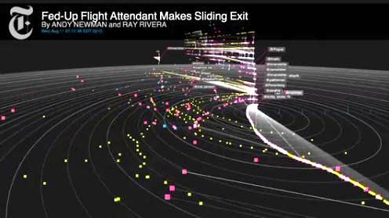
Purpose of Data Visualization
Exploration
Data analysis phase
Translating data set into a visual medium to help you get a sense of what’s inside your data set.
Used to find the story the data has to tell you.
Exploration is generally best done at a high level of granularity. There may be a whole lot of noise in your data, but if you oversimplify or strip out too much information, you could end up missing something important.
http://nytlabs.com/projects/cascade.html
Designing Data Visualizations, Oreilly Media
Notes:
NYTimes Cascade

Slide 12
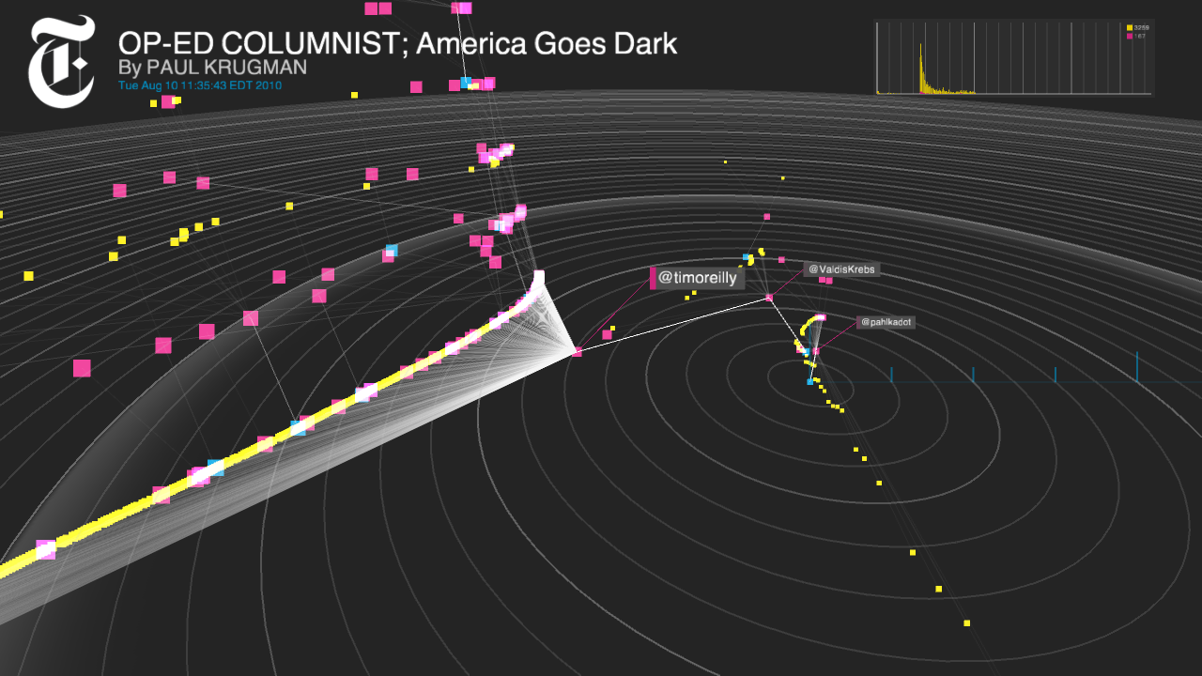

Slide 13
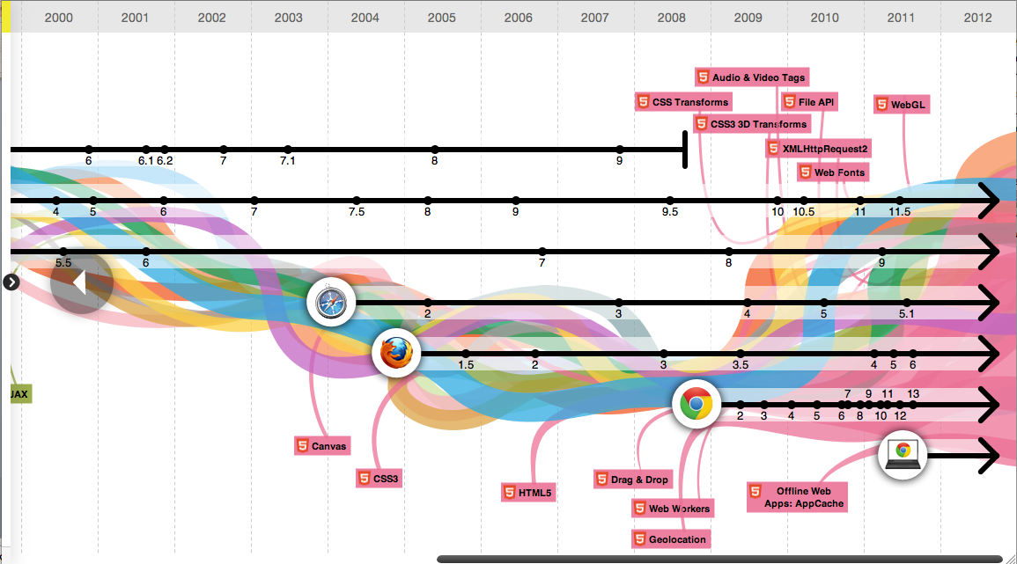
Purpose of Data Visualization
Explanation
Part of the presentation phase.
Selecting focused data that will support the story you are trying to tell.
You already know what the data has to say, and you are trying to tell that story to somebody else.
Such a visualization may stand on its own, or may be part of a larger presentation, such as a speech, a newspaper article, or a report. In these scenarios, there is some supporting narrative—written or verbal— that further explains things.
http://evolutionofweb.appspot.com/
Designing Data Visualizations, Oreilly Media

Slide 14
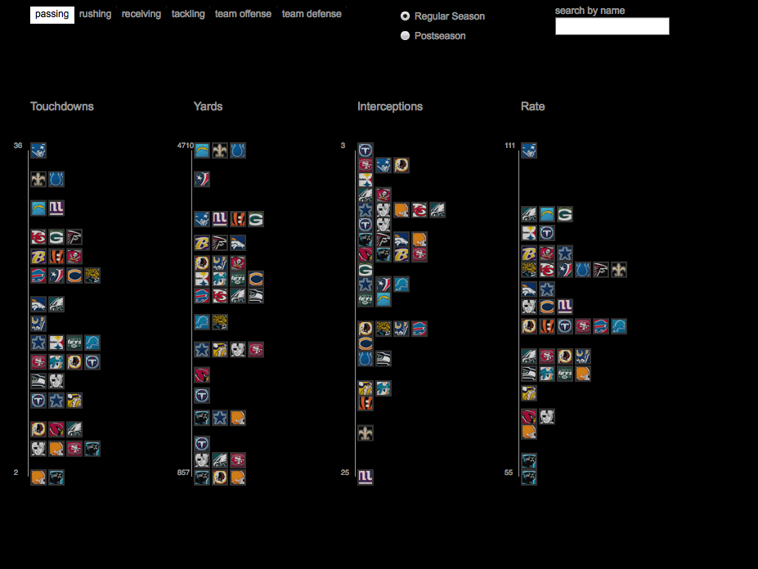
Purpose of Data Visualization
Hybrid
A curated dataset that is nonetheless presented with the intention to allow some exploration on the reader’s part.
There is a certain freedom-of-discovery aspect to the infor- mation presented.
The data is usually not totally raw; it has been distilled and facilitated to some extent.
These might even be insights the creator of the visualization hasn’t come across yet.
Visualizing NFL Statistics
http://www.juiceanalytics.com/nfl-visualization/
Designing Data Visualizations, Oreilly Media

Slide 15
Visualizing NFL Statistics
http://www.juiceanalytics.com/nfl-visualization/

Slide 16
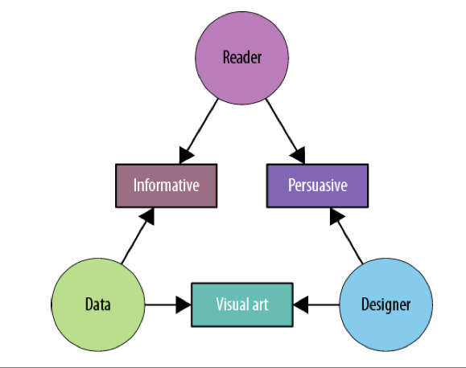
Categories of Explanatory Visualizations
Designing Data Visualizations, Oreilly Media

Slide 17
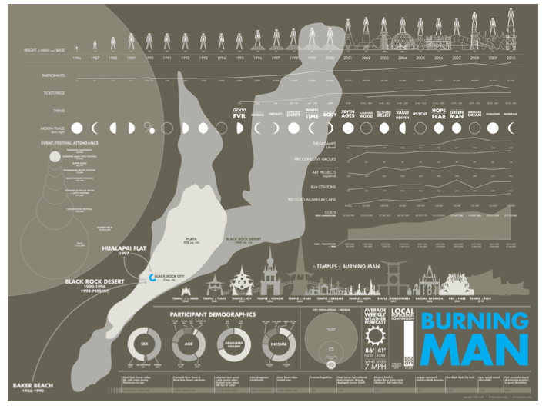
Categories of Explanatory Visualizations Informative
It aims for a neutral presentation of the facts in such a way that will educate the reader (though not necessarily persuade him)
Informative visualizations are often associated with broad data sets, and seek to distill the content into a manageably consumable form
Flint Hahn’s Burning Man infographic is a great example of an aesthetically rich, manually-drawn piece
Designing Data Visualizations, Oreilly Media
Notes:
Flint Hahn’s Burning Man infographic is a great example of an aesthetically rich, manually-drawn piece

Slide 19
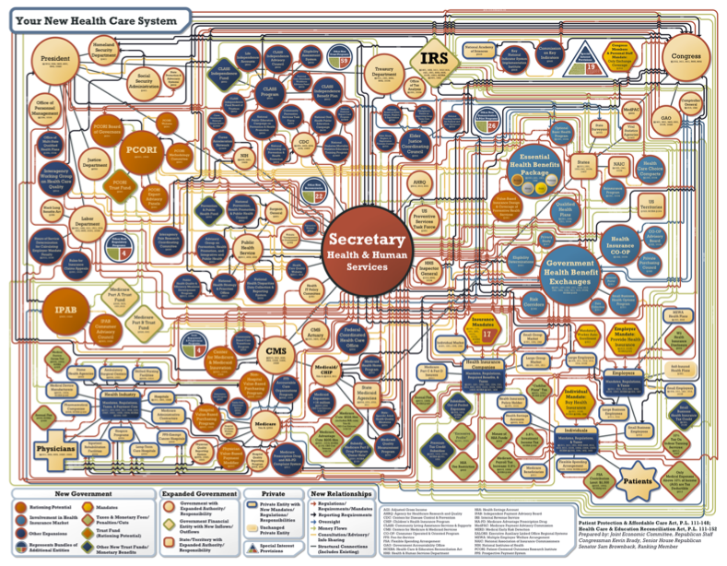
Categories of Explanatory Visualizations Persuasive
It represents a very specific point of view, and advocates a change of opinion or action on the part of the reader.
In this category of visualization, the data represented is specifically chosen for the purpose of supporting the designer’s point of view, and is presented carefully so as to convince the reader of same.
Your New Health Care System, Joint Economic Committee minority, Republicans. This rendition of the healthcare plan clearly revels in and aims to exaggerate the system’s complexity.
Designing Data Visualizations, Oreilly Media
Notes:
Flint Hahn’s Burning Man infographic is a great example of an aesthetically rich, manually-drawn piece

Slide 21
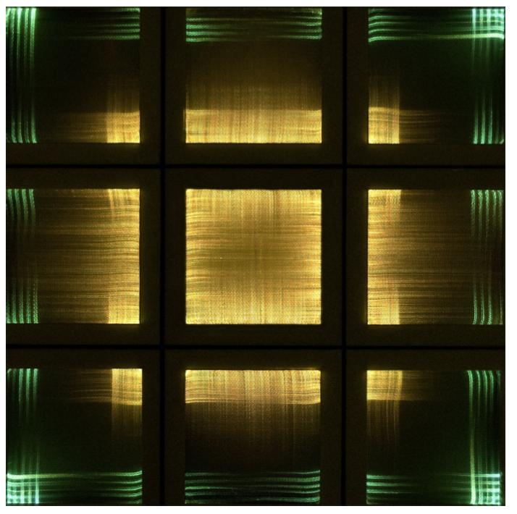
Categories of Explanatory Visualizations Visual Art
Visual art merely translates the data into a visual form. The designer may intend only to condense it, translate it into a new medium, or make it beautiful; she may not intend for the reader to be able to extract anything from it other than enjoyment.
Nora Ligorano and Marshall Reese designed a project that converts Twitter streams into a woven fiber-optic tapestry
Designing Data Visualizations, Oreilly Media
Notes:
Flint Hahn’s Burning Man infographic is a great example of an aesthetically rich, manually-drawn piece

Slide 23
By putting data into a human context, it gains meaning.
These Data become our histories
Jer Thorp
http://blprnt.com/

Slide 24
Visualization Stories
Question + Visual Data + Context = Story

Slide 25
Steps to Data Visualization

Slide 26
Steps
Formulate the Question
Gather the Data
Apply Visual Representation

Slide 27
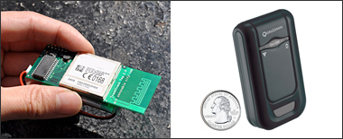
Gather Data Build your own system
http://senseable.mit.edu/trashtrack/

Slide 28
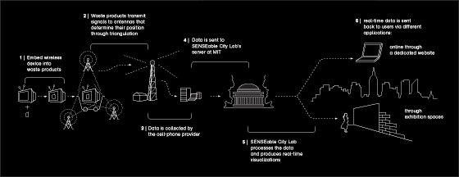

Slide 29
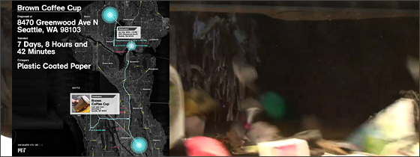
http://senseable.mit.edu/trashtrack/

Slide 30
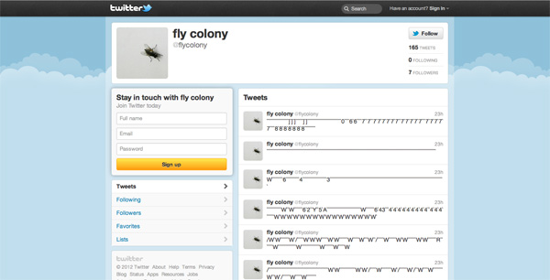
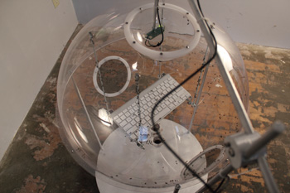
Gather Data Build your own system
Fly Tweet, David Brown
http://www.dwbowen.com/fly_tweet.html
Notes:
Fly Tweet

Slide 31
Notes:
Fly Tweet

Slide 32
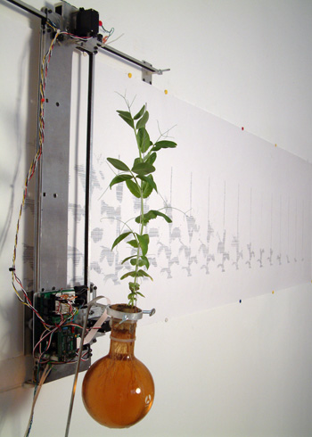
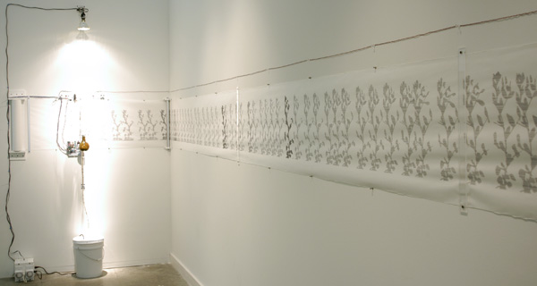
Gather Data Build your own system
Growth Rendering Machine, David Brown
http://www.dwbowen.com/growth.html

Slide 33
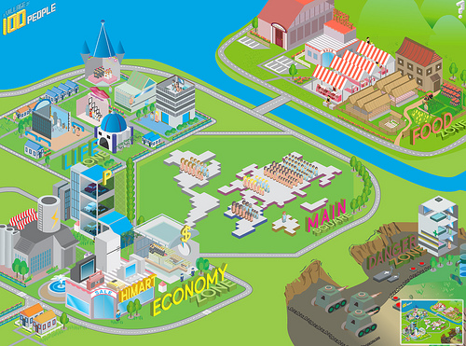
Gather Data You could fake the data (Under a certain purpose)
If the world were a village of 100 people
The statistics were derived from Donella Meadows "State of the Village Report" first published in 1990)
Notes:
If the world were a village of 100 people

Slide 35
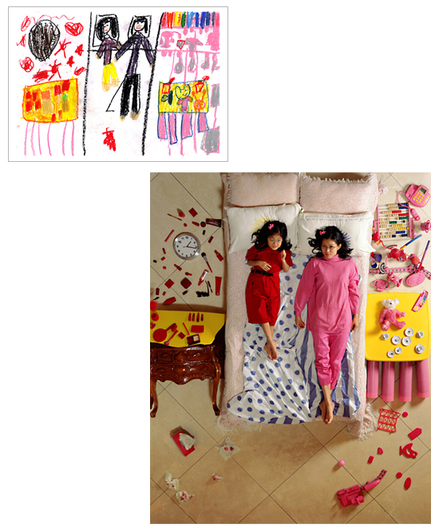
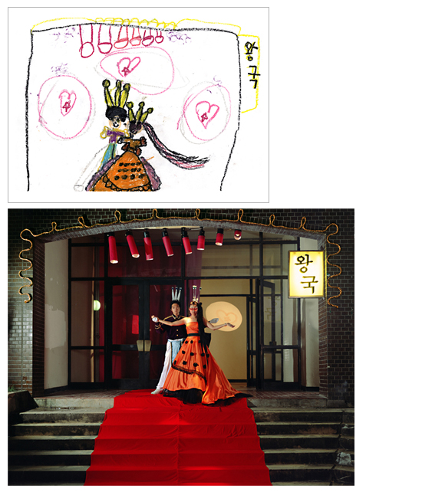
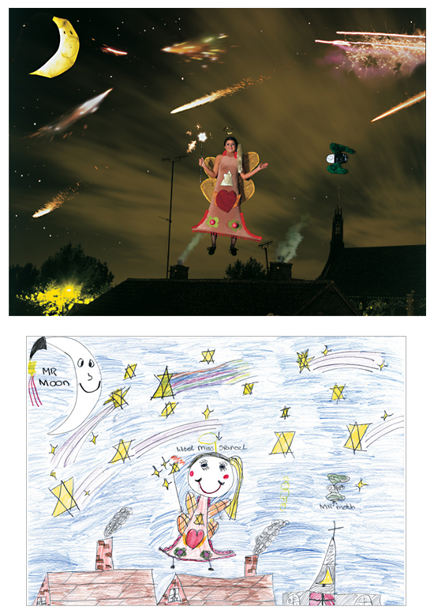
Gather Data Interview or do a survey
Wonderland. 2005 , Yeon Doo Jung
http://www.yeondoojung.com/artworks_view_wonderland.php?no=88
Notes:
Wonderland 2005 Yeon Doo Jung

Slide 36
Wonderland. 2005 , Yeon Doo Jung
Notes:
Wonderland 2005 Yeon Doo Jung

Slide 37
Wonderland. 2005 , Yeon Doo Jung

Slide 38
Wonderland. 2005 , Yeon Doo Jung

Slide 39



Gather Data Interview or do a survey
Balloons of Bhutan is a portrait of happiness in the last Himalayan kingdom
Balloons of Bhutan, Jonathan Harris
http://balloonsofbhutan.org/
Notes:
Wonderland 2005 Yeon Doo Jung

Slide 40
Question : what makes them happy, what is their happiest memory, what is their favorite joke, what is their level of happiness between 1 and 10, and, if they could make one wish, what would it be.
Result : Based on each person's stated level of happiness, I inflated that number of balloons, so very happy people would be given 10 balloons and very sad people would be given only one (but hey, it's still a balloon). Then I wrote each person's wish onto a balloon of their favorite color. I repeated this process for 117 different people, from all different ages and backgrounds.

Slide 41
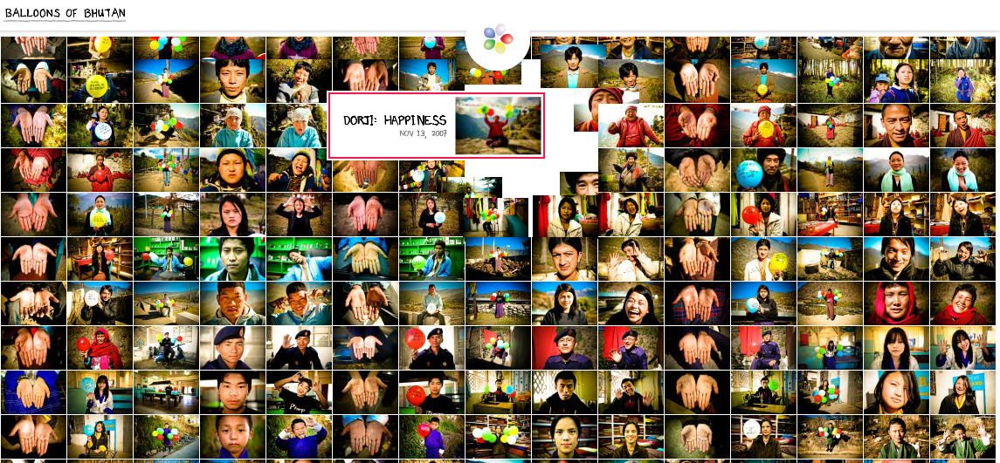
Balloons of Bhutan, Jonathan Harris
http://balloonsofbhutan.org/

Slide 42
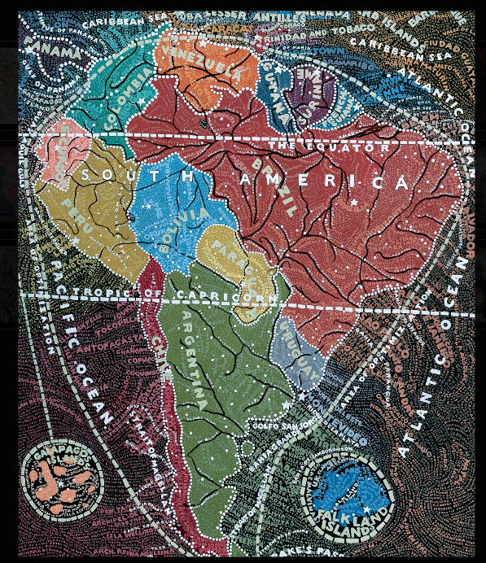
Gather Data You could fake the data (Under a certain purpose)
Maps, Paul Sacher
http://www.paulaschermaps.com/
Notes:
Paul Sacher Maps

Slide 44

Gather Data Create your own data
encrypted love letter, crocheted yarn
If a Mouth were to Whisper.. , Jeane Jo
http://www.jeannejo.com/portfolio/if-a-mouth-were-to-whisper/

Slide 45
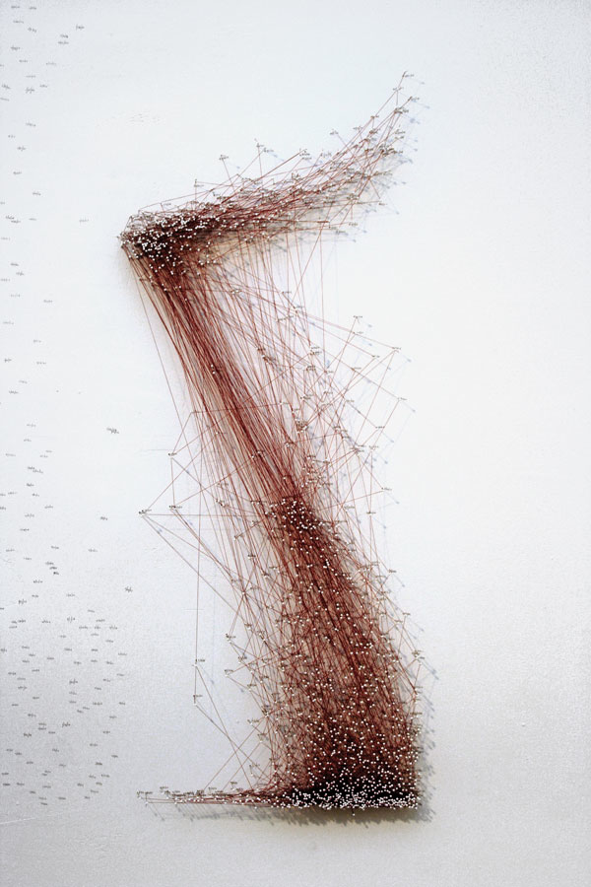
Gather Data Create your own data
Using simple tools like pins, thread and a pencil she mapped her sentiments on a invisible grid.
Each section of the grid on the wall is correlated with a different part of the body. Every time she felt a sensation in a particular area on her body, she documented the feeling onto the corresponding place on the grid with a pin and the date.
201 Days. pins, pencil, thread;
Mappin 201 days, Katie Lewis
http://katiehollandlewis.com/
Notes:
201 Days. pins, pencil, thread;

Slide 46
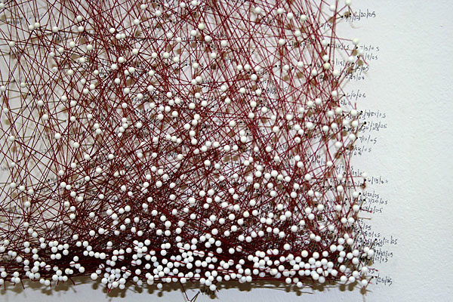

Slide 47
Apply Visual Representation

Slide 48
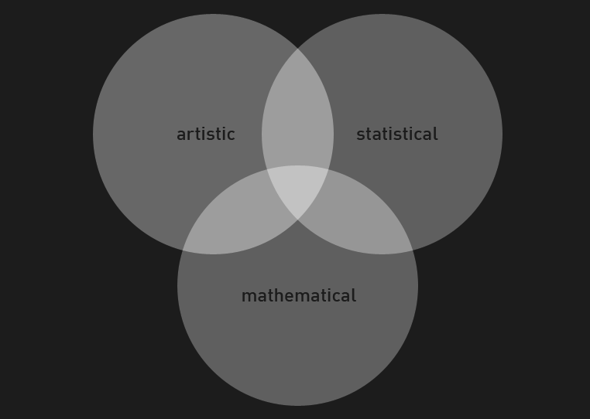

Slide 49
Edward Tufte
Edward Tufte : a pioneer in the field of data visualization
“Excellence in statistical graphics consists of complex ideas communicated with clarity, precision, and efficiency.”
Graphical Excellence
Edward R. Tufte
http://www.edwardtufte.com/

Slide 50
Edward Tufte
Publications
The Visual Display of Quantitative Information
Envisioning Information
Visual Explanations
Powerpoint is Evil

Slide 51
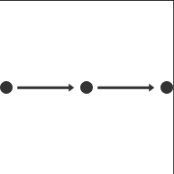
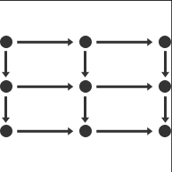
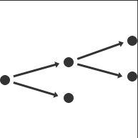
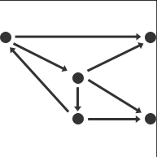


How is your data organized?
linear
tabular
hierarchical
networked
geographic
other

Slide 52
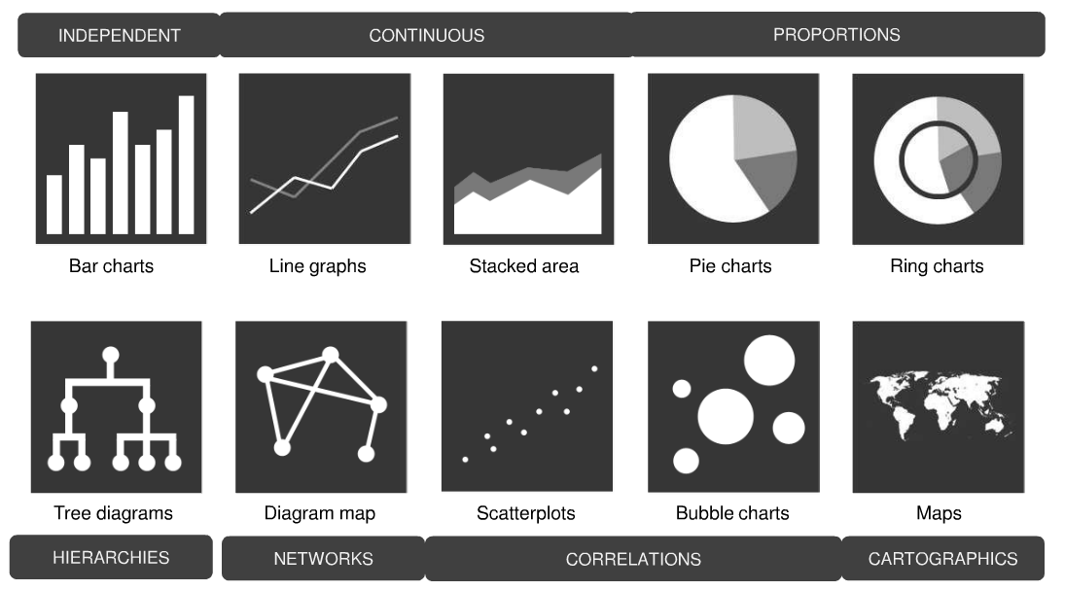
Data Visualization Patterns

Slide 53
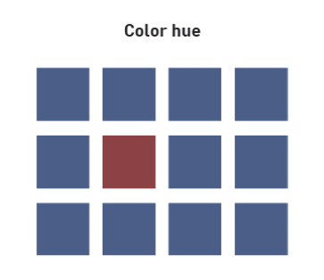
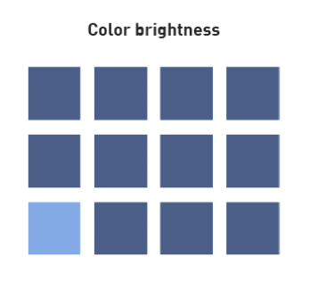
8 Presentative Variables

Slide 54
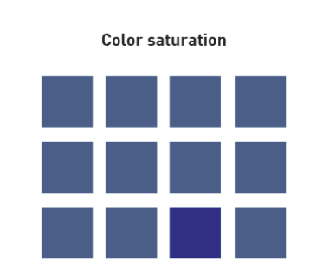
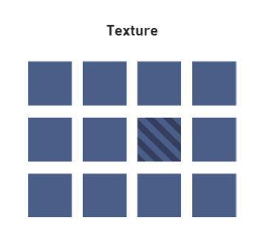

Slide 55
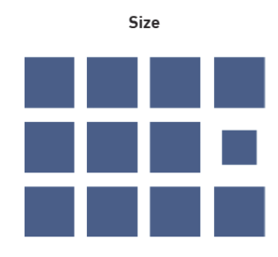
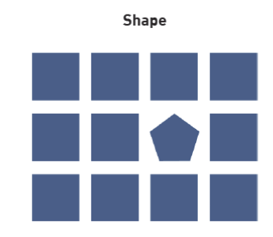

Slide 56
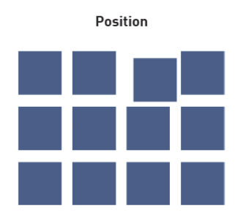
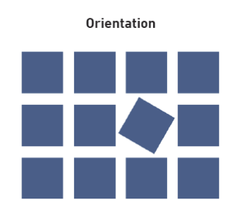

Slide 57
Apply Visual Representation

Slide 58
Text

Slide 59
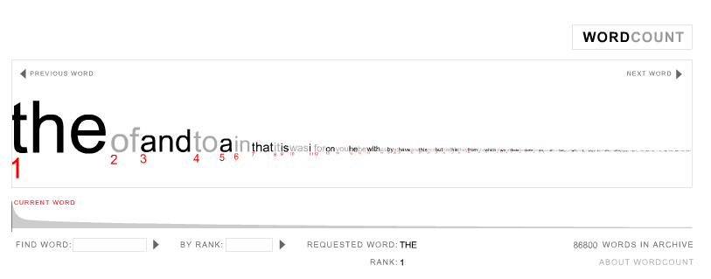
Subject Matter : Search Key Words
Word Count, Jonathan Harris
http://wordcount.org/
Notes:
Subject Matter : Search Key Words

Slide 60
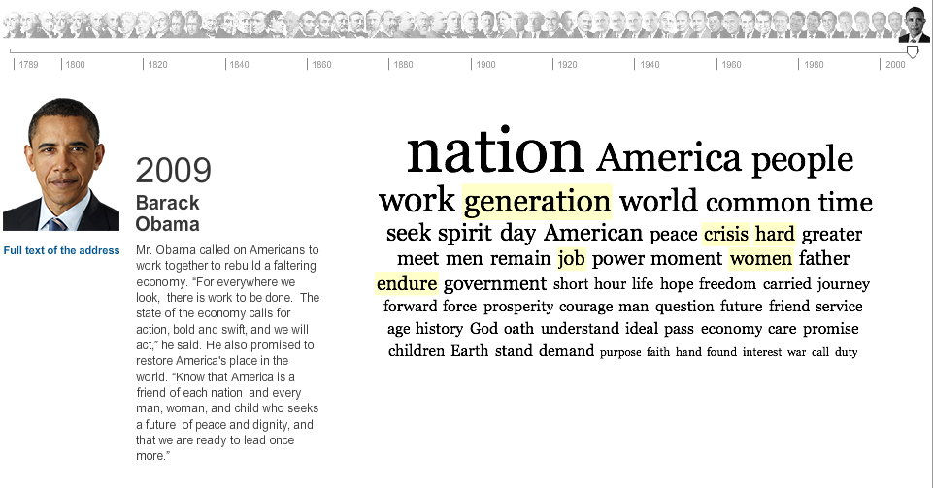
Subject Matter : Inaugural Words
Inaugural Words: 1789 to the Present, NYTimes
http://www.nytimes.com/interactive/2009/01/17/washington/20090117_ADDRESSES.html

Slide 61

Subject Matter : Highlighted words during presidency
Hindsight is Always 20/20, Luke DuBois
http://hindsightisalways2020.net/

Slide 62
Circular Forms

Slide 63
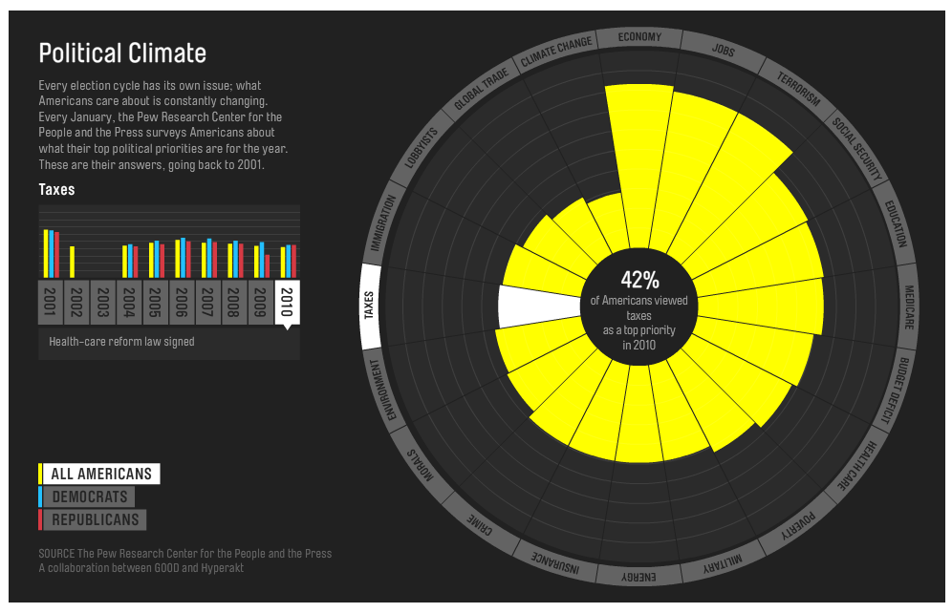
Subject Matter : Political Climate
http://awesome.good.is/transparency/web/1010/political-climate-chart/interactive.html

Slide 64
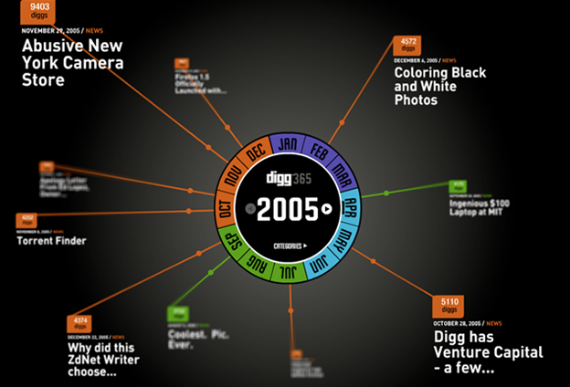
Subject Matter : Digg?
Barbarian Group Digg
http://barbariangroup.com/portfolio/digg_showcase
Notes:
Barbarian Group Digg

Slide 65
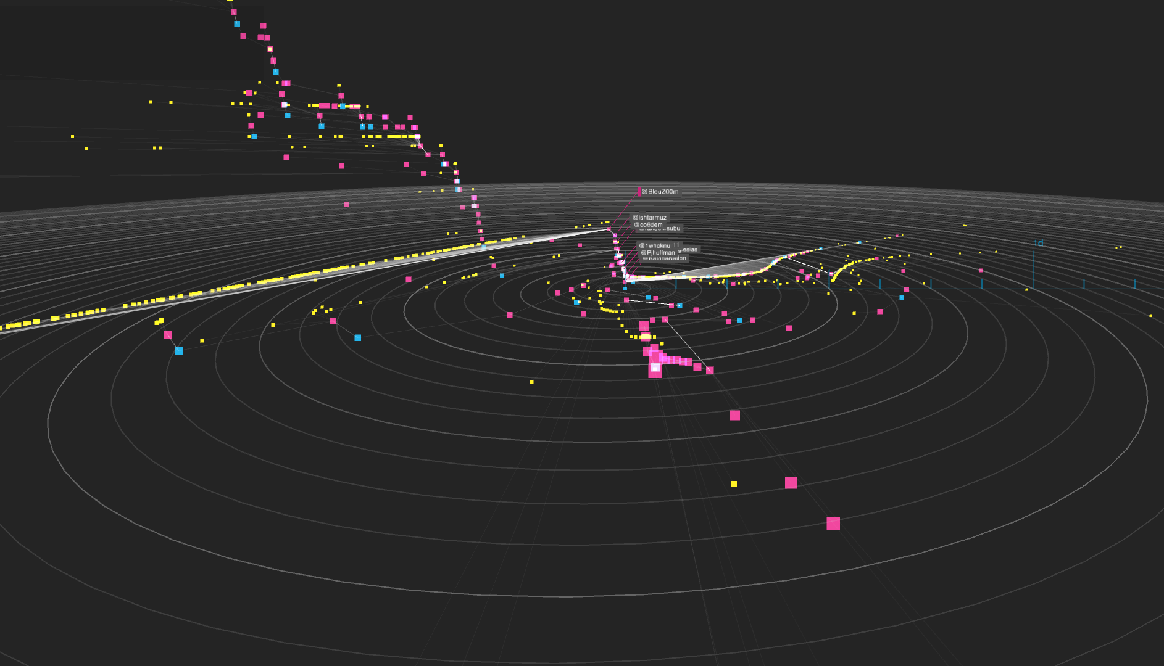
Subject Matter : Sharing pattern of the news
NYTimes Cascade
http://nytlabs.com/projects/cascade.html
Notes:
NYTimes Cascade

Slide 66

Subject Matter : Song
Shape of Song, MartinWattenberg
http://www.bewitched.com/song.html
Notes:
Shape of Song, MartinWattenberg

Slide 67
Particles

Slide 68

Subject Matter : Emotional Contents on the Web
Jonathan Harris
http://wefeelfine.org/
Notes:
Jonathan Harris

Slide 69

Subject Matter : Obama’s Budjet Proposal
http://www.nytimes.com/interactive/2012/02/13/us/politics/2013-budget-proposal-graphic.html?scp=3&sq=interactive%20graphics&st=cse
Notes:
Subject Matter : Obama’s Budjet Proposal

Slide 70
Bar Chart

Slide 71

Subject Matter : Sex Experience of People
http://sexperienceuk.channel4.com/the-sexperience-1000#/

Slide 72

Subject Matter : Weather - Temperature
Weather Tower, Belgian Design Agency Lab [au]
http://datavisualization.ch/showcases/weather-tower/
Notes:
Weather Tower

Slide 73
graphs

Slide 74

Subject Matter : Box Office Receipts
The Ebb and Flow of Movies: Box Office Receipts 1986 — 2008, NYtimes
http://www.nytimes.com/interactive/2008/02/23/movies/20080223_REVENUE_GRAPHIC.html

Slide 75
Illustrations

Slide 76

Subject Matter : Youtube Video Upload Amout per time
Youtube Visualization
http://www.onehourpersecond.com/
Notes:
Youtube Visualization

Slide 77

Subject Matter : Timeline of Personal Issues
Timeline, Oguz Akin
http://www.oguzakin.com/ill10.html
Notes:
Oguz Akin

Slide 78

Subject Matter : Need for Blood Donation
Canadian Blood Services
http://www.bloodsignal.ca/

Slide 79

Subject Matter : Slavery Footprint
Slavery Footprint
http://slaveryfootprint.org/survey/

Slide 80
Lines

Slide 81

Subject Matter : Geographically track the money spending of myself
The system, Mapped Out
Eroon Kang
http://www.eroonkang.com/projects/The-System-Mapped-Out/
Notes:
The system, Mapped Out

Slide 82


Slide 83

Subject Matter : Relationships of the Subjects
Moma, Design and Elastic Mind
http://www.moma.org/interactives/exhibitions/2008/elasticmind/
Notes:
Moma, Design and Elastic Mind

Slide 84


Subject Matter : Family Tree
Visual Geneology, Jinwan Park
http://fma.cau.ac.kr/park_web/index.files/Page305.htm
Notes:
Visual Geneology

Slide 85
Graph /timeline

Slide 86

Subject Matter : Time Magazine Cover
Time Magazine Covers, Software Studies (Lev Manovich)
http://lab.softwarestudies.com/p/research_14.html

Slide 87

Subject Matter : Mondrian Painting
Mondrian, Software Studies (Lev Manovich)
http://lab.softwarestudies.com/p/research_14.html

Slide 88

Subject Matter : Google Logo
Google, Software Studies (Lev Manovich)
http://lab.softwarestudies.com/p/research_14.html

Slide 89
Map

Slide 90


Subject Matter : Oil Spill
protei _ oil spill visualization, Sey Min
http://ttoky.com/sub/sub_protei.html

Slide 91

Subject Matter : Flight Pattern
Flight Pattern, Aaron Koblin
http://www.aaronkoblin.com/work/flightpatterns/index.html
Notes:
Flight Pattern, Aaron Koblin

Slide 92

Subject Matter : Cab Spotted Data
In Transit by Amy Balkin
http://cabspotting.org/

Slide 93
Grid / pixels

Slide 94

Subject Matter : Dead in Iran or Afgan
Faces of the Dead, NYTimes
http://www.nytimes.com/interactive/us/faces-of-the-dead.html#/may_kenneth_b_jr

Slide 95

Subject Matter : Sale
http://milliondollarhomepage.com/

Slide 96

Subject Matter : Pixels Drawn by Amazon Turk Users
Ten Thousand Cents, Aaron Koblin
http://www.tenthousandcents.com/
Notes:
Ten Thousand Cents, Aaron Koblin

Slide 97
Subject Matter : Dreams and Happiness of people in Bhutan
Balloons of Bhutan, Jonathan Harris
http://balloonsofbhutan.org/

Slide 98

Subject Matter : Face of the Marathon Runners
Addidas, the face of the marathon
http://www.adidas.com/campaigns/angesichtdesmarathons/content/index.asp?country=en

Slide 99

Subject Matter : Face of the Marathon Runners
Addidas, the face of the marathon
http://www.adidas.com/campaigns/angesichtdesmarathons/content/index.asp?country=en

Slide 100


Subject Matter : Face during the past 8 years
The Adaption to My Generation, a daily photo project, Jonathan Keller
http://jk-keller.com/daily-photo/
Notes:
The Adaption to My Generation, a daily photo project, Jonathan Keller

Slide 101
On ready Made

Slide 102

Subject Matter: Economic crisis and inequality
The income growth disparity in America is wider than it was
pre-Great Depression
http://occupygeorge.com/

Slide 103

In America, the average CEO earns 185 times more than the average worker.

Slide 104
Collage / misselaneous

Slide 105

Subject Matter: Desire to touch, or be touched
FleshMap, Martin Wattenberg
http://www.bewitched.com/fleshmap.html
Notes:
FleshMap, Martin Wattenberg 2008

Slide 106




Slide 107
Subject Matter: How we believe on incorrect information
Maps, Paul Sacher
http://www.paulaschermaps.com/
Notes:
Paul Sacher Maps

Slide 108
Converting into Physical

Slide 109

Physical Output
Subject Matter: Urgently Trashed News
Urgently! ,Aristarkh Chernyshev
a physical info-sculpture that displays news stories from the Internet in real time
http://www.youtube.com/watch?v=onMn9jQAJqc

Slide 110


Subject Matter: Dynamic Human Movement
Body Cloud
http://datavisualization.ch/showcases/bodycloud/
Notes:
Body Cloud

Slide 111

Subject Matter : Long Distance SMS Messages
SMS to paperplanes
Christian Groß
http://www.christiangross.info/en/sms-to-paper-airplanes/
Notes:
SMS to paperplanes

Slide 112
Subject Matter : Massive Flickr Uploads
Erik Kessels, 24 hours in photos:
http://www.creativereview.co.uk/cr-blog/2011/november/24-hours-in-photos

Slide 113
Subject Matter : Fantasy and dreams of childhood
Wonderland. 2005 , Yeon Doo Jung
Notes:
Wonderland 2005 Yeon Doo Jung

Slide 114
Artists & Organizations
Organizations
NYTimes R & D Lab http://nytlabs.com/
IBM Many Eyes http://www-958.ibm.com
MIT Sensible City Lab http://senseable.mit.edu/
Software Studies Lab by Lev Manovich http://lab.softwarestudies.com/
Artist
Lev Manovich http://manovich.net
Aaron Koblin http://www.aaronkoblin.com/
Jonathan Harris http://www.number27.org/
Martin Wattenberg http://www.bewitched.com/
Jer Thorp http://blog.blprnt.com/
George Legrady http://www.georgelegrady.com/
Ben Fry http://benfry.com/
Nicholas Feltron http://feltron.com (Information Design)
Edward Tufte http://www.edwardtufte.com/tufte/ (Information Design)

Slide 115
Blog, Websites, Books
Blog/Websites
http://www.visualcomplexity.com/
http://infosthetics.com/
http://flowingdata.com/
http://www.visualizing.org/
http://datavisualization.ch/
Books
Data flow 1, Data flow 2, Gestalten (Information Design)
Beautiful Visualization, Oreilly Media
Designing Data Visualizations, Oreilly Media

