Slide 1
Introduction to API
Week 09
TCNJ Web 2
Jean Chu

Slide 2
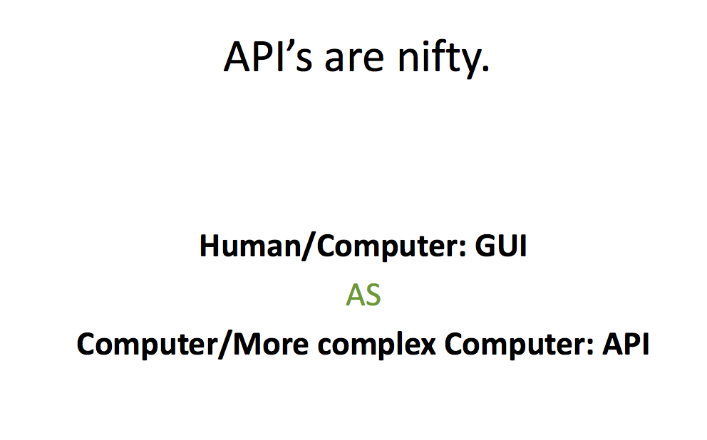
Shamefully Stolen from http://www.binaryspark.com/classes/

Slide 3
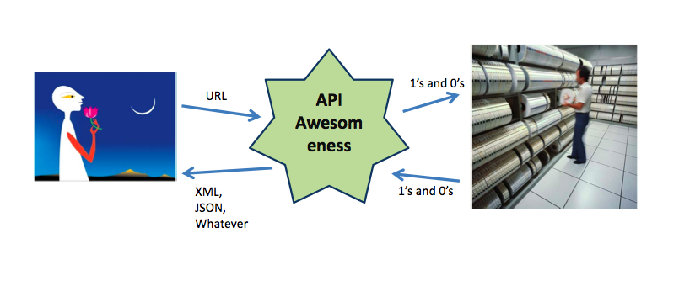
Shamefully Stolen from http://www.binaryspark.com/classes/

Slide 4
Application Programming Interface (Api)
Through the API you are able to call functions from a web service.
An API is an interface implemented by a software program that enables it to interact with other software. Consider it similar to the way the user interface facilitates interaction between humans and computers.

Slide 5
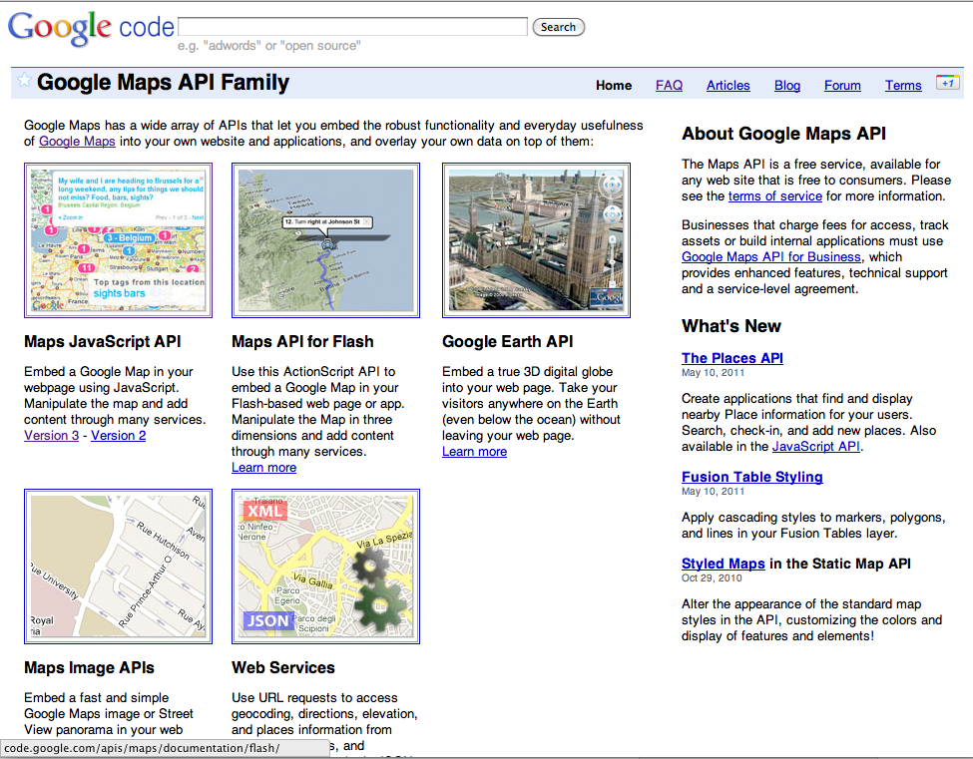
Google Map API
http://code.google.com/apis/maps/documentation/javascript/

Slide 6
"The Google Maps Javascript API lets you embed Google Maps in your own web pages.
Get Key Access
Application Programming Interface (API) Key to access the API
  https://code.google.com/apis/console
https://developers.google.com/maps/documentation/javascript/

Slide 7
Google Map Geocoding
Geocoding
  "Geocoding is the process of converting addresses (like "1600 Amphitheatre Parkway, Mountain View, CA") into geographic coordinates (like latitude 37.423021 and longitude -122.083739), which you can use to place markers or position the map. The Google Maps API provides a geocoder class for geocoding addresses dynamically from user input." - Google –
https://developers.google.com/maps/documentation/javascript/geocoding

Slide 8
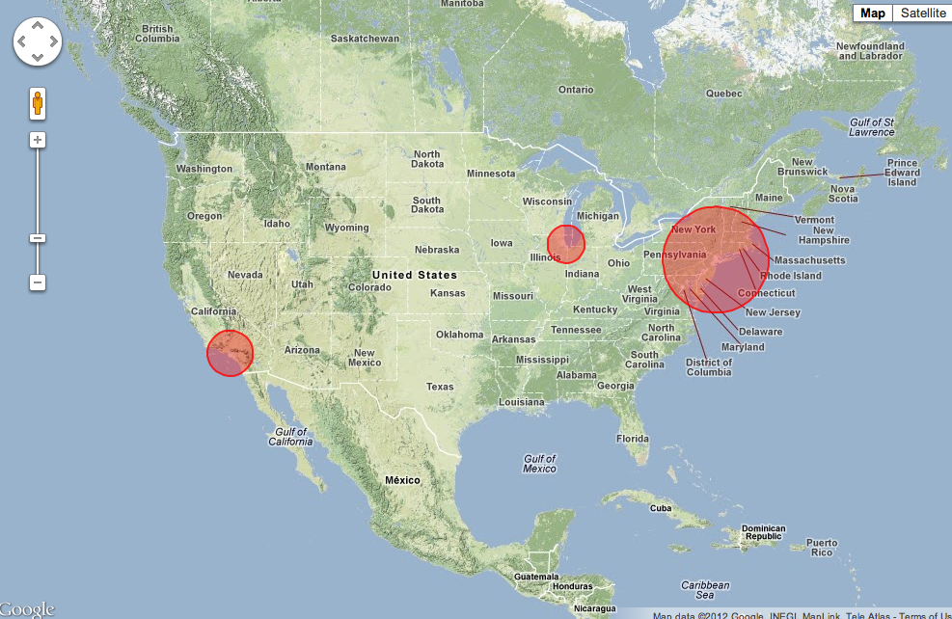
Google Map API
http://code.google.com/apis/maps/documentation/javascript/examples/circle-simple.html

Slide 9
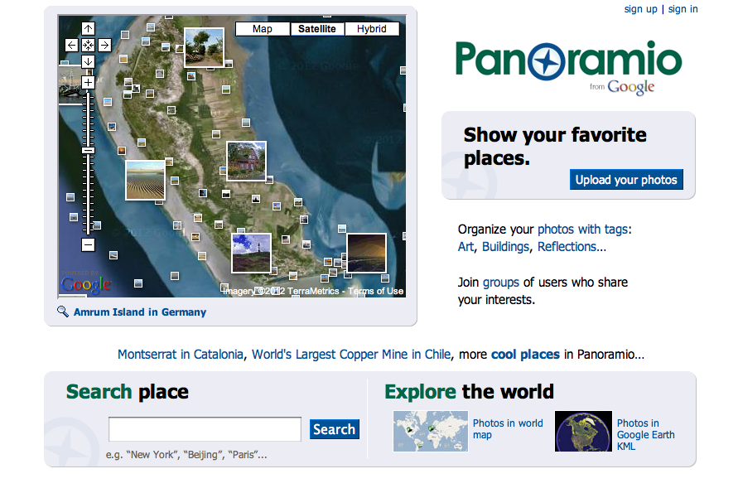
Cf) Panoramio
http://www.panoramio.com/

Slide 10
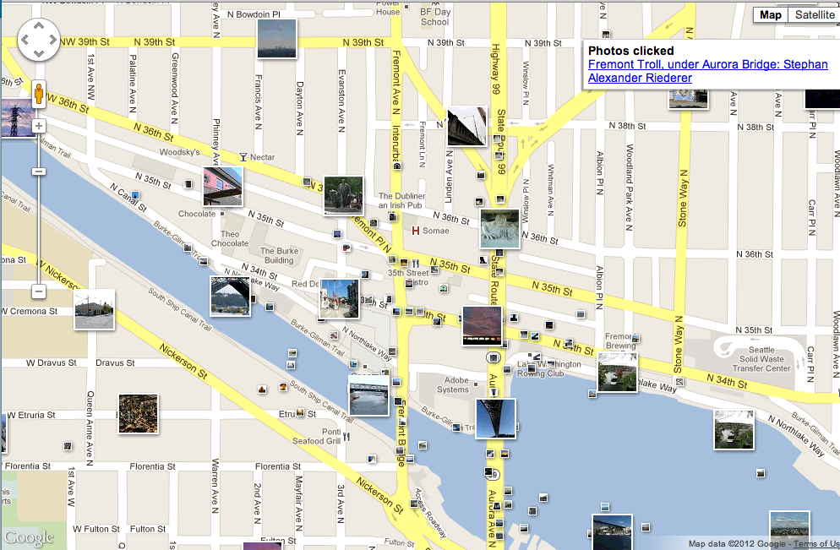
Google Map API Examples (Panoramio)
http://code.google.com/apis/maps/documentation/javascript/examples/layer-panoramio.html

Slide 11

New York Times API
http://developer.nytimes.com/

Slide 12
New York Times API
APIs
  The Article Search API
  The Best Sellers API
  The Community API
  The Event Listings API
  The Most Popular API
  The Movie Reviews API
  The Real Estate API
  The Times Newswire API
  The TimesPeople API
  The TimesTags API
  The Semantic API
  The Geographic API
  The Campaign Finance API
  The Congress API
  The Districts API
  The NY State Legislature API
Internal NYTimes Data
External NYTimes data they are hosting for fun
http://developer.nytimes.com/
Notes:
Internal NYTimes Data

Slide 13
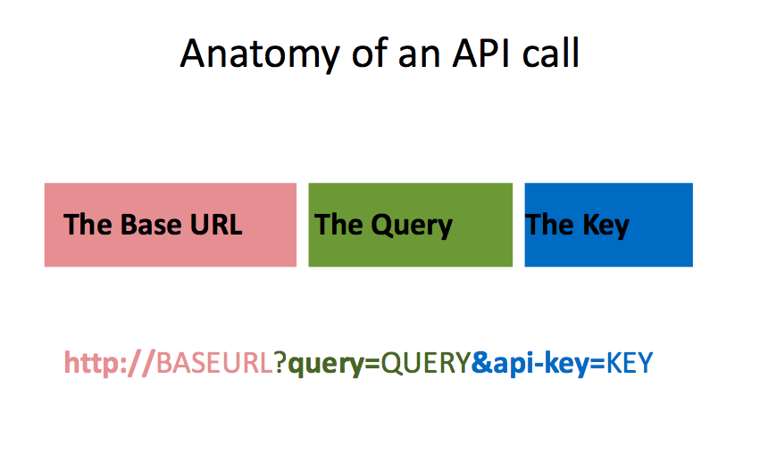
http://api.nytimes.com/svc/search/v1/article?format=json&query=starbucks
&api-key=904d40d226b4eb6aec79fe4e36ee86c4:8:55993044%20

Slide 14
Request an API Key
  http://developer.nytimes.com/apps/register
All API keys has to be requested and registered and would give you different api keys
We will use in class
Article Search API and
Newswire API
API Key : 904d40d226b4eb6aec79fe4e36ee86c4:8:55993044
API Key : b4525fbaa93223c48893726e76c00370:6:55993044

Slide 15
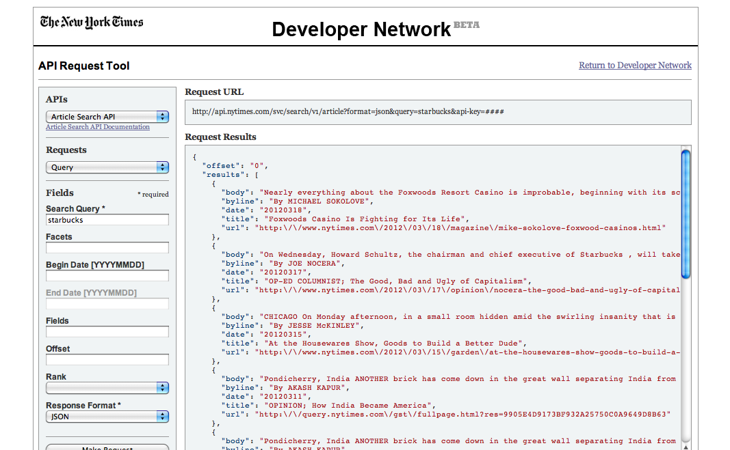
API Request Tool
  http://prototype.nytimes.com/gst/apitool/index.html

Slide 16
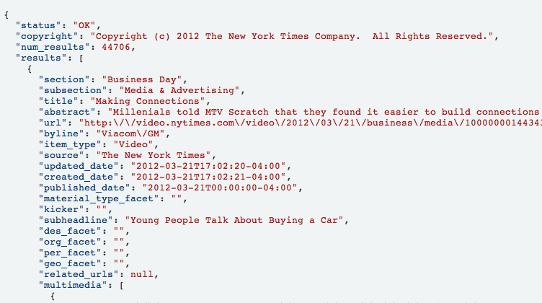
Results
Json

Slide 17
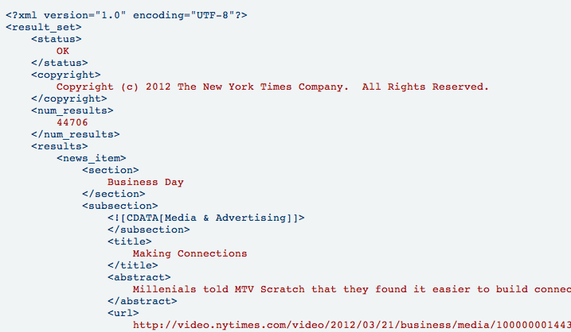
Results
XML

Slide 18
Parsing the Data
$articleSearchUrl=“http://api.nytimes.com/svc/search/v1/article?format=json&query=starbucks&api-key=904d40d226b4eb6aec79fe4e36ee86c4:8:55993044%20”
$json=file_get_contents($articleSearchUrl);
$obj = json_decode($json);
Reads entire file into a string
Decodes a JSON String : Takes a JSON encoded string and converts it into a PHP variable

Slide 19

Twiiter API
Search API
Rest API
Streaming API
https://dev.twitter.com/

Slide 20
Search API Search Query
http://search.twitter.com/search.json?callback=?&q=starbucks
baseurl
query
Notes:
query

Slide 21
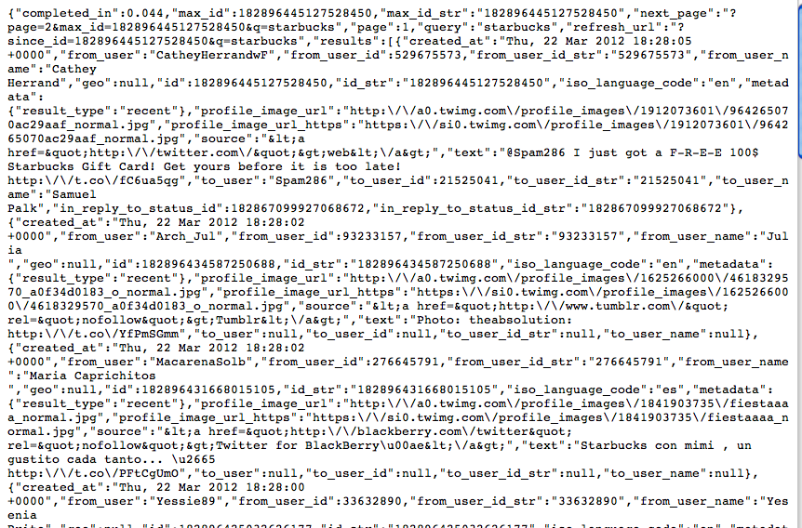
Json Results

Slide 22
Parse json
jQuery
PHP
jQuery.getJSON( url, [data], [callback] )
json_decode($json);

Slide 23
Get Twitter Search Json using JQuery
jQuery.getJSON( url, [data], [callback] )
The first parameter of this function, the URL you are planning to read, is required. The second parameter is used if you need to POST data to the URL. Last but no least, the callback function, although not required, is almost always necessary.
Important: The URL can be to a local or external file. If the file is in another server the URL must contain a callback variable. You’ll see how this works in the next paragraphs.
http://webhole.net/2009/11/28/how-to-read-json-with-javascript/

Slide 24
More to be found!
Research and experiment!

