Slide 1
Cookies / Sessions
Week 10 TCNJ Web 2
Jean Chu

Slide 2

Webpages have no memories.

Slide 3
Cookies, Sessions
Session and cookies enable the website you are visiting to keep track of your movement from page to page.
Example : Shopping cart feature of any e-commerce site.

Slide 4
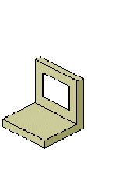
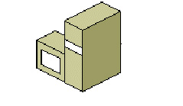
cookies store data in the user’s web browser
sessions store data on the server itself
<
First, sessions are likely more secure in that all of the recorded information is stored on the server and not continually sent back and forth between the server and the client. Second, you can store more data in a session. Third, some users reject cookies or turn them off completely. Sessions, while designed to work with a cookie can function without them, too.
Notes:
<

Slide 5
How to Use Sessions
Start
Store
Destroy
session_start()
unset($_SESSION['views']);
or
session_destroy();
$_SESSION['views']=1;
Or update
if(isset($_SESSION['views'])){
$_SESSION['views']=$_SESSION['views']+1;
}

