Slide 1
User Experience Design & Usability
Week 12
TCNJ Web 2
Jean Chu

Slide 2
Now you have something that YOU have produced…
Let’s try to think as another person, as a USER

Slide 3
User Experience Usability
User Experience
Usability
How the User Feels,
What service to provide
User Friendliness & Efficiency of the Interface

Slide 4
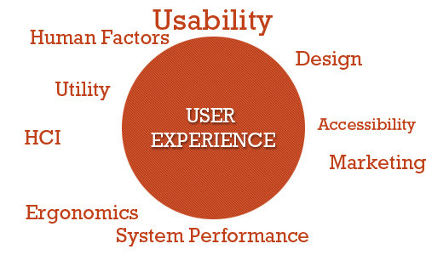
http://uxdesign.smashingmagazine.com/2010/10/05/what-is-user-experience-design-overview-tools-and-resources/

Slide 5

Flow : The Psychology of Optimal Experience

Slide 6
According to “Flow”…
Flow : "being completely involved in an activity for its own sake.”
People enter a flow state when they are fully absorbed in activity during which they lose their sense of time and have feelings of great satisfaction.

Slide 7
According to “Flow”…
How does it feel to be in "the flow"?
Completely involved, focused, concentrating - with this either due to innate curiosity or as the result of training
Sense of ecstasy - of being outside everyday reality
Great inner clarity - knowing what needs to be done and how well it is going
Knowing the activity is doable - that the skills are adequate, and neither anxious or bored
Sense of serenity - no worries about self, feeling of growing beyond the boundaries of ego - afterwards feeling of transcending ego in ways not thought possible
Timeliness - thoroughly focused on present, don't notice time passing
Intrinsic motivation - whatever produces "flow" becomes its own reward
Notes:
Theegofallsaway.Timeflies.Everyaction, movement, and thought follows inevitably from the previous one, like playing jazz. Your whole being is involved, and you're using your skills to the utmost.”

Slide 8
Techniques Of UX Design

Slide 9
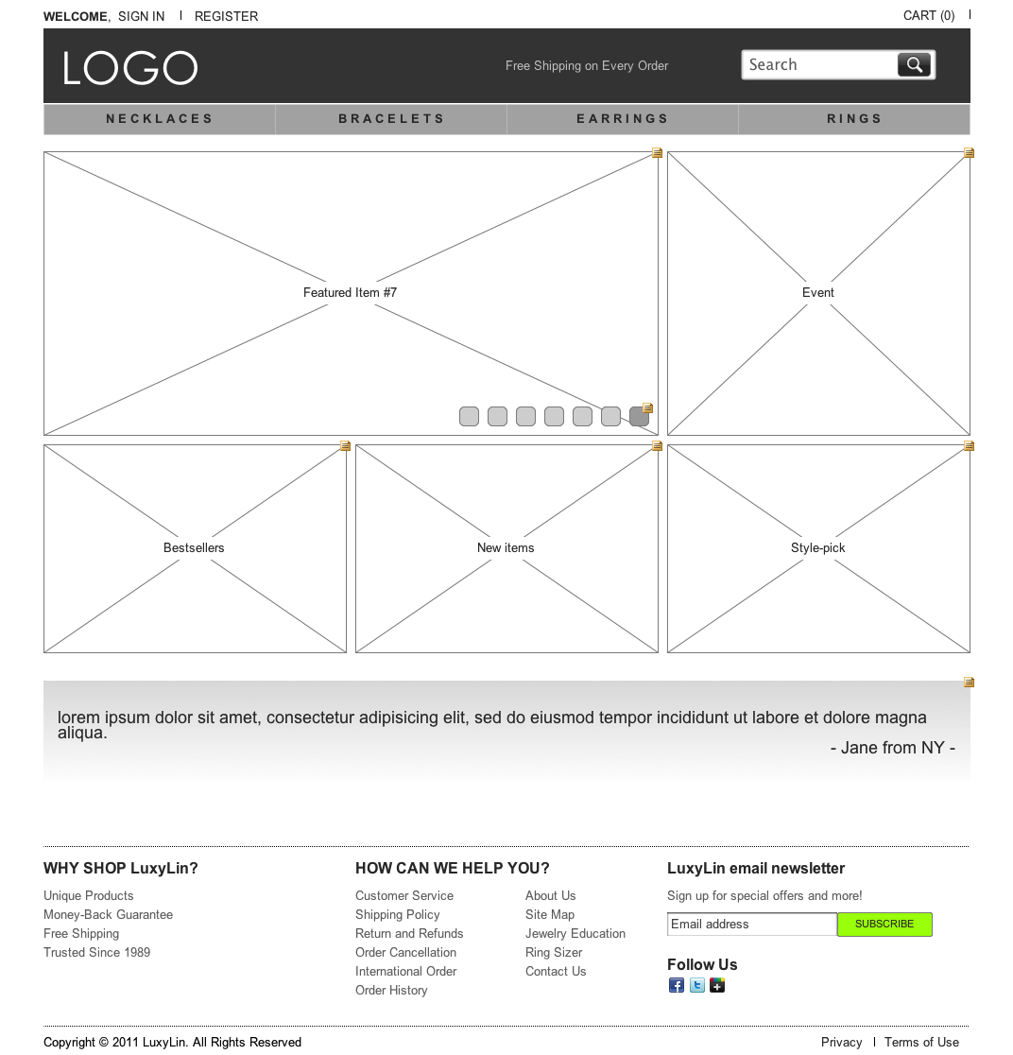
Wireframing
http://sokions.com/

Slide 10
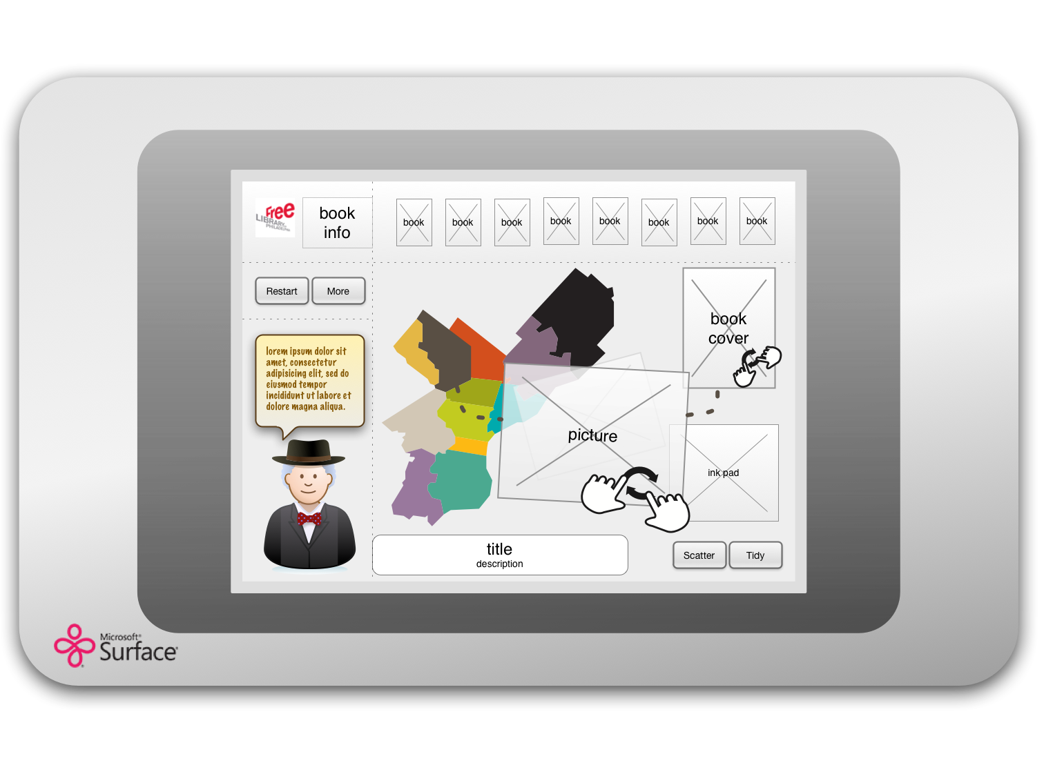
Wireframing
http://sokions.com/

Slide 11
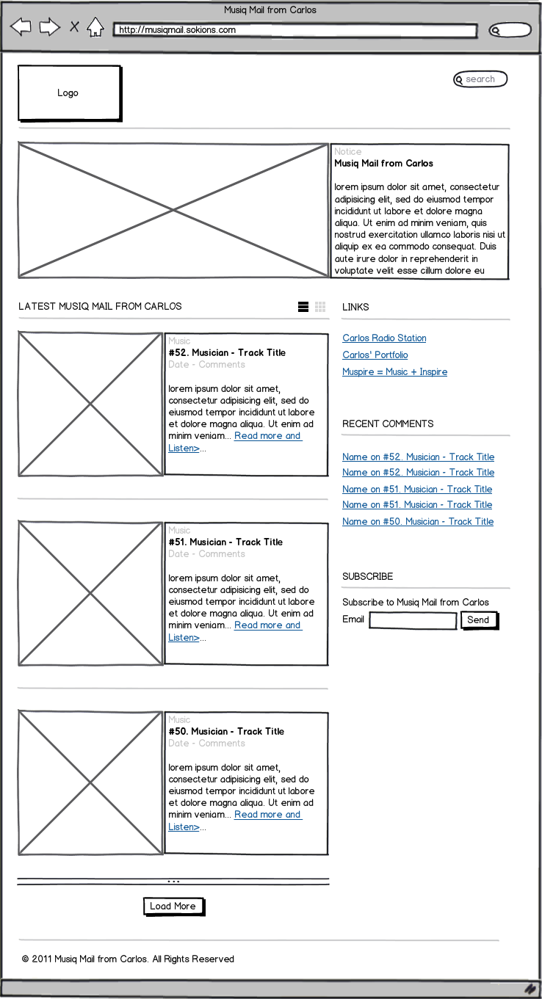
Wireframing
http://sokions.com/

Slide 12
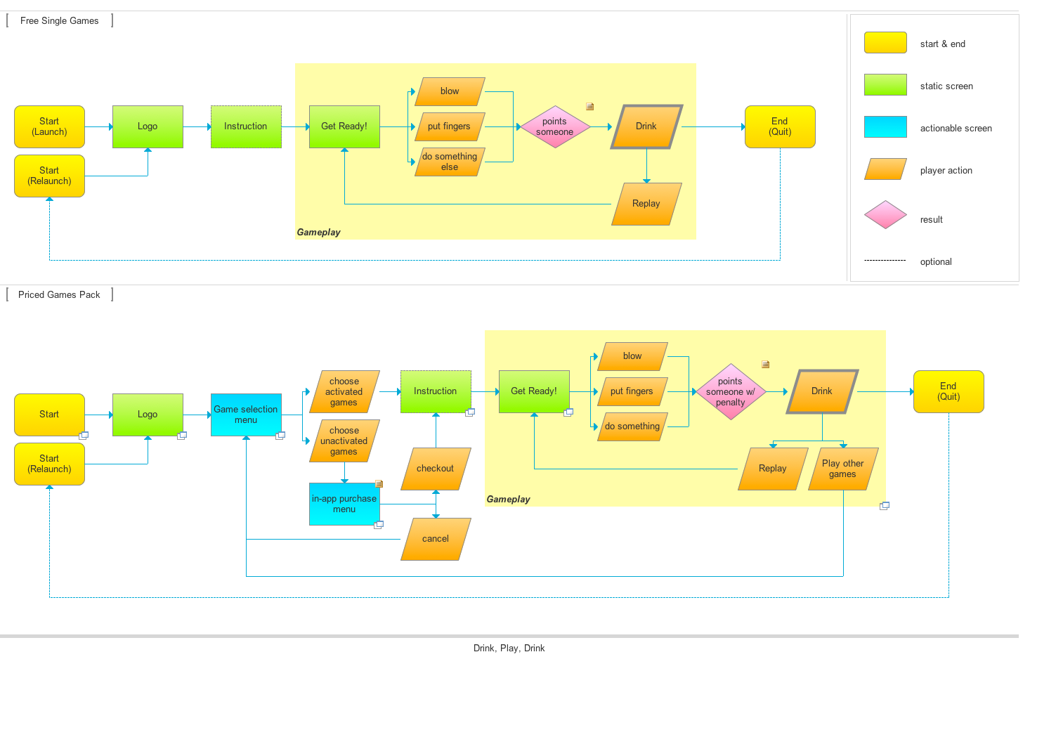
User Flowchart
http://sokions.com/

Slide 13
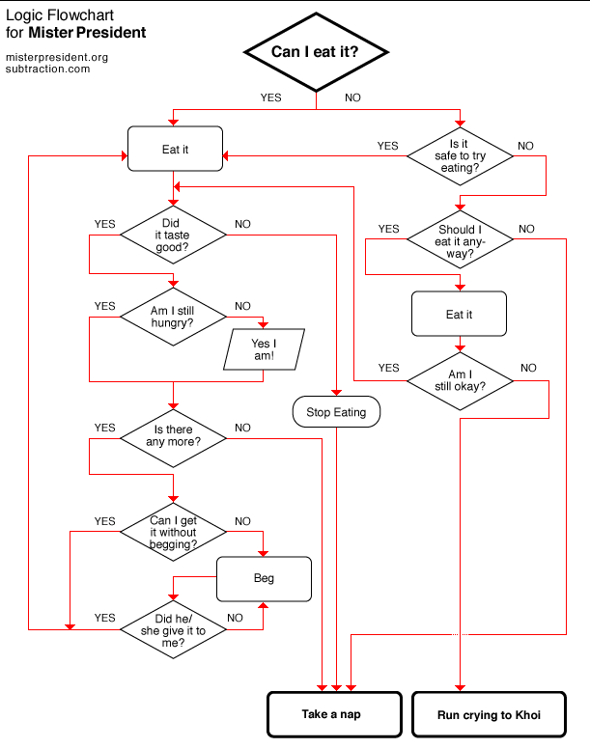
Example : Think like a dog (Khoi Vinh )
http://www.subtraction.com/

Slide 14
Personas & User Scenarios
User 1 : Jenny, 20 year old female
She has 10 browsers open and texting with her friend, listening to itunes. She saw someone talking about the website random.com and came to your website. She thinks it would be fun to use it. She tries to sign in, but suddenly got distracted since, one of her friend talks to her messenger…………. …………. …………. …………. …………. …………. …………. …………. …………. …………. …………. …………. …………. …………. …………. …………. …………. …………. …………. …………. …………. …………. …………. …………. …………. …………. …………. …………. …………. …………. …………. …………. …………. …………. …………. …………. …………. …………. …………. …………. …………. …………. …………. …………. …………. …………. …………. …………. …………. …………. ………….

Slide 15
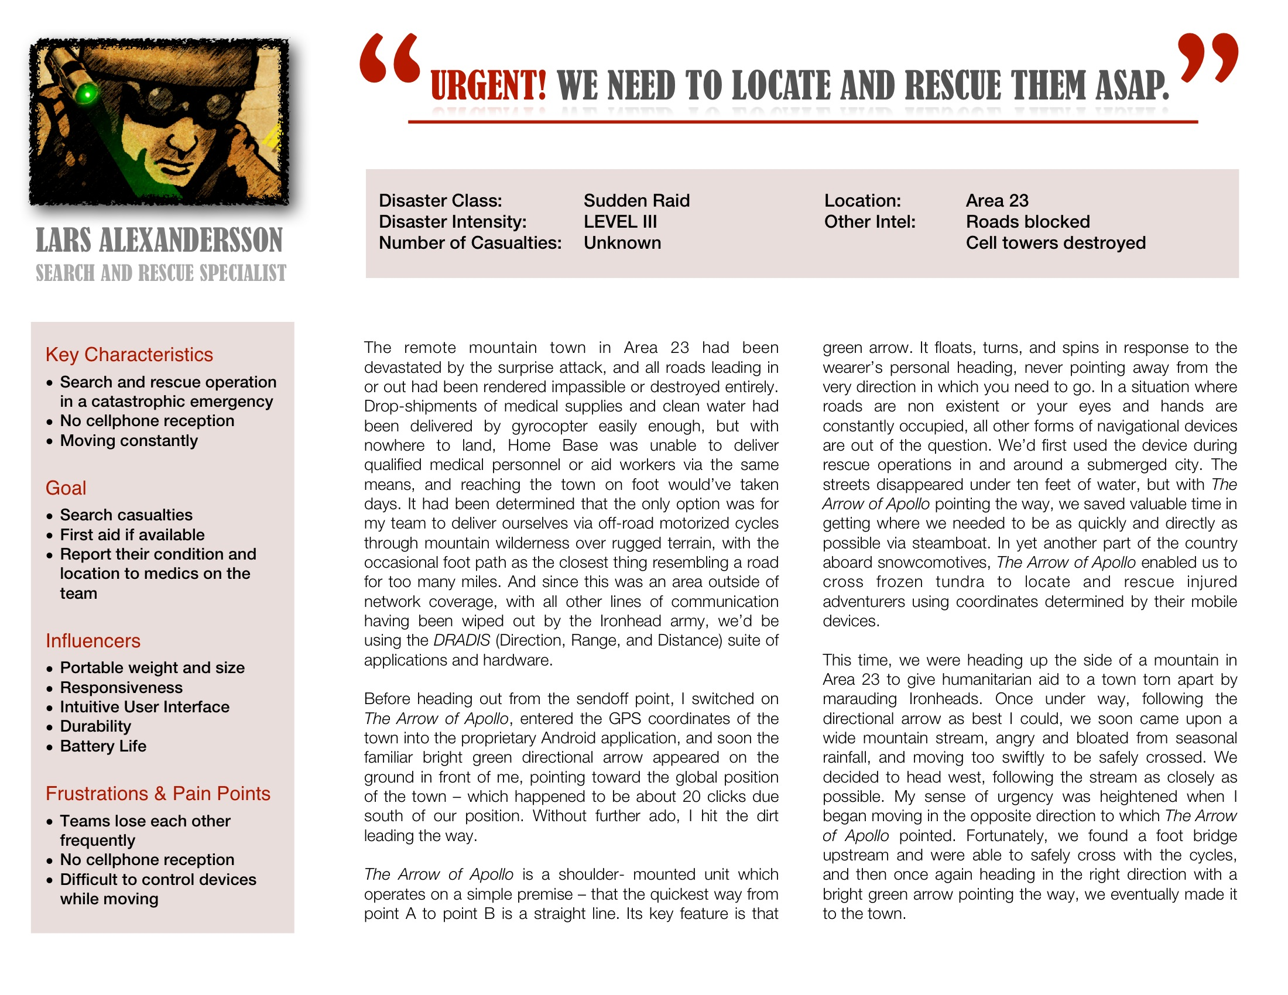
Personas & User Scenarios
http://sokions.com/

Slide 16
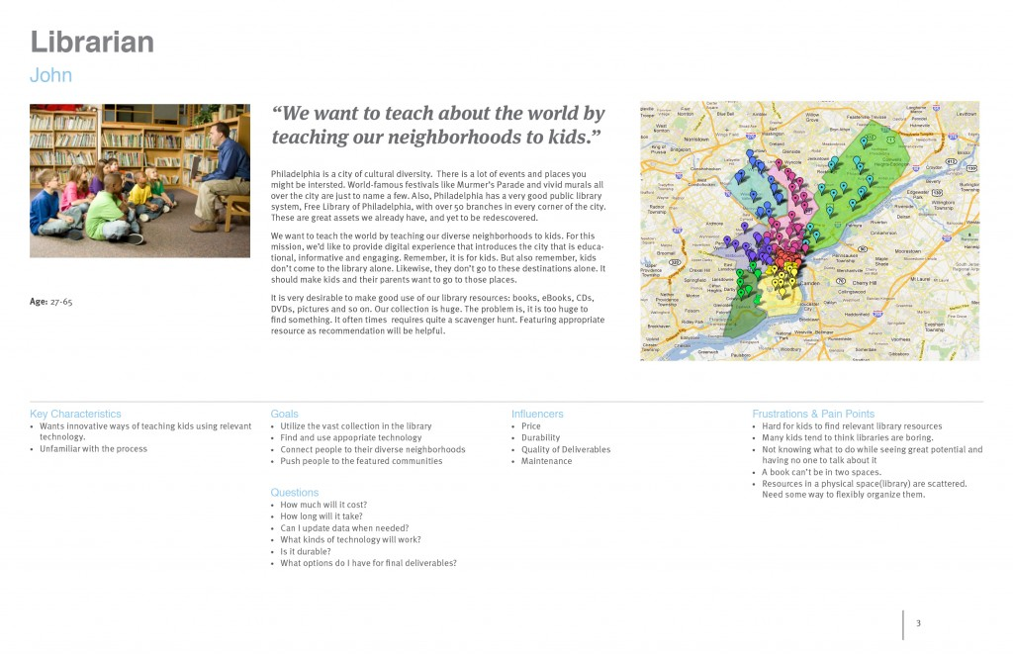
Personas & User Scenarios
http://sokions.com/

Slide 17

Reference : The Elements of User Experience

Slide 18
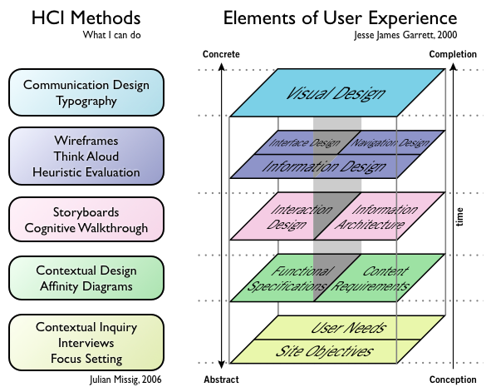
Usability

Slide 19
Usability

Slide 20

Don’t Make me THINK

Slide 21
According to “Don’t make me THINK”
We don’t read pages. We scan them.
We don’t make optical choices. We satisfice.
Create a clear visual hierarchy
Keep the noise down to a dull roar.
Omit Useless words
Break up pages into clearly defined areas.
Make it obvious what’s clickable
And more…
So how should we design the page?
Notes:
So how should we design the page?

