Slide 1
Coding for Mobile
Week 13
TCNJ Web 2
Jean Chu

Slide 2
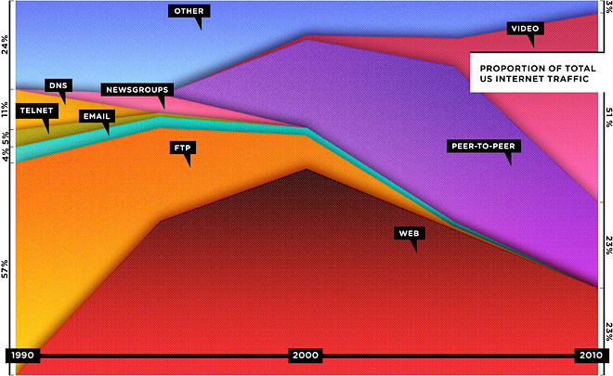
Web is Dead. Long live the Internet
http://www.wired.com/magazine/2010/08/ff_webrip/all/1

Slide 3
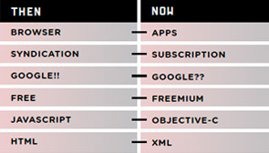
http://www.wired.com/magazine/2010/08/ff_webrip/all/1

Slide 4
Coding Web for Mobile

Slide 5
Mobile Specific Meta Tags
<meta name = "viewport" content = "width = device-width; initial-scale=1.0; maximum-scale=1.0; user-scalable=no;" />
<meta name="HandheldFriendly" content="True" />

Slide 6
Detect the browser and redirect
Detect the Browser
<?php $_SERVER[‘HTTP_USER_AGENT’]; ?>
Redirect to the mobile page
<?php header('Location: http://www.example.com/'); ?>

Slide 7
Detect the browser and redirect
- Easy Way to Use a library
http://www.detectmobilebrowsers.mobi/
require_once('mobile_device_detect.php');
$mobile =mobile_device_detect(true,false,true,true,true,true,true,'http://www.domain-name.com/m/',false);

Slide 8
Extra : Click to Call Mobile
<a href="tel:555-555-5555">555-555-5555</a>

Slide 9
Validating Code
http://validator.w3.org/mobile/

Slide 10
Simulators
iphone
  http://testiphone.com/
Blackberry
  http://us.blackberry.com/developers/resources/simulators.jsp
Android
  http://developer.android.com/sdk/index.html
Notes:
Mobile Web (Oreilly Media)
Mobile Design and Development (Oreilly Media)

Slide 11
BUILD Mobile Web / APP USING jQUERY MOBILE
Using jQuery Mobile (alpha version yet)

Slide 12
jQuery Mobile
It is Alpha Version so far (Not even Beta)
  http://jquerymobile.com/
  http://jquerymobile.com/demos/1.1.0/
HTML5 markup-driven
Supports Mobile only events (Tap, Swipe, etc)

