Slide 1
Presenting & Proposing your work
Week 13
TCNJ web 2
Jean Chu

Slide 2
Awards , Commissions
Student Awards for Interactive Projects (For completed projects)
  Adobe : http://www.adobeawards.com/us/
  CHI : http://chi2012.acm.org/cfp-students.shtml
Artist Commissions for Net Art Proposals (For ongoing projects)
  Turbulence : http://turbulence.org/guidelines.html
  Rhizome : http://rhizome.org/commissions/submit/
And more…

Slide 3
What to Submit?
Example (Adobe)
  Description : Describe Briefly (500 Characters)
  Objective : Communication Objective (1000 Characters)
  Date of Completion
  Tools Used
  Representative Images
  The Work (PDF or Images or URL to show your work)
    For Interactive Projects, URL can be used to show a demo of your work, animations, large series of posters or images

Slide 4
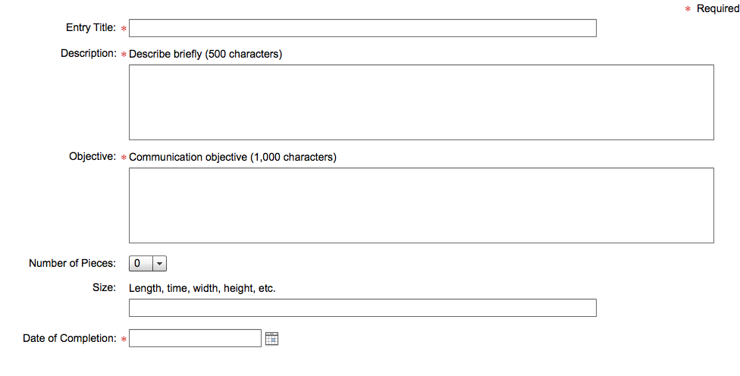

Slide 5
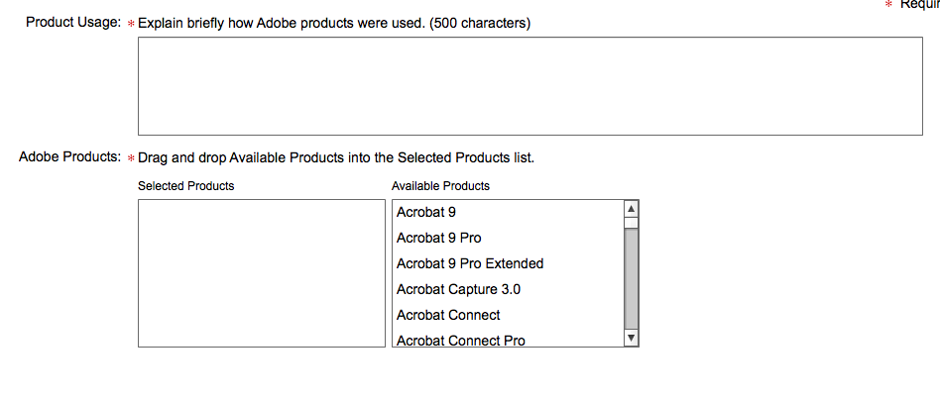

Slide 6
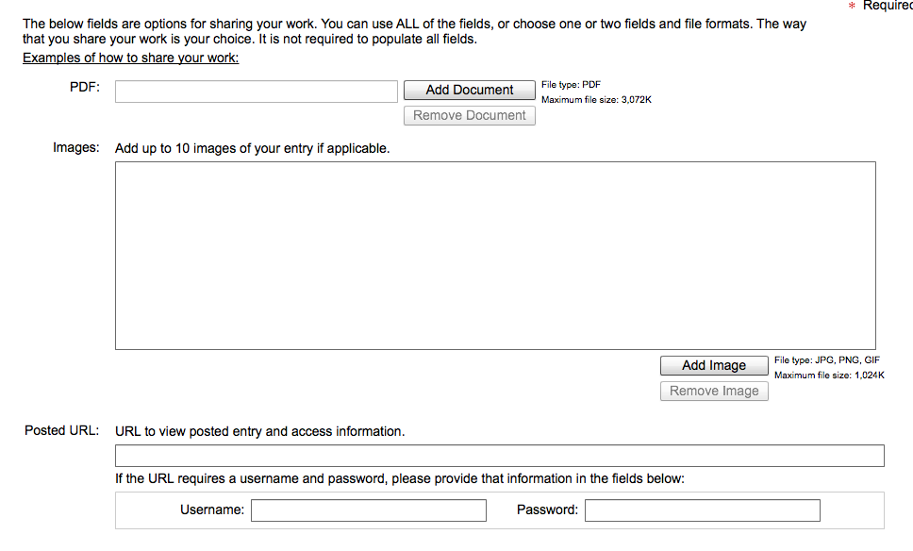

Slide 7
Examples of Winners
Mobile Design
  http://www.marcosswald.adaagallery.com/
Browser Based Design
  http://www.andrewmahon.adaagallery.com/
  http://www.joshhepworth.adaagallery.com/
  http://www.natalieschultz.adaagallery.com/
  http://www.sumitpaul.adaagallery.com/
Application Development
  http://www.laurabordin.adaagallery.com/
  http://www.qianliu.adaagallery.com/
  http://www.paulhoppe.adaagallery.com/
  http://www.chrismendez.adaagallery.com/

Slide 8
What to Submit?
Example (Commission to Rhizome)
  Summary
    A one-line overview of the project. Limit 140 characters)
  Description
    An general overview of the project, including a statement of intent.
  Your CV/BIO
    Please include a resume, bio, or c.v. for yourself and any artists involved with the project.
    Please outline relevant skills, past projects, any shows that you've had or in which you've participated.
  Project Timeline & Budget
    Please include a year-long, step-by-step breakdown detailing how you intend to execute your project, include anticipated costs in labor, materials, etc.
    Please provide a estimated grand-total cost for the project.
  Work Samples (MAX 4 Samples)
    Please provide samples and summaries of previous works you've completed, particularly works that share similarities in style or execution to the current proposal.

Slide 9
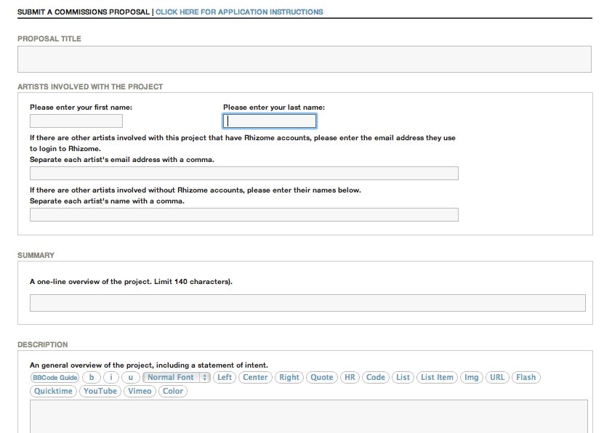

Slide 10
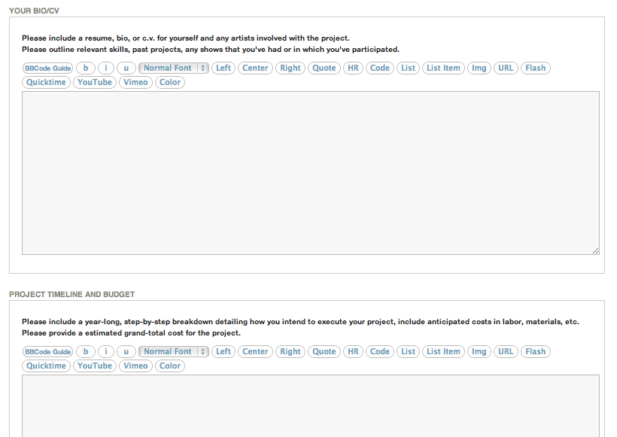

Slide 11
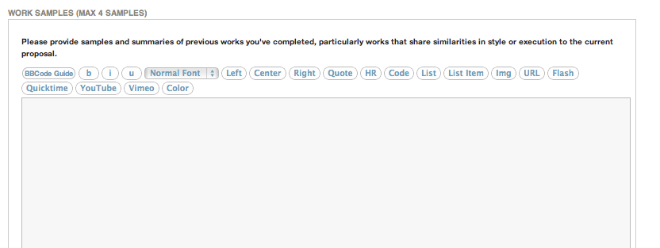
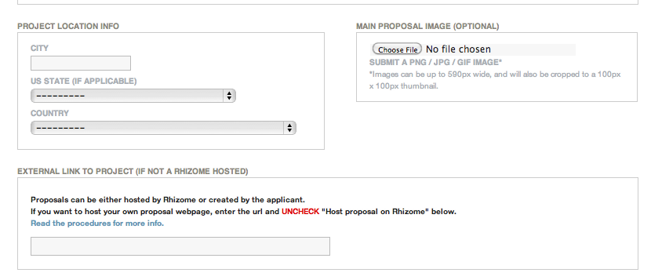

Slide 12
Demonstrating your work
Use Screen Recorder Programs to to demo
  Windows & Mac
    Camtasia (Video Capture, paid) http://www.techsmith.com/camtasia.html
    Snaggint (Screen Capture, paid) http://www.techsmith.com/snagit.html
  Windows (free)
    Camstudio http://camstudio.org/
  Mac (paid)
    ishowU http://www.shinywhitebox.com/ (whoever wants to borrow a copy of ishowUHD, contact me)
You could also make a pre-demo by video editing

Slide 13
Video Demo Examples
Video Demo
  Delete City by Jeff Crouse
    http://www.jeffcrouse.info/projects/delete-city/
Pre-Demo for Proposals
  Project Glass by Google
    http://www.youtube.com/watch?v=9c6W4CCU9M4
  Unlogo by Jeff Crouse
    http://www.jeffcrouse.info/projects/unlogo/
  Adam Pruden
    Voxel http://www.behance.net/gallery/Voxel/1798582
    Dolly http://www.behance.net/gallery/Dolly/1803560

Slide 14
For your Final Project Documentation…
Let’s go Similar to Adobe
  Description : Describe Briefly (500 Characters)
  Objective : Communication Objective (1000 Characters)
  Date of Completion
  Tools or Technology Used
  Representative Image (72dpi jpg, png)
  The Work (PDF or Images or Video Demo, URL to show your work)
    Images Format: 72dpi jpg, png
    Video Format : Quicktime h264 mov
      (You could upload the video on youtube or vimeo and give me the URL)

Slide 15
What if my project is still in progress…
  Make a of video or image or a PDF to give a preview as a final product (Use After Effects or Photoshop)
  State clearly of what you have achieved, what needs to be achieved further, and how you can achieve it. (Prove that you have enough skills and knowledge for the project. Show current stage of work in progress or your previous works)
  Give a proposed timeline (of when and how it could be finished step by step)
  State collaborators if you have (or your plans for finding collaborators)

