Slide 1
Web and Physical Computing -Forward to Reality-
TCNJ Dynamic Web
Week 14
Jean Chu

Slide 2
Trend of Digital Design
Tangible
Engaging / Experiential
Mixed Reality
Merge to Real
Analog
Real
Raw
Digital
Virtual
Mobile
→ →
In my personal opinion… you do not have to agree
Notes:
For the past few decades we have been so focused on the virtual – on products that are not tangible, products that reside online, that we interact with through our computers, mobile devices and so on. But now it’s time to take a step in a different direction – actually an old familiar direction, it’s time to reach out of our digital boxes, into the real world and make real things but still retain that connection with the virtual world.It’s time to merge the digital and the physical and create an internet of things.We believe this to be the next step in web interaction – well it's already happening – we are merely the messengers!

Slide 3


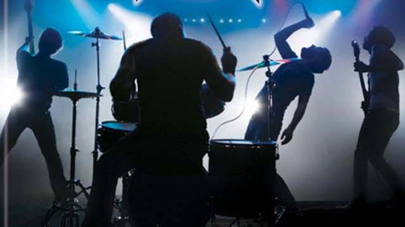
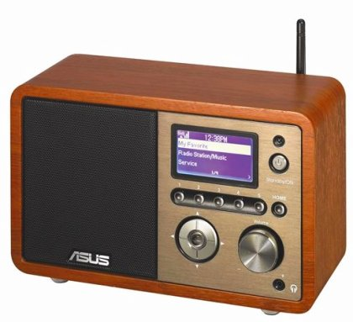
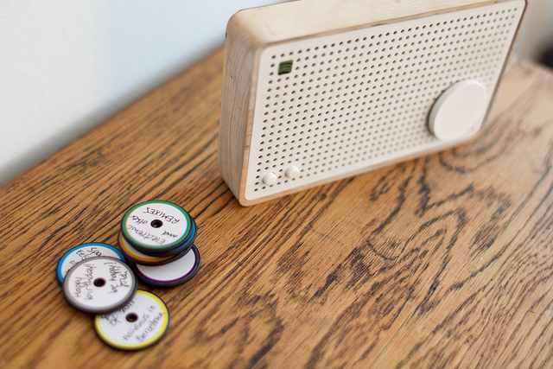
Merging to Real Life
Example
Music played
by a band At a party
→ →
MP3 played on spotify
At a party
Spartify
(Guests choose song playlist)
→ →
Music Streamed By radio
Spotify box
Notes:
What else?
The internet of things and physical computing is connecting everything and letting you connect to and interact with everything anywhere. Today’s tech world is mobile, tomorrow’s world is seamlessly integrated, connected, intelligent and tangible.
What we are talking about is a blend of physical computing, embedded systems, web apps, mobile apps, websites, games, devices etc.

Slide 4
Future of the Media -Merge to Real-
Tangible, Engaging, Mixed Reality
In my personal opinion… you do not have to agree

Slide 5
Tangible / Fluid
Tangible Media Lab
Fluid Interface Group
http://tangible.media.mit.edu/
http://fluid.media.mit.edu/
Notes:
Tangible Media Lab
Fluid Interface Group

Slide 6
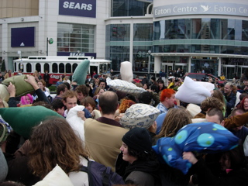
Engaging / Experiential
Using Web to enhance
Participation to Events
Flashmob
http://en.wikipedia.org/wiki/Flash_mob
http://www.spartify.com/
Notes:
Party or Events

Slide 7
Mixed Reality
Augmented Reality Game
http://www.blasttheory.co.uk/bt/index.php
Machinima
http://en.wikipedia.org/wiki/Machinima
Facebook sitcom
http://www.facebooksitcom.com/
http://en.wikipedia.org/wiki/Mixed_reality
Notes:
Mixed Reality Game
http://rhizome.org/editorial/2012/apr/2/artist-profile-ed-fornieles/

Slide 8
Why does this matter?
To enhance engagement and interactions,
and to make unforgettable content and experience, merging closer to our real lives!

Slide 9
So… let’s get started !
Web and Physical Computing

Slide 10
Spotify Box
SPOTIFY BOX
by Jordi Parra
So how do you give someone a mix tape in a world where all music is digital?
Spotify Box is a device and a way to interact with digital music in the physical world.
http://blog.zenona.com/

Slide 11
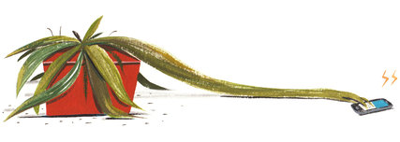
Botanicals
BOTANICALS
By Rob Faludi, Kate Hartman, and Kati London
The Botanicalls project is about communication between plants and people.
http://www.botanicalls.com/

Slide 12
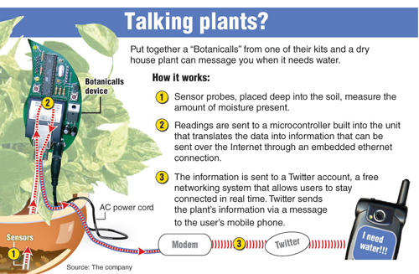

Slide 13
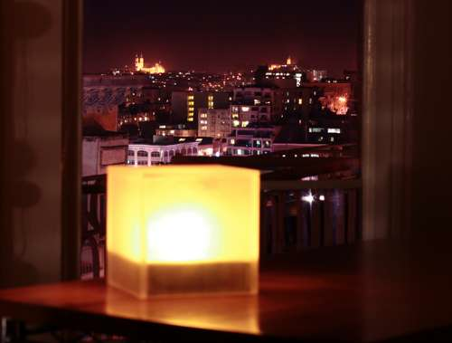
Twitter Mood Light
TWITTER MOOD LIGHT
By Random Matrix
The Twitter Mood Light shows the current mood of Twitter.The lamp monitors certain keywords, such as “love”,“hate”,“surprising” andsoon,ontwitter.com and lights up different colors depending on the mood of the tweets.
http://www.instructables.com/id/Twitter-Mood-Light-The-Worlds-Mood-in-a-Box/
Notes:
Twitter Mood Light
By Random Matrix

Slide 14
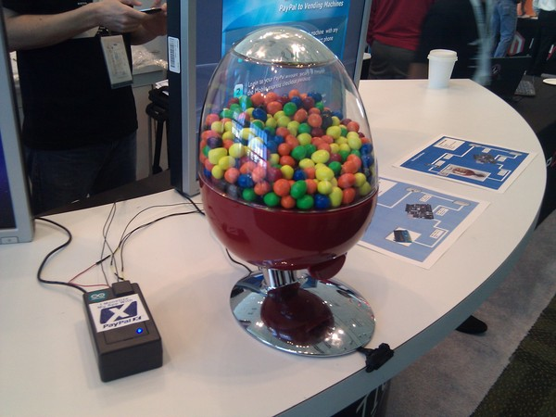
Paypal Vending Machine
PAYPAL VENDING MACHINE
by PayPalLabs
PayPal made a experimental system utilizing QR codes, Arduino and smart-phones to let their users pay with their PayPal account in the physical world.
http://blog.makezine.com/2010/10/27/paypal-vending-machine/

Slide 15
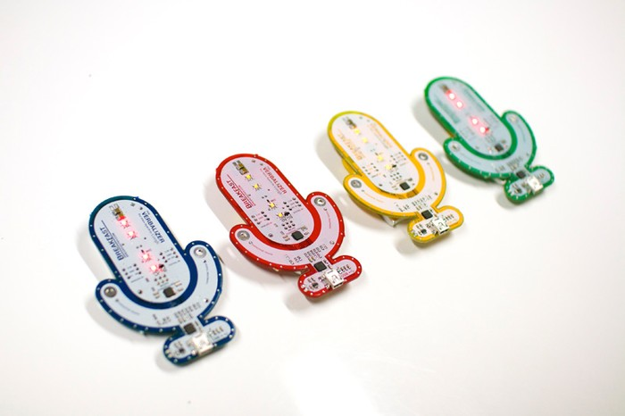
THE VERBALIZER
THE VERBALIZER
by Breakfast
The Verbalizer connects wirelessly to your computer and triggers google voice search.
http://breakfastny.com/2011/06/verbalizer-open-source-toy-googles-voice-search/

Slide 16
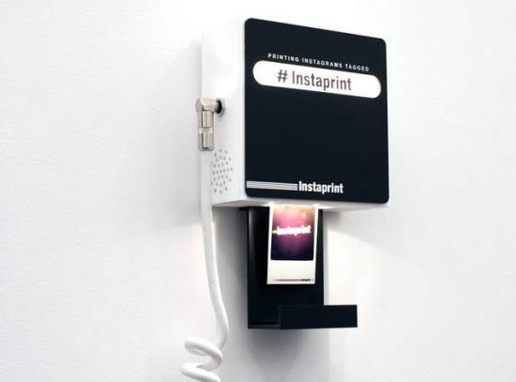
INSTAPRINTER
INSTAPRINT by Breakfast
Instaprinter is a digital photobooth tapping into the mobile photo-sharing service, Instagram, and in real time prints out every picture taken at a specific location.
http://breakfastny.com/projects/2011/instaprint/

Slide 17
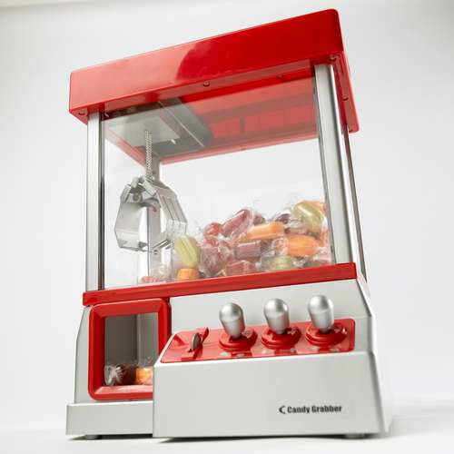
Candy Grabber
CANDY GRABBER
by odvratno.zgodan
The Candy Grabber is controlled by an Arduino which lets online users remotely interact with the machine via a website.
http://www.instructables.com/id/Arduino-Candygrabber/

Slide 18
Examples Referneced from
http://www.slideshare.net/MediaFront/forward-to-reality-physical-computing-the-next-level-of-web-interaction
http://breakfastny.com/projects/

Slide 19
How to do Physical Computing
Let’s Try it!

Slide 20
Physical Computing
Physical computing, in the broadest sense, means building interactive physical systems by the use of software and hardware that can sense and respond to the analog world.
-wikipedia-
http://en.wikipedia.org/wiki/Physical_computing

Slide 21
Why Arduino?
Creativity, Sharing and Collaboration

Slide 22
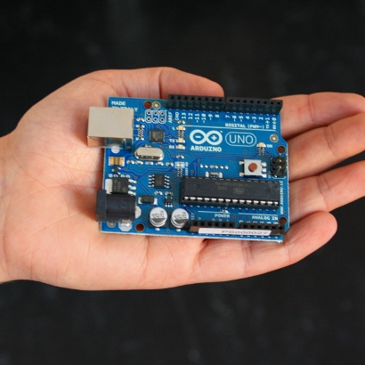
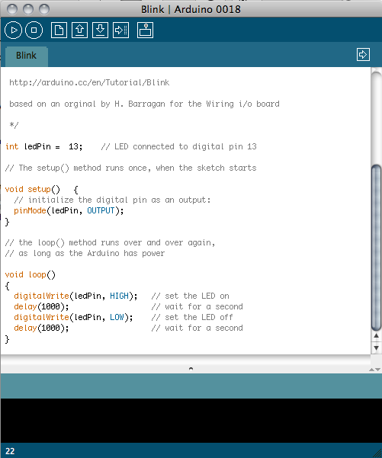
Arduino
open-source electronics prototyping platform based on flexible, easy-to-use hardware and software
http://www.arduino.cc/
Notes:
Open source, low cost hardware

Slide 23
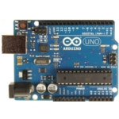
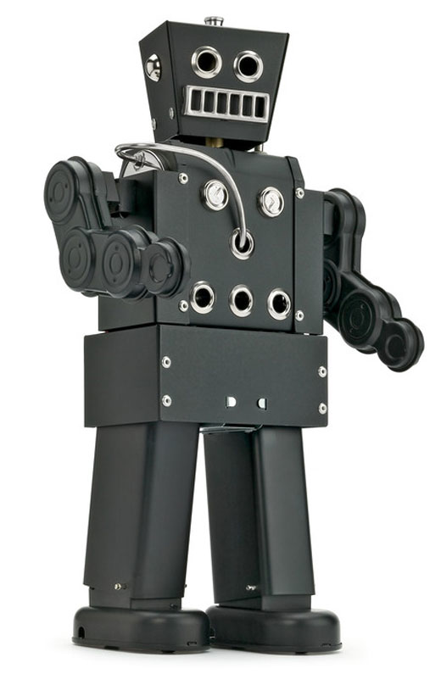
Brain :
Hardware- Arduino Board (Micro Contoller)
+
Knowledge :
Software - Arduino Program and Codes
Energy : Power – 5v power supplied via USB Cable
or
External 5v Power Supply
Body Part : physical Computing (Wires, LED, Motors, ETC)
Notes:
External 5v Power Supply

Slide 24

How to connect Arduino and the Web
1. Download the Software. It is Free
http://arduino.cc/en/Main/Software

Slide 25
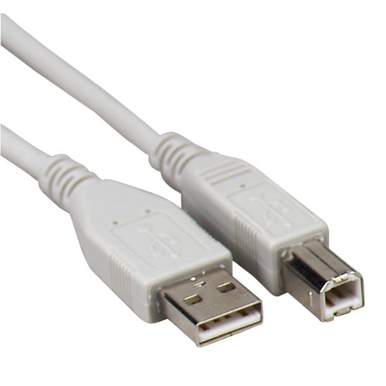
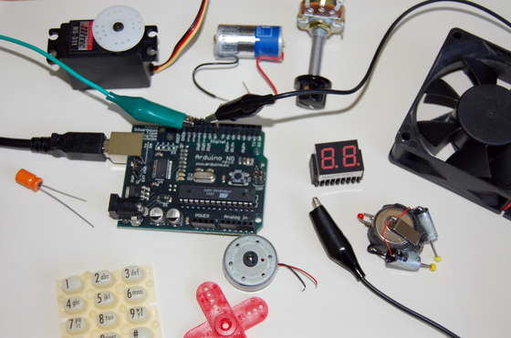
How to connect Arduino and the Web
2. Buy the basic Hardware for Arduino
Arduino Board
Standard A-B USB Cable
More for
physical computing…
(Wires, LED lights,
Sensors, Switches,
LCD Panel, etc)
Micro Controller
To Connect the Arduino Board
to the Computer
For Physical Computing
http://arduino.cc/en/Main/ArduinoBoardUno
Notes:
Arduino Board

Slide 26
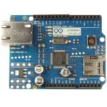
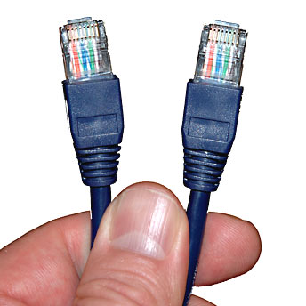
How to connect Arduino and the Web
2. Buy more for Arduino to connect to Web
Ethernet Shield
Ethernt Cable
http://arduino.cc/en/Main/ArduinoEthernetShield
Notes:
Arduino Board

Slide 27
Where to buy?
Arduino stuffs :
Arduino Store
Official Arduino store (Not stable yet. Europe. I don’t recommend.)
http://store.arduino.cc/ww/index.php
Distributors
Sparkfun (More Stable. USA I recommend here)
http://www.sparkfun.com/categories/103
General electronics stuffs can be found at Radio Shack or Sparkfun

